Slide 1
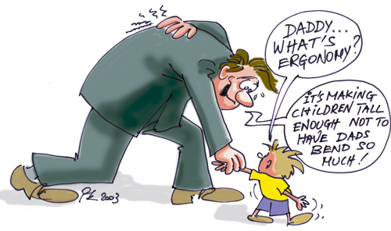
Introduction to Ergonomics and Human Factors
Scottish Manual Handling Forum
May 2023
Kevin Tesh BSc (Hons) PhD C.ErgHF FCIEHF
Chartered Ergonomist & Human Factors Specialist
Notes:
Thank you for all for attending. This training will provide you with some further ergonomic knowledge using a simple, light hearted, engaging and interactive message. Background working in private and public sector doing both product and occupational ergonomics. Asked to talk about Ergo and HF from my ergonomic background gained over 35+ years and not from my current role in NHS doing Cas. All non-clinical based but the principles I will discuss can be applied equally across the clinical side.
I have tailored the examples on ergonomic principles and the practical session by using NHS case studies working across the facility / non-clinical sector.
Keep those observational and communication skills sharp! CA allows us ‘prime time’ with a staff member to coach, provide feedback and make them feel a valued member of the team.

Slide 2
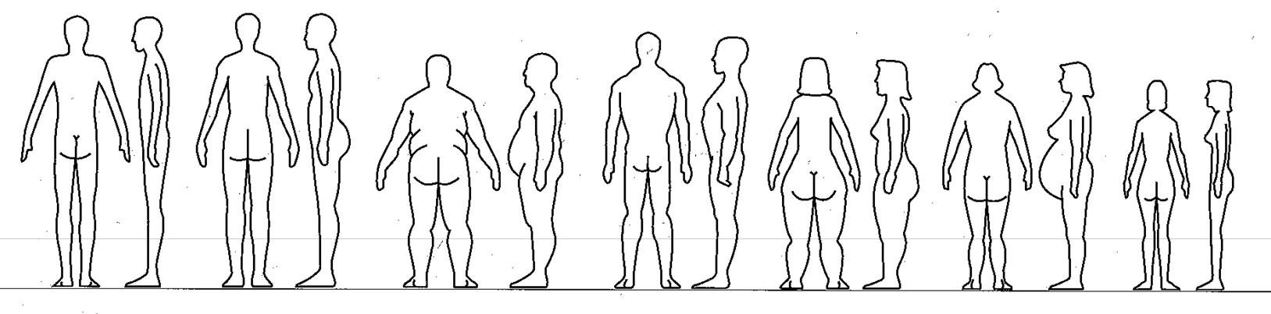
We all vary in size and shape!
Notes:
6
First interactive exercise is for each operator to come up and indicate which body outline best fits their profile! Seriously though as an ergonomist we have to design our workstations, equipment, working methods to accommodate the most users. So to the left we have the men who are generally on average taller, have longer arm reaches and leg lengths and bulkier bodies. Whereas at the other end of the scale the female tend to be shorter, have less arm reach and leg length and are not as strong. When designing a workstation, equipment or product we need to avoid designing for Mr. or Mrs. AVERAGE as we will be ignoring a lot of our users.

Slide 3
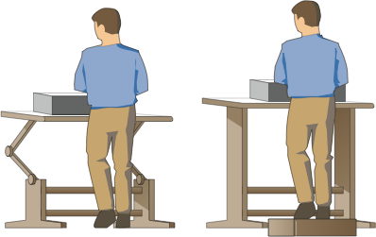
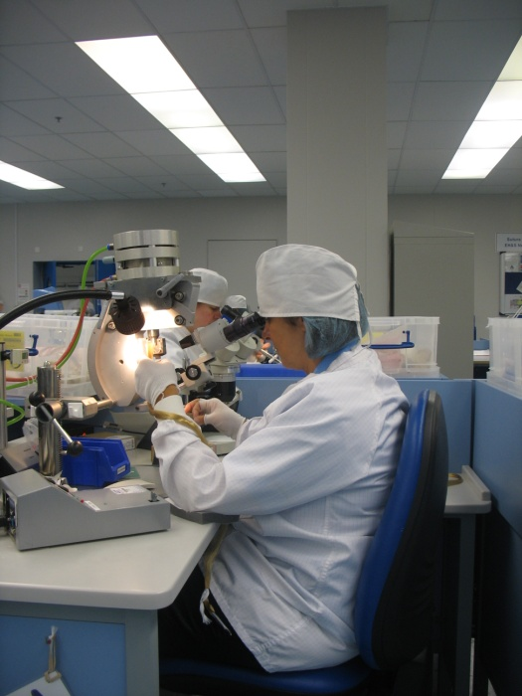
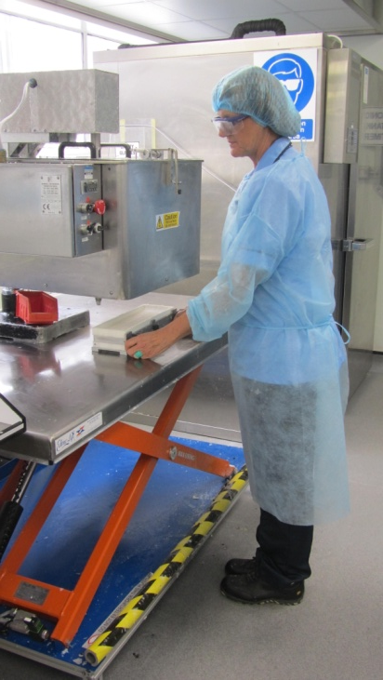
What is Ergonomics / Human Factors?
Ergonomics Is
“Fitting The Job To The Person”
Notes:
In order to accommodate the most workers we can provide some adjustment or we can design an optimum fixed workstation based on the range of users to maximise the comfort for MOST workers. So Heather here has a height adjustable bone wax melting pot table to: a) lower so that we can avoid awkward lifting postures when we load the top of the pot; b) raise the table so we can see the mould under the pot to avoid overfilling / spillage and; c) adjust for the different elbow heights to the ground when preparing the moulds for transfer to the chiller via a trolley.
Alternatively we have Karen carrying out attaching at a fixed attaching table height to accommodate sufficient room under the table to comfortably place the legs on the footrest but also providing adjustment in the seat and attaching press / microscope to accommodate the different sitting eye heights, arm lengths and working methods.

Slide 4
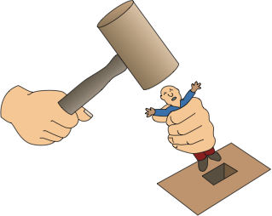
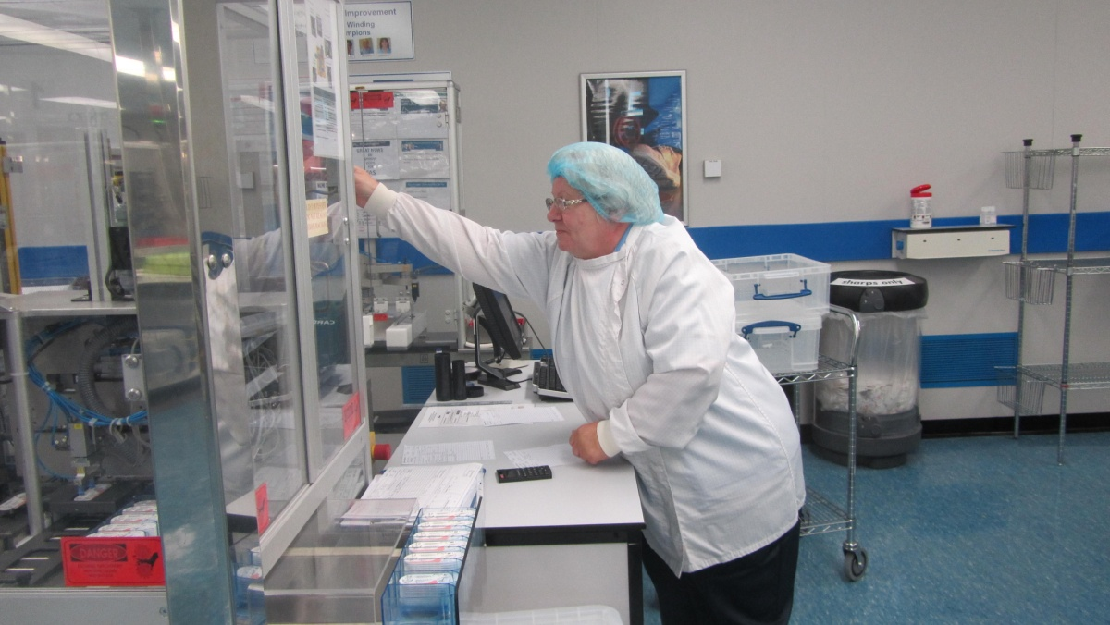
What is Ergonomics /Human Factors?
Ergonomics Is NOT
“Fitting The Person To The Job”
Notes:
If we try and fit the person to the job we will develop ergonomic, quality and safety problems. Here we see Anne McKay accessing the cassette loading door on the GZW and is having to stretch forward, bend her back and reach up above her shoulder joint. Now Anne is 5ft 3” tall which for a British adult female is about the average height. That means that 50% of female operators workers shorter than Anne would encounter similar and worse reach problems. Design okay for most male workers as most are taller than 5ft 3” ! So what is the solution? Employ taller operators, provide step, reduce desk width and allow desk to sit closer to zipper winder machine. Machine designed in isolation as worktable is required to inspect the work making sure the ‘tails’ of the suture are enclosed for later proper sterility.
So if you see or know a worker who looks like this then there is a job for them on serving GZW machines! Longer arms will solve the reach problem, telescopic legs to avoid reaching above shoulder height and a longer neck to observe GZW operators on machine to see if they are running low on product material!

Slide 5
What is Ergonomics / Human Factors?
The scientific study of people in their working or leisure environment
Aim to achieve a balance between:
Demands of
the tasks
Capabilities of
the user(s)
Notes:
Demands of the task must balance the capabilities of the user based on their physical, physiological and cognitive ability. Interesting also to not what happens if the capabilities outweigh the demands. Low job satisfaction, short cuts etc.

Slide 6
Importance of Ergonomics / Human Factors at concept design stage
Ability to
Influence
Cost of
Design Change
Time
Design
Phase
Manufacturing Planning
Existing
Layout / Design
Notes:
Started my ergonomic career at Jaguar Cars in the styling department where we could apply ergonomic standards / data and then make modifications to the vehicle shape by shaving off plasticine with a potato peeler! It is a compromise with comfort / design versus style of the vehicle but at least we are sitting at the same table. Ergonomic input at design stage also means it is easier to introduce retrospective changes to the final design if additional features of production need to be added.

Slide 7
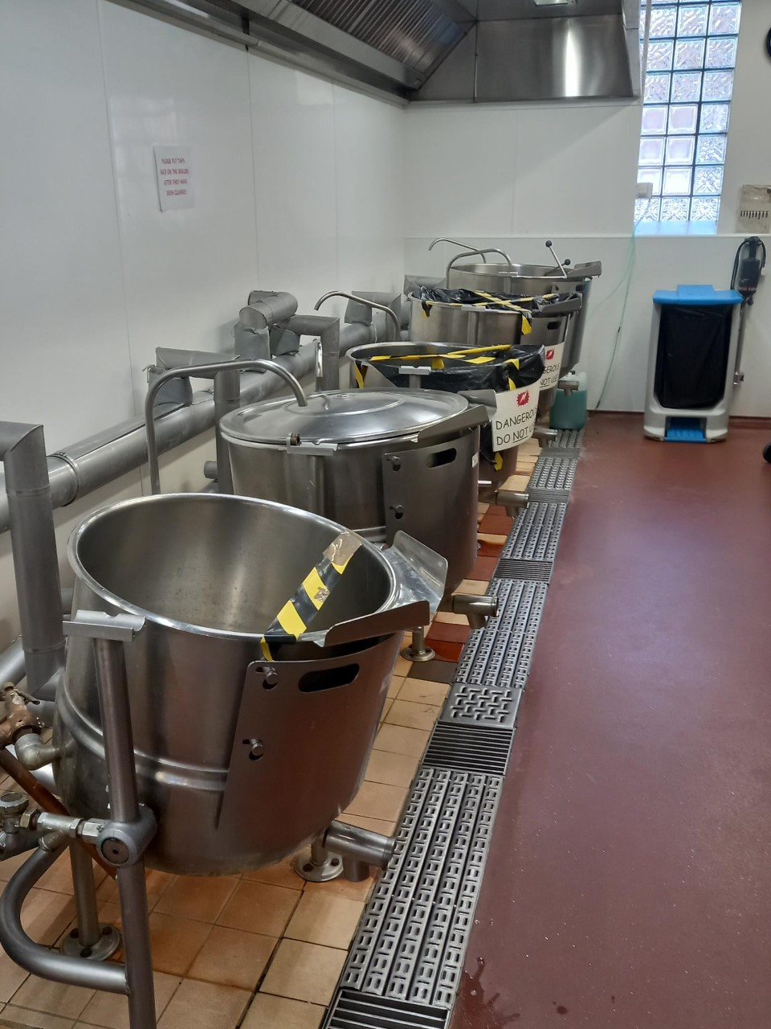
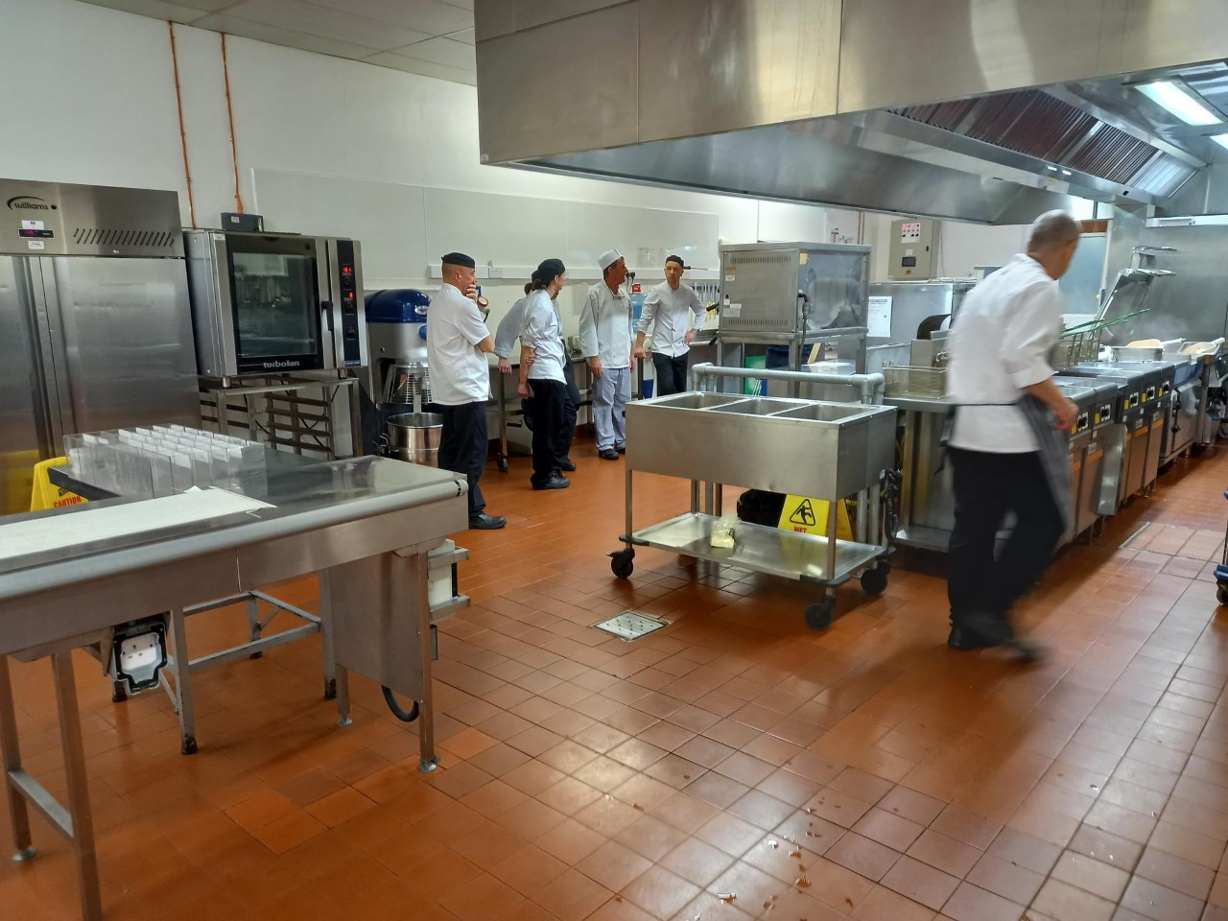
Engaging the end user!
Notes:
My latest assignment at NHS Lothian is across different catering departments in the city and timing is perfect…………….need to consider the end users chefs + catering assistants who clean the boilers. Out of commission boilers is also spilling over to patients who complain they are not getting their hot soup and desserts!

Slide 8
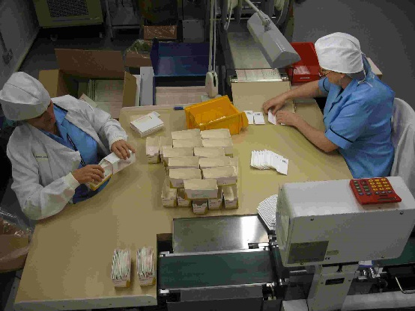
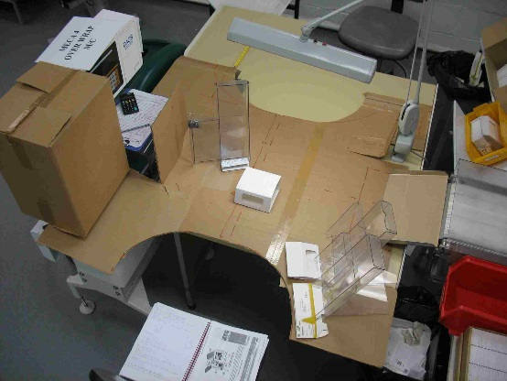
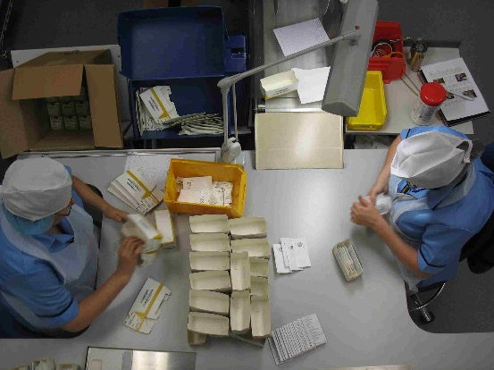
Use the human-centred approach
Identify and understand the target users
Use ergonomic / human factors guidance and best practice to create an initial design
Test the design with the target users
Use feedback from testing to improve design and repeat the cycle
Notes:
Need to build time in the project plan to evaluate design/process change and then re-visit if desired changes are not to the original design specification.

Slide 9

Michelangelo’s workplace design skills
Notes:
Laurientian library, Florence in early 16C. From dimensions of current layout you can estimate the ~ height of the seated person who is about 5ft 8” which was about the average height of a Florentine person in the 16C! Looks like Michelangelo was concerned with ease of accessibility, knee room when seated, reading height from inclined stand! Almost wanting to optimise the workplace design to match the quiet and learning library setting!

Slide 10
Ergonomics explores:
Workstation design
Display layouts
Work methods
Tools
Equipment design
Material handling
Human error reduction
Incident investigations
Environment
Bio-mechanics
Job rotation
Job conditioning
Occupational risk factors
Notes:
Been involved in most of these areas during my career. Going to touch on them as we talk more broadly about ergonomics but will come back to talk about HER

Slide 11
The Risk Factors For Musculoskeletal Disorders
+ + =
MSDs
P
o
s
t
u
r
e
F
o
r
c
e
R
e
p
e
t
i
t
i
o
n
Musculoskeletal Disorders
Additional factors:
• Cold
• Vibration
Lack of adequate rest or recovery
Frequency & duration
Notes:
• The primary risk factors for developing a MSDs at work are the postures, forces, and repetition required by each task performed during the day. Posture closer to full ROM will cause more loading on muscle/joint. Force could be; operating a control, manual handling or direct force on the body (palm, elbows, knees)
The combined effect of these primary risk factors increase the risk of developing a MSD.
A job with low forces, but high repetitions and poor postures (keyboard work) may cause symptom development.
Alternatively, there might be a job with relatively few repetitions, but high force and poor postures that could produce the same MSD problems.
• Other workplace factors such as cool temperatures, hand/arm vibration, and fatigue contribute to the development of CTDs.
• Because the development of CTDs can be the result of many different combinations of factors, there are no absolute limits that define acceptable forces or repetitions. However, the Ergo Job Analyzer which will be discussed later attempts to capture many risk factors and assign relative risk.
• So when you look at jobs with an "ergonomics eye" to identify MSD problems, focus in on the postures, forces required, and repetitiveness of the tasks and the root cause will become apparent.

Slide 12
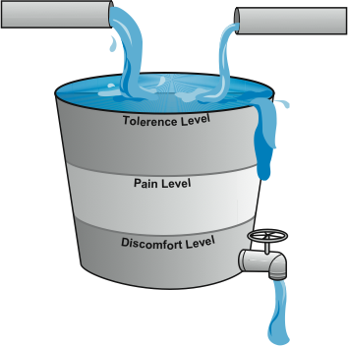
How Much is Too Much?
On-the-job Stressors
Off-the-job Stressors
  As Designed
    Force
    Repetition
    Posture
  As Performed
  Sports
  Hobbies
  Second jobs
Overflow - Reportable Injury Occurs
Tolerance for
Musculoskeletal Stress may vary with individual and may change over time
Rest and Recovery
  Micro-breaks
  Scheduled breaks
  Job rotation
  Overnight rest
  Periodic vacations and holidays
  Psychosocial Issues
  Pre-existing Conditions
  Strength and Conditioning
Notes:
When the musculoskeletal system is exposed to these risk factors over a period of time, a degeneration
(wear & tear) process occurs and physical symptoms such as pain
and swelling are reported.
Increasing magnitude of risk factors increases the risk of MSDs
Example, high force exertion has higher risk than low force exertion
Dose - Response relationship not yet clearly understood
Combining risk factors increases the risk of MSDs
Example: High force + high repetition job has more risk than high force only job
Another way to look at the cumulative development of injuries is to examine the bucket theory. The bucket can be seen as an individual’s tolerance to risk factors.
First examine situations and tasks that happen at work.
Some things that may make symptoms worse are excessive overtime, a new and stiffer tool, parts that don’t fit, higher than normal production.
Next examine things people do at home, their hobbies, sports, general health and fitness level, etc. Again, we are all 24-hour people and it is the combined effect of all we do that fills our buckets to capacity.
If we continue to fill the bucket throughout the day without rest and recovery, the bucket will rise to the level of discomfort, then pain, and will then overflow.
Some things that promote tissue healing include weekend recovery, a vacation or holiday, low production schedules, etc.
• Unfortunately, people tend to ignore pain. They may also not associate the pain and discomfort with the job until the injury becomes serious and requires medical attention. My teaching mantra is ‘take this advice/ coaching/feedback’ beyond the working hours! Tend to listen more if it becomes personal and their lives are affected.

Slide 13
General Rule
Ergonomics is fun - we watch people at work and design for 90% of our users!
A design should accommodate from the 5th percentile female to the 95th percentile male
5%
50%
95%
Notes:
Called anthropometry. 100 people off the street. Anthropometric data can vary by age, country of origin and gender + plus time data was collected. Very useful to provide some objectivity to your observations as you can start to build a stronger case for workplace or equipment change if you say x% of staff will find this not suitable for use! Generally, in workplace design we set 5-95% to accommodate 90% of population but for H&S we may need to expand these limits to 100% e.g. openings in machine guarding should be minimal to allow the smallest finger to reach moving parts. Jaguar Cars – did have challenges with space in the sports car version selling the vehicle globally as vehicle sold on its style that was compromised with driving space. But being at the same table allows ergonomists to put their case forward. Can get around space by ensuring we build in adjustments to create driver space; wide door opening angles seat moving back and down and steering wheel moving up and out simultaneously! Can make individual modifications by the dealership.

Slide 14
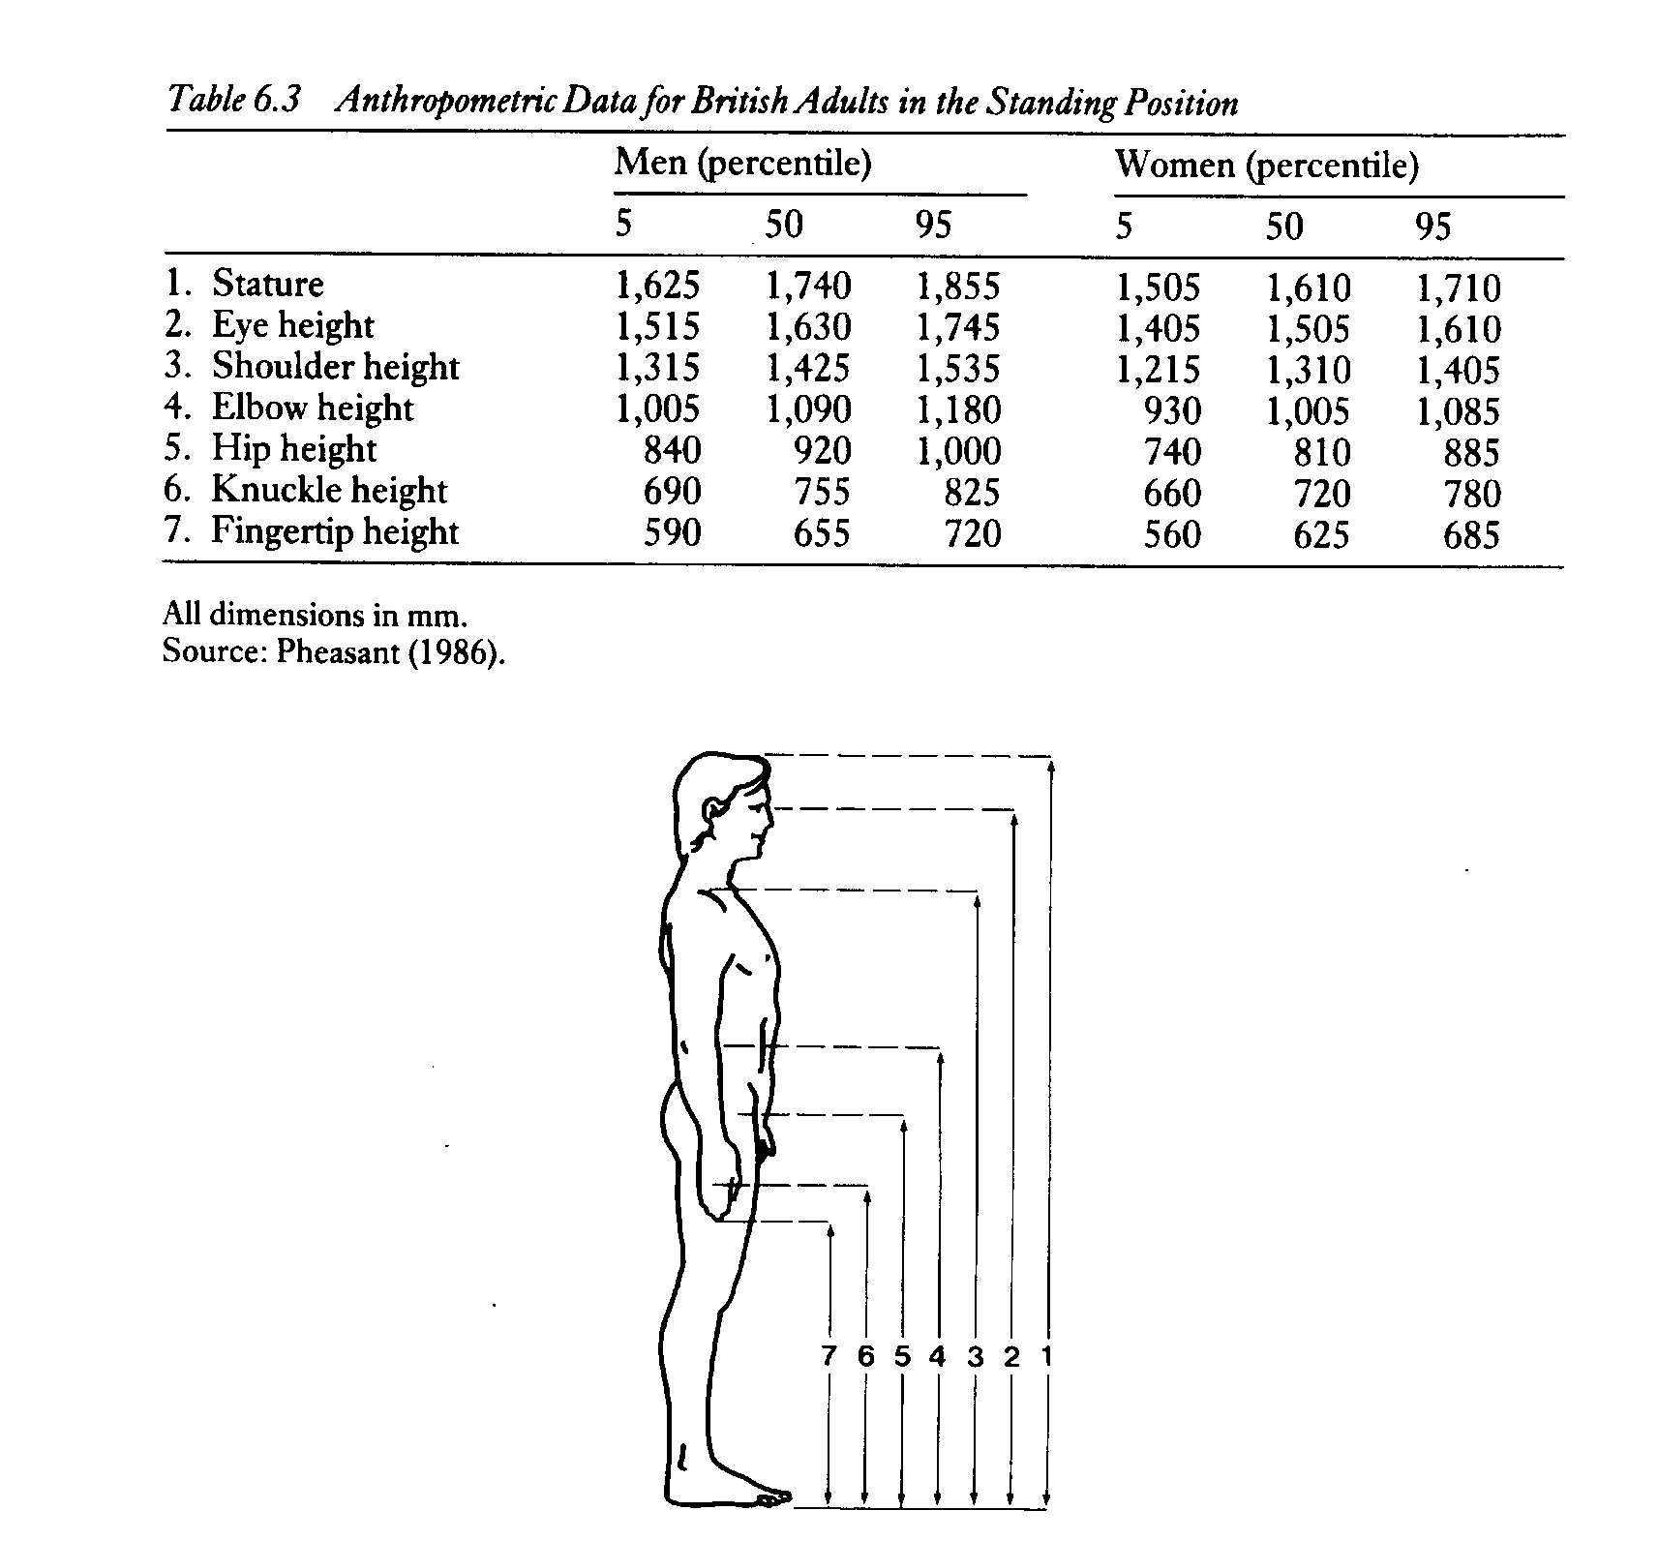
Notes:
Useful if you wanted to build in adjustment – how much? 2. Standing eye height for adjustment in screen height at standing w/s. 4. Elbow height for suitable working heights. Remember no footwear, clothing or PPE adjustments. Also remember these dimensions are static figures so important in initial design layouts but need to carry out functional fit tests. Example Jaguar cars – where drivers do not sit bolt upright with their legs straight out front, they tend to splay out when cruising, spread their arms on the armrests.

Slide 15
Five types of design restraints – the limiting user
Posture – 5th to 95th %ile (range of users)
Vision – 5th to 95th %ile (range of users)
Reach – 5th %ile user (smallest user)
Clearance – 95th %ile user (largest user)
Strength – 5th %ile user (weakest user)*
* Slightly higher force figure for safety critical controls
and foot pedals where the foot is supported
Notes:
Strength design here could be lifting a load or operating a tool

Slide 16
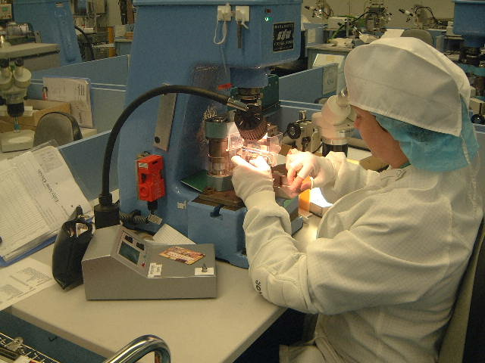
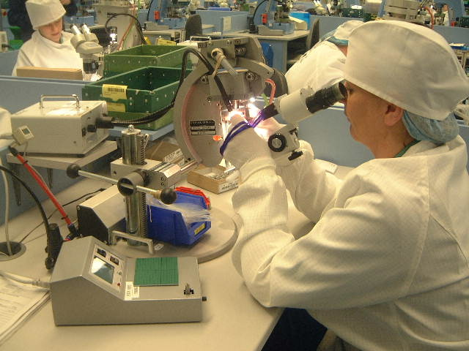
Attaching Presses – Working Postures
S&W - not as good
Edinburgh Swager- better
Sitting eye height range – 160mm!
Notes:
Glimpse inside Ethicon at J&J where we manufactured surgical sutures attaching the needle to the suture

Slide 17
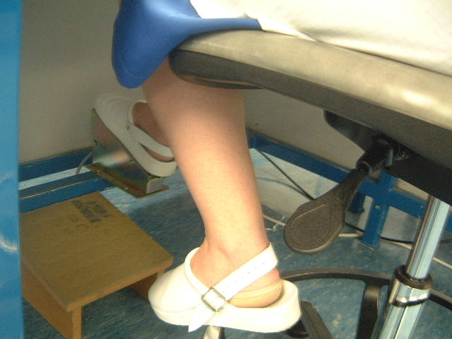
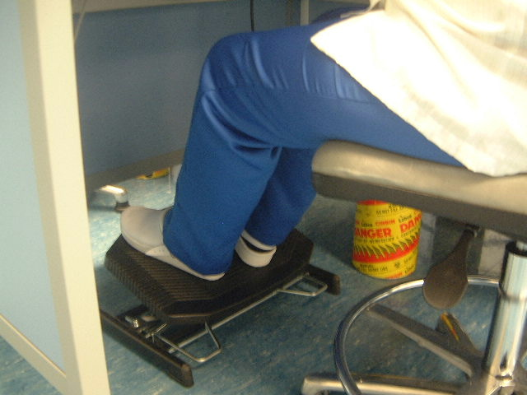
Footrest and switch – Lower Limb Postures
Before
After
Leg length range – 265mm!
Notes:
Inspection tip for you – look down as well as up! Build adjustment for optimum posture above the desk but do not forget the adjustment underneath. Without both the person’s posture will be compromised. Also activation force for pedal strength needs to slightly above the weaker user to support and rest the foot particularly if repetitive movements.

Slide 18
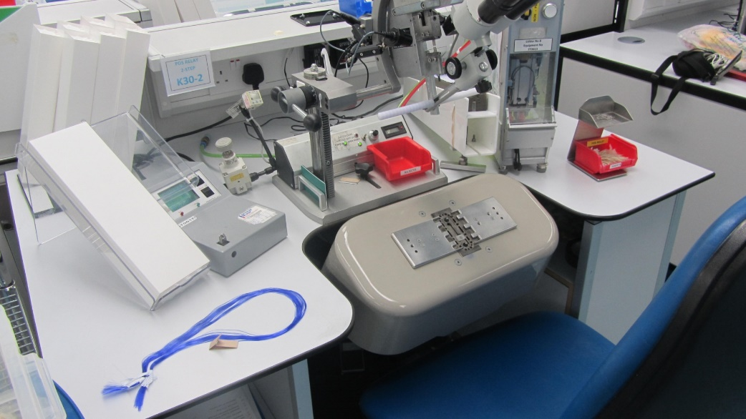
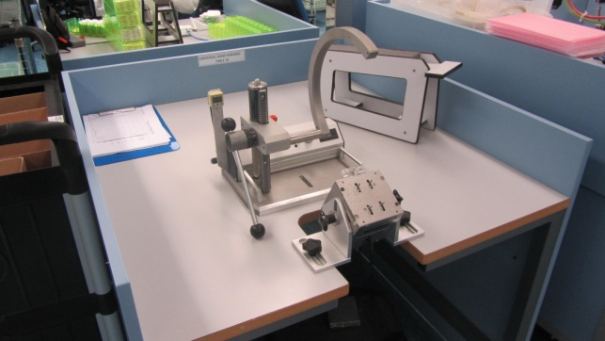
Reach Design Zones
Notes:
Arranging a layout on a work desk you need to locate for the shortest user – hence the range figures. Not too close or you can get ‘the chicken wing effect’ where wrist bends / elbow moves back behind plane of shoulders. Remember when placing items – those that are most often used are the closest to operator and those most looked at should be in central visual zone. So mouse ‘does not wander’ and double screens located depending on most used monitor.

Slide 19
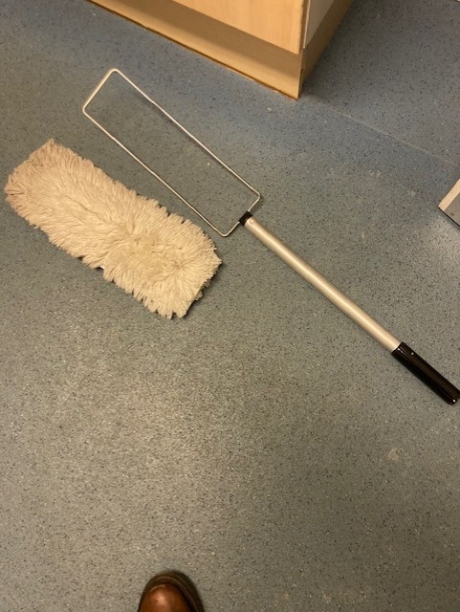
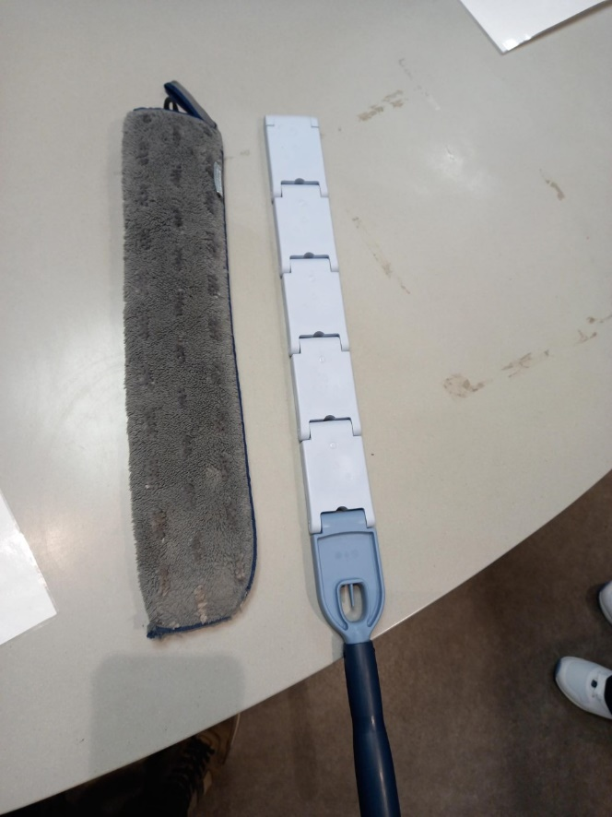
Highs and Lows for domestics
Adjustable duster head on
extendable pole
Fixed duster head with non-adjustable handle
Notes:
Reach examples for domestic staff Solutions do not need to be expensive – duster types in the community

Slide 20
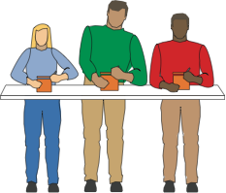
Workstation Design Guidelines
Notes:
More on posture and the impact that table heights have on our backs, upper limbs and neck postures.
People’s postures will tell us a lot about the suitability of the table height (th).
Take fixed workbench, the person in green is leaning to the side (or even stooping forward form the side) leading to additional loading on the back muscles – (th) too low, person in blue has arms abducted loading the shoulders so th too high. Person in red has upper arms comfortably down by their side so th is ideal for this person.
Does depend on what task is being performed, the working height of the hands and working techniques.
Who do you design for – taller person with adjustments for the shorter staff

Slide 21
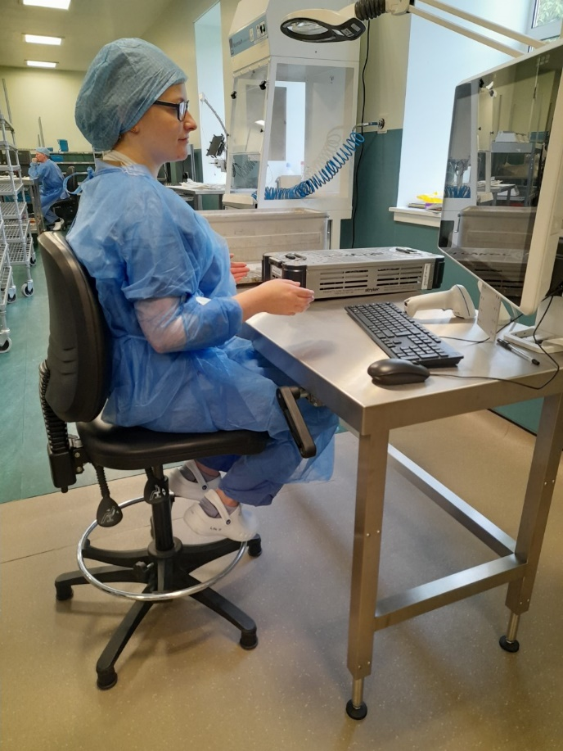
Recommended working heights
Tasks | Working height relative to elbow height (mm)
Heavier (applying downward pressure) | 100 –250 below
Manipulate with a moderate degree of force and precision | 50-100 below
Keying / Mousing | Level or slightly above
Lighter, delicate tasks (writing) | 50-100 above
Lifting and handling | Between knuckle and elbow height
Two-handed pushing / pulling | Between shoulder and knuckle height
Hand-operated controls | Between shoulder and knuckle height
Notes:
Work at Hospital Sterilisation & Disinfection Unit (HSDU) where we introduced height adjustable tables for stripping down contaminated instruments and then re-assembling kits after sterilisation. Guidance prepared for staff so they know why these tables were introduced and how to adjust. Latter is a key message. As mentioned table height depends on tasks with the heavier and more demanding tasks done well below elbow height. As tasks become less forceful and delicate the table height raises to above elbow height.

Slide 22
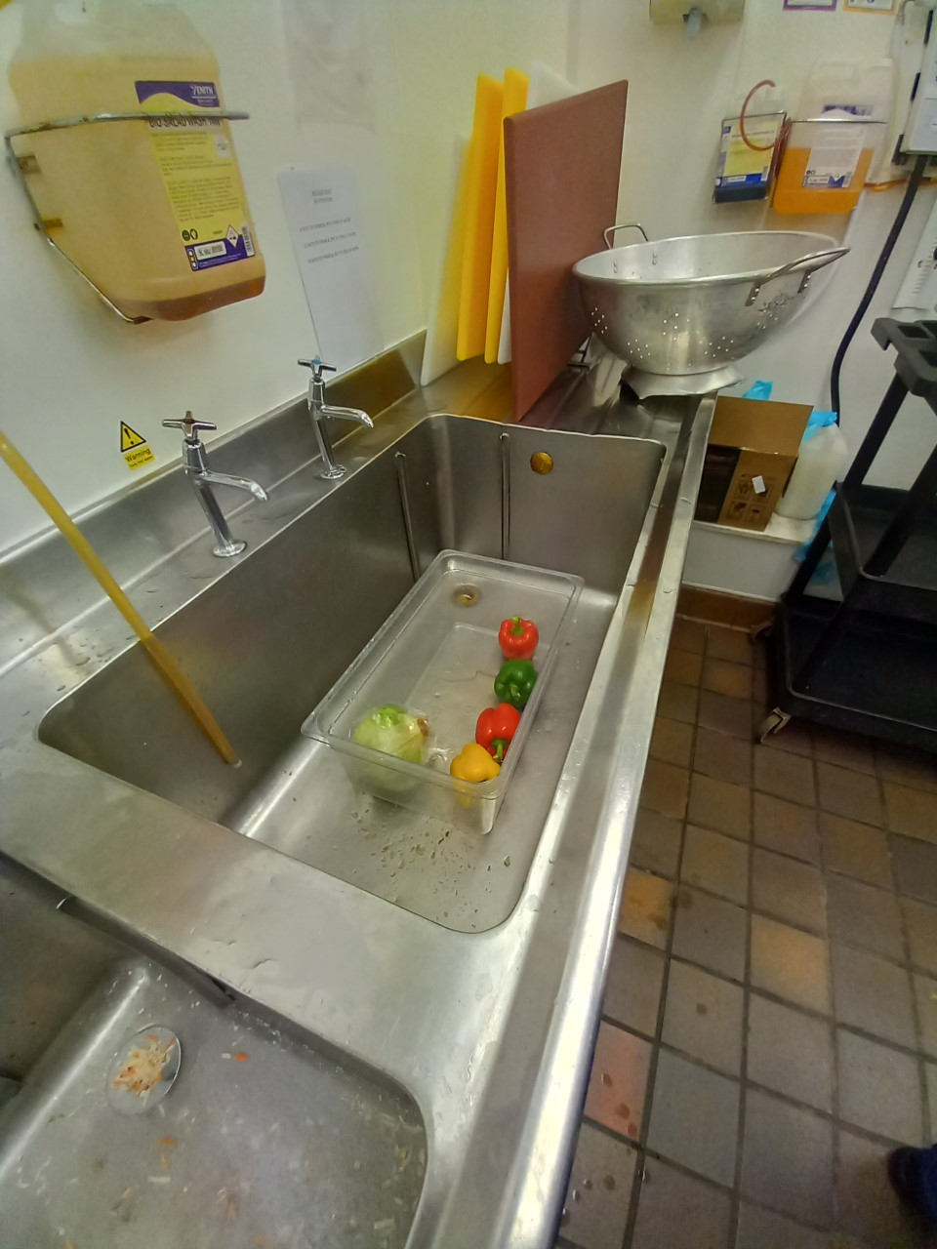
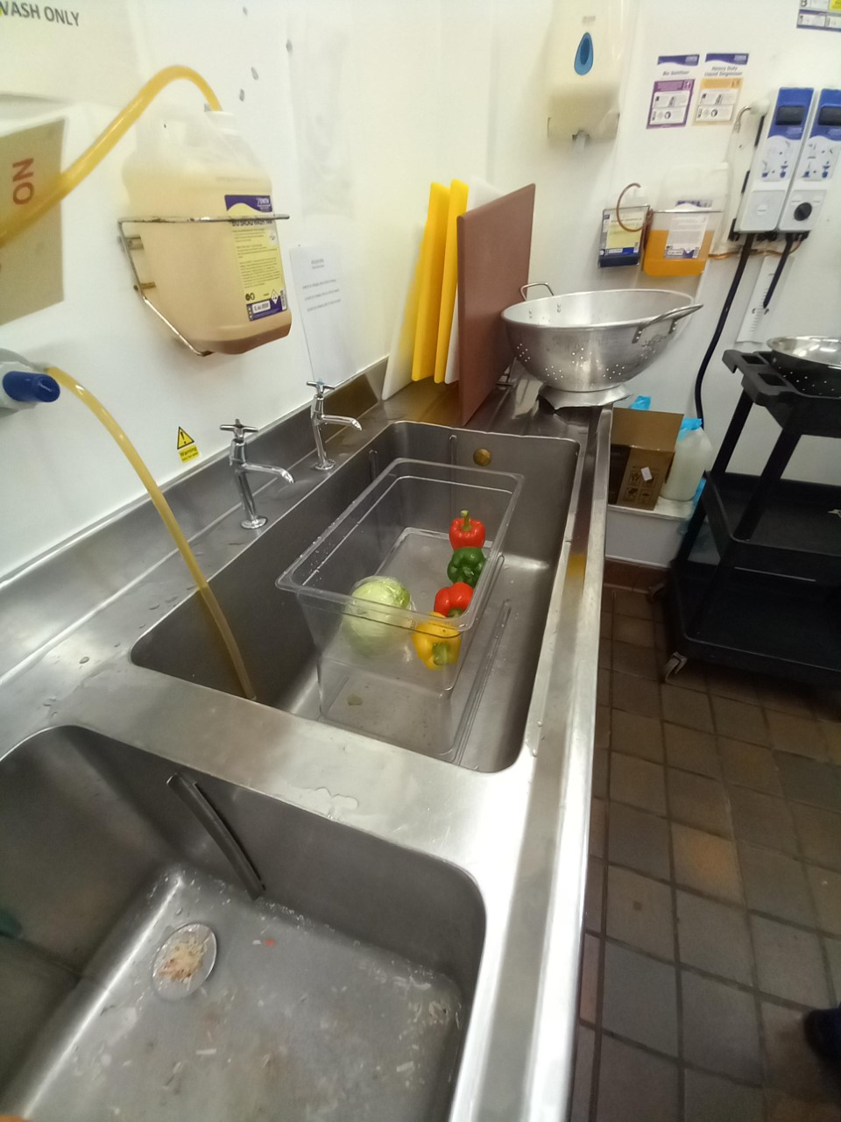
Simple fixes for fixed workstations
Notes:
Working heights is a big challenge when sinks involved. HSDU have purchased height adjustable sinks but there are other alternative cost effective solutions – sink spacers as demonstrated. Push back that staff did not like tells me we have not explained the what the ergonomic/ postural issues and why this solution is chosen

Slide 23
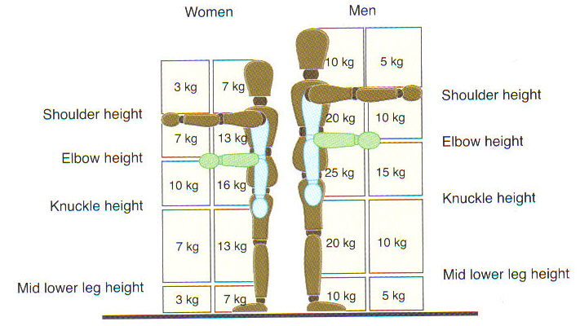
MHORs lifting and lowering filter
Notes:
See a lot of this image posted in areas of NHS where a lot of handling takes place – stores, walk-in fridges, receiving areas! These are minimal figures but can be reduced if repetition increases, poor postures are required, load not easy to grasp, environmental constraints and handler cannot adopt a stable body position. Don’t forget the sitting filter where the elbow height load, close to the body, reduces to 3 and 5kg respectively!
Not to regard them as safe weights for handling. Even the figure listed in the zones should be avoided or made less demanding wherever it is reasonably practicable to do so.

Slide 24
Good aide memoire - body landmarks
Top of Head
Shoulder
Elbow
Knuckles
Notes:
Useful aide memoire for manual handling assessors
As you watch people work, you will want to be observant of these body landmarks: knuckles, elbow, shoulder, and top of head.
Knuckle height is important because any work done below knuckle height requires the person to stoop. If the work is above knuckle height, then the person can reach the work.
Elbow height is important because that is where most work should be done. Watch to see if the person is working too far above or too far below elbow height.
Shoulder height is important because work done above the shoulder height almost always requires use of the shoulder joint and shoulder muscles, and they can tire easily.
Finally, the top of the head is a good landmark because work done above the top of the head results in extensive use of the shoulder joint. Extended work in this position can result in damage to the shoulder joint.

Slide 25
Recommended guidelines for safe pushing and pulling (kg) MHORs
 | Men | Female
Starting or Stopping the load | 20 | 15
Keeping load in motion | 10 | 7
Notes:
As we start to implement control measures for MH and start to load onto carts/trolleys/cages/pallets etc. we start to develop other MH issues if we do not consider the design of the equipment, what surfaces we are moving across and how we perform the task. Two types of forces involved, generally the start up force tends to be the one to watch in terms of force level and effort required.

Slide 26
Recommended Upper Force Limits for Horizontal Pushing and Pulling Tasks
Condition. | Forces that should not be exceeded, in kg | Examples of Activities
Standing 1. Whole body involved | 22.5 | Truck and cart handling. Moving equipment on wheels or casters. Sliding rolls on shafts
Standing 2. Primarily arm and shoulder muscles, arms fully extended | 11.0 | Leaning over an obstacle to move an object Pushing an object at or above shoulder height
B. Kneeling | 18.8 | Removing or replacing a component from equipment, as in maintenance work. Handling in confined work areas, such as tunnels or large conduits.
C. Seated | 13.0 | Operating a vertical level, such as a floor shift on heavy equipment. Moving trays or a product on and off conveyors.
after Caldwell, 1964; Davis & Stubbs, 1980; Keyserling et al., 1980; Kroemer, 1970;
Nielsen & Faulkner, Eastman Kodak Company, 1967; Snook & Ciriello, 1974
Notes:
More efficient biomechanically to push as you can use the whole body particularly the legs. What if you push or pull by just using your arms maybe because of space restraints.

Slide 27
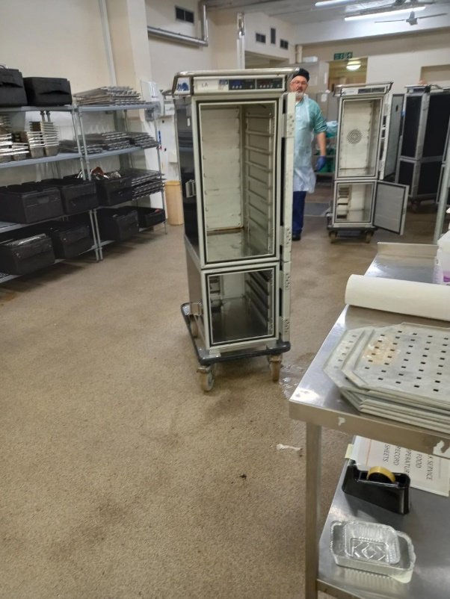
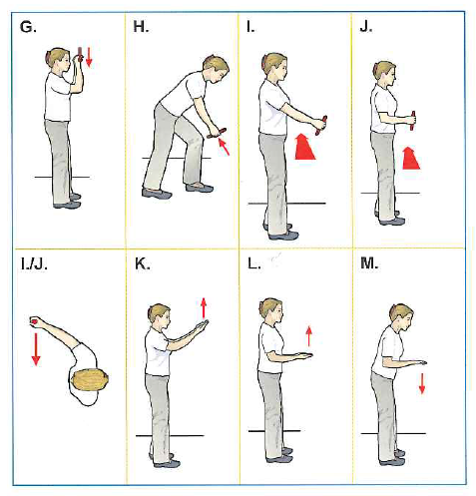
Standing arm strength case study
I | Pull across body (lateral) at waist height – 2 hands, elbow fully extended
J | Pull across body (lateral) at waist height – 2 hand, elbow at 90°
2.9kg (6.3Ib) | 3.7kg (8.2Ib)
3.8kg (8.4Ib) | 4.9kg (10.9Ib)
Notes:
Also observed staff moving a trolley, in this case a food trolley after contents removed, standing to the side of the trolley and pulling/pushing across in front of their body like a twisting action to move the trolley. The resistance to overcome the momentum of the trolley and perhaps the misalignment of the swivel wheels can momentarily create high forces. Acceptable forces slightly higher when arms by the side nearer elbow height. Optimum performance figure on left and maximum on the right.

Slide 28
Guideline for stopping or starting a load (Pushing / Pulling)
2% of M
Smooth
Surface
M
10% of M
Rough
Surface
M
Notes:
600kg pallet load with 24 X 25kg sacks – start up load on smooth surface will be 12kg but 60kg for rough surface. Size and type of castor material can influence push / pulling force. Regular maintenance programmes to check wheels, castors particularly within domestic and porter jobs can ensure wheels

Slide 29
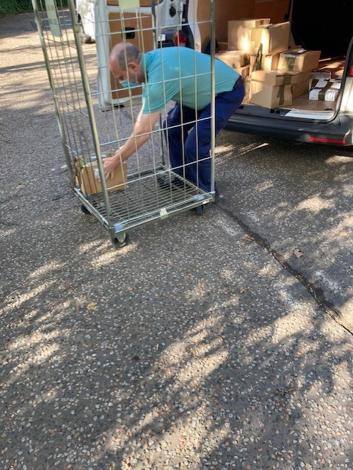
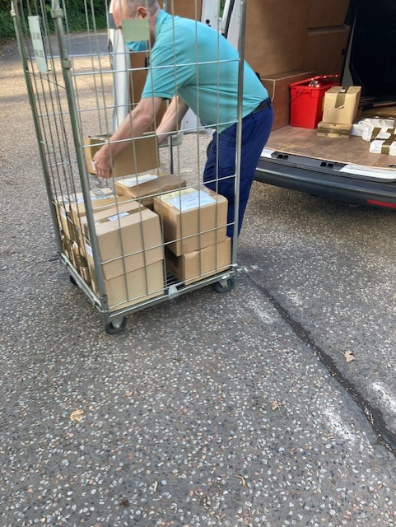
What is the correct distance between lift starting and finishing points?
Notes:
Regular observation in my two years performing CAs in transport, stores, kitchen, estates is distance between pick-up and drop off point. Still performing the lifts but optimising the workplace to minimise amount of twisting and speed of work.

Slide 30
Bending Velocity
Twisting
    0.5m
1.0m -1.25m
1.7.5m​
Optimising distance for handling to maintain acceptable twisting (Ohio State University 2014)

Slide 31
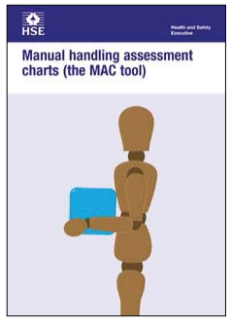
Health & Safety Executive (HSE) Tools
MAC (Manual Handling Assessment
Charts)
V-MAC (Variable Manual Handling
Assessment)
Assess the most common risk factors
Points assessor to the factors that need controlled
On-line tool
Colour bands to risk level
Suitable for more complex handling where weight and frequency varies
Use for different shift lengths (4 -12hrs)
Cannot only be use for live loads
www.hse.gov.uk/pubns/indg383.pdf
www.hse.gov.uk/msd/mac/vmac/2-what-you-need-to-know-before.htm
Notes:
A couple of tools that allows a more deeper dive into specific risk factors lifting / lowering, carrying and team handling. Again breaking down the task into specific areas allowing the assessor to tackle small bite size improvements.

Slide 32
The work relatedness of back disorders: overview of the risk factors
Category of risk factor | Risk factor | Evidence
Psychosocial / work-organisational factors
 | Job – content | + / 0
 | Work / time pressure | + / 0
 | Job control | + / 0
 | Social support | +++
 | Job satisfaction | +++
Notes:
NIOSH study in early 2000. Physical and individual risk factors but also these psychosocial and work organisational factors. Strong evidence that social support and job satisfaction have strong correlation with back disorders. Also competing demands and little control over work.

Slide 33

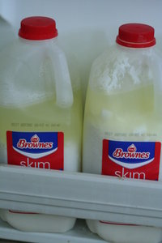
Some things get better with age......

Slide 34
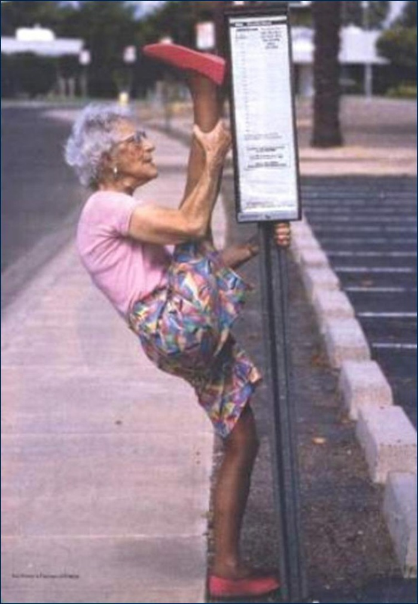
Myths about older people
Myth | The reality
Loss of ability increases with age | Actually abilities change with age and infact often improve
Older workers are not as productive as younger | Not correct – older workers perform more consistently and deliver higher quality
Discrimination against older workers is based on accurate and up to date data | Discrimination against older workers is based on inaccurate, outdated and inappropriate stereotypes
Cognition is significantly impaired with age | Not true – insignificant impairment over the working age
Older workers have more accidents | Not true – older workers are less prone to accidents
Age is a barrier to learning | Incorrect - Older workers only require more training and time to learn

Slide 35

Ageing Effects – likely impact
Most -
Some -
Reaction Times
Sensory Abilities
Intellectual
Functioning
Aerobic Capacity
Dexterity
Balance
Joint Mobility
Physical Strength
And Endurance
Thermal Tolerance
Notes:
Sensory (light/vision), mobility and physical strength and endurance. Nissan story with designers

Slide 36
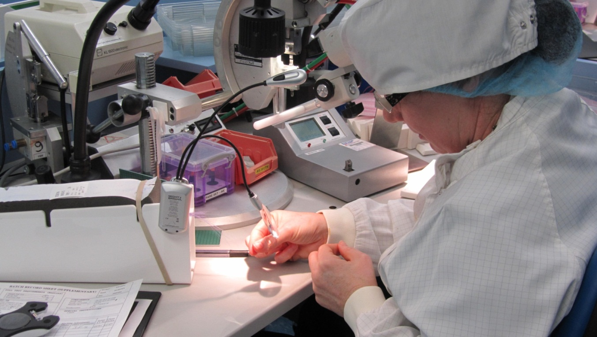
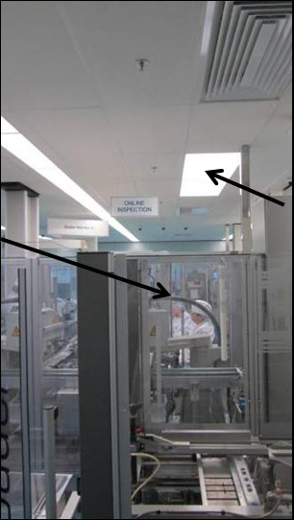
Visual and Lighting Improvements
‘Work has a positive impact on health and older workers have a right to work safely. Badly designed working
conditions and a lack of training are the main factors that turn ageing into a handicap, rather than the natural
process of ageing itself’ (FOM) 2004
Notes:
A well designed work area benefits everyone!

Slide 37
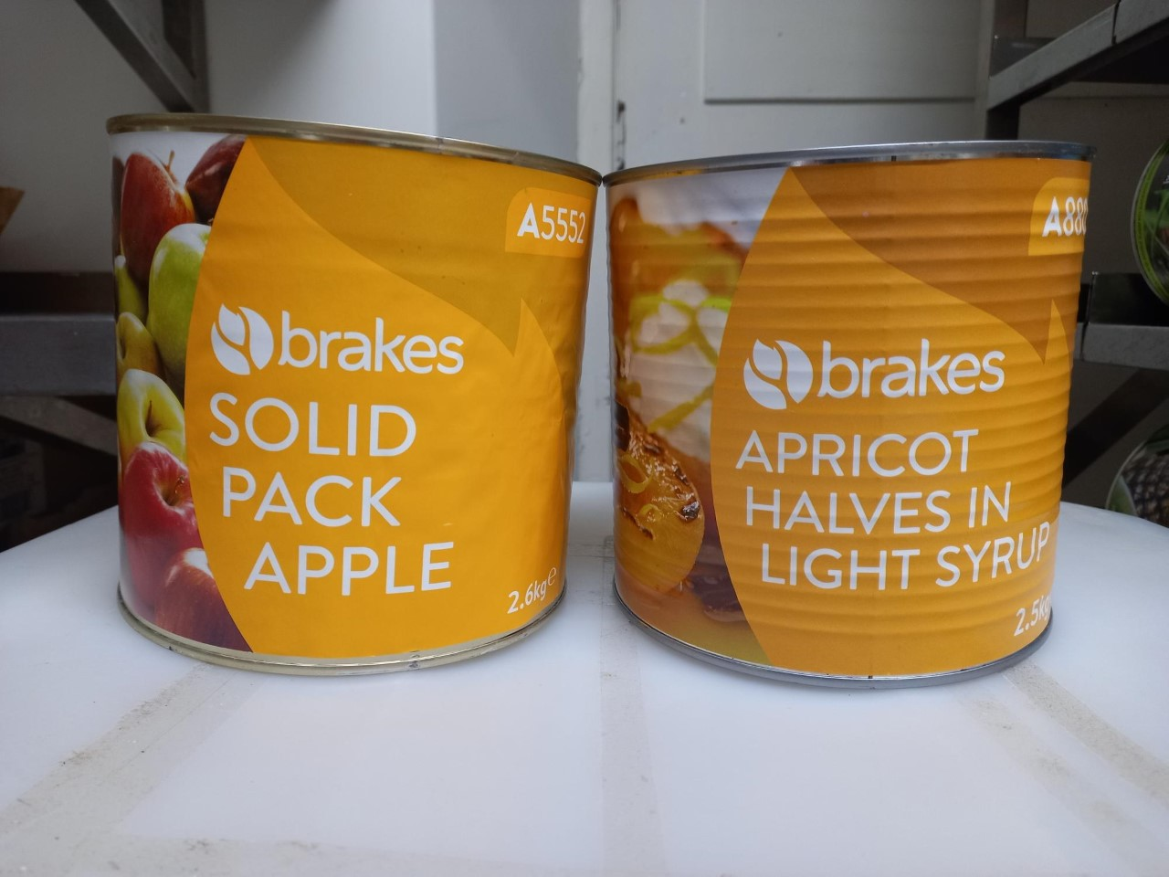
Consequence of human error……..low

Slide 38
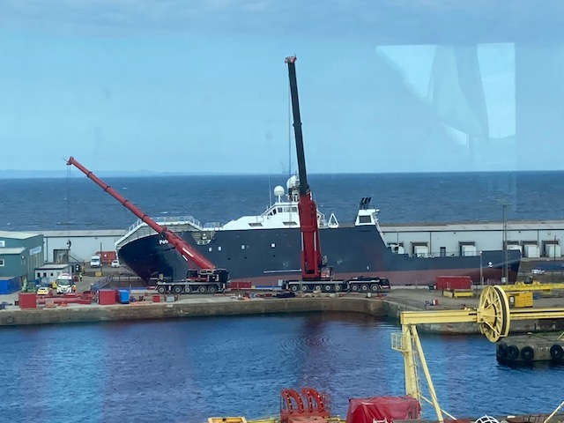
Consequences of human error……..high

Slide 39
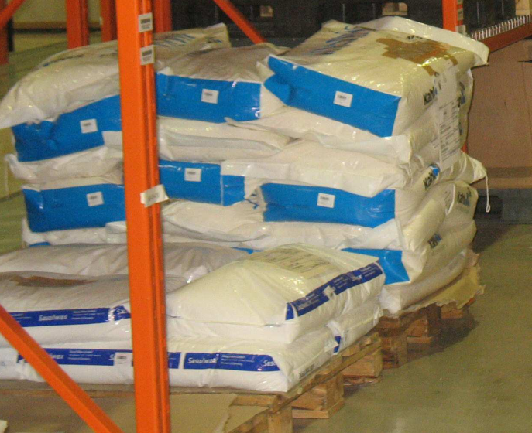

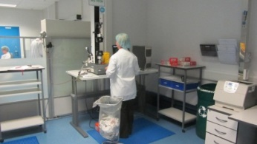

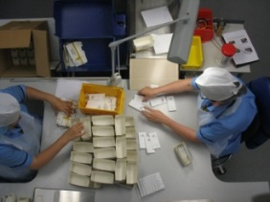
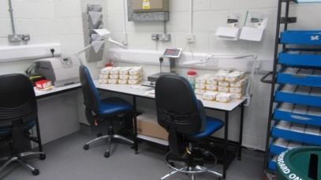
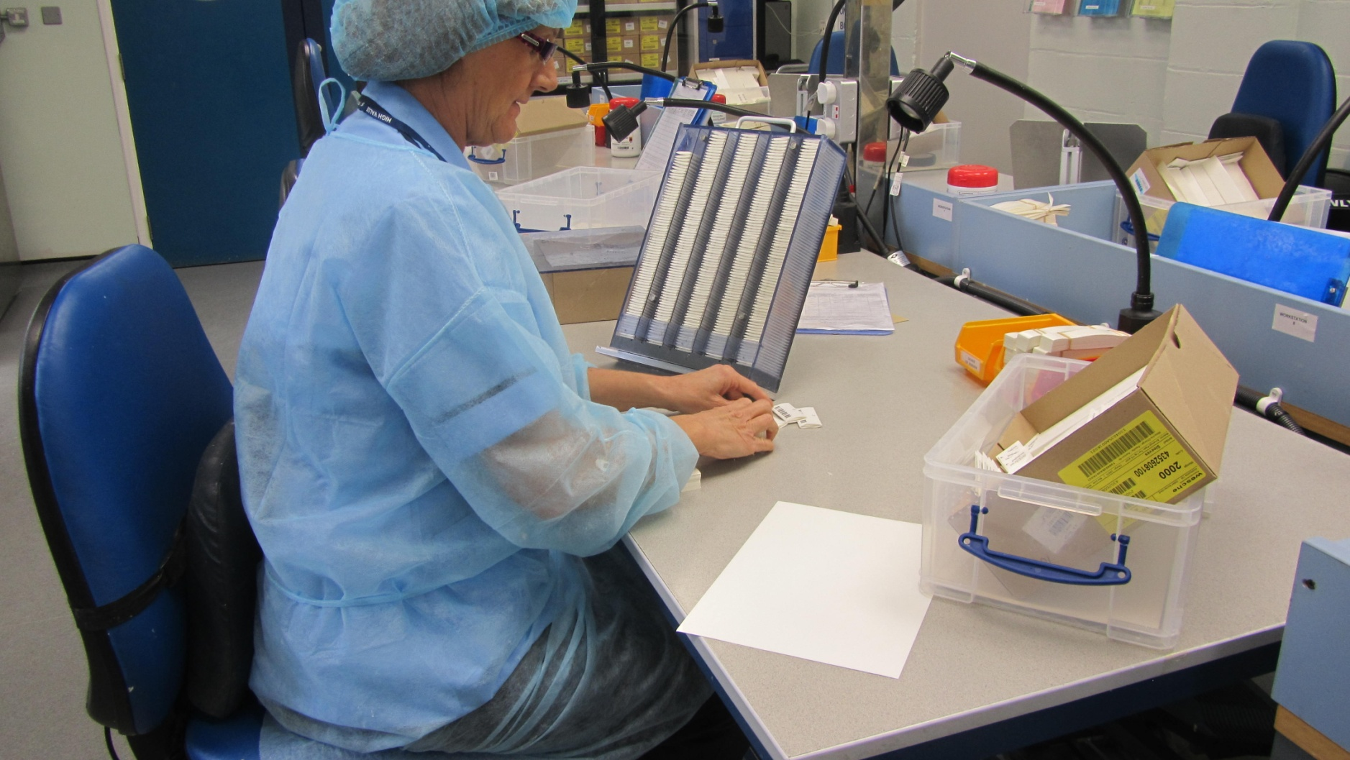
Human error reduction
Incoming goods quality check
Visual Inspection in mixing pot
Mould check when decanting
CUSTOMER
Inspection during packing assembly
Pack inspection on MECA
Finished Goods Inspection - Physical Testing Lab
Off Line Inspection
Highlights:
2/3rd reduction in potential human sources
Solutions included – shift handover checklist,
lighting improvements, formalised job rotation,
noise reduction and training
25% decrease in non-compliance reports
Notes:
Person approach
Longstanding and widespread tradition focussing on unsafe acts of people at the sharp end due to forgetfulness, inattention, poor motivation, carelessness, negligence and recklessness. Measure are to reduce unwanted variability in human behaviour.
System approach
Humans are fallible and errors are to be expected. Errors seen as consequences rather than causes. Find those error traps by addressing the conditions of human work – look at the blunt end of the process.

Slide 40
Audience Participation – Hazard Spotting
Break up into syndicate groups
Discuss the case studies with notes
Identify ergonomic hazards and potential solutions
Think beyond the picture on the ‘system process in place’
Spokesperson to share teams’ view

Slide 41
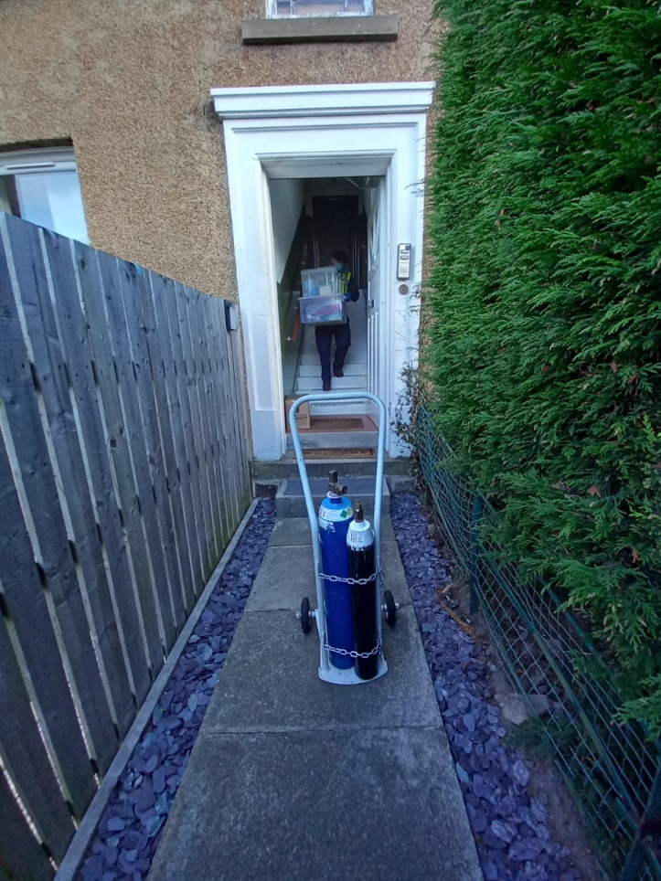
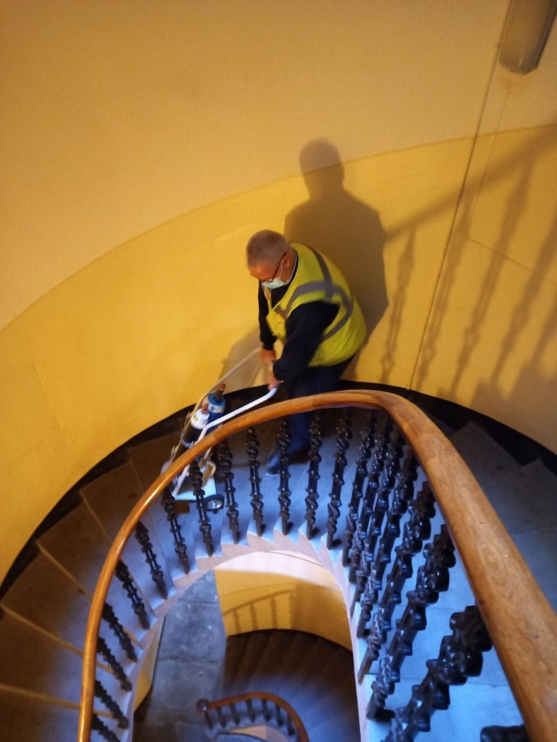
1A. Hazard spotting – home birth deliveries
One person job
2-3 deliveries or pick up per day (afternoon tasks)
Any type of home property
Entonox & oxygen cylinder with trolley ~ (30kg)
One large box of PPE and medical equipment (~5kg)
Morning task – confidential waste collection (community clinics), moderate handling risk

Slide 42
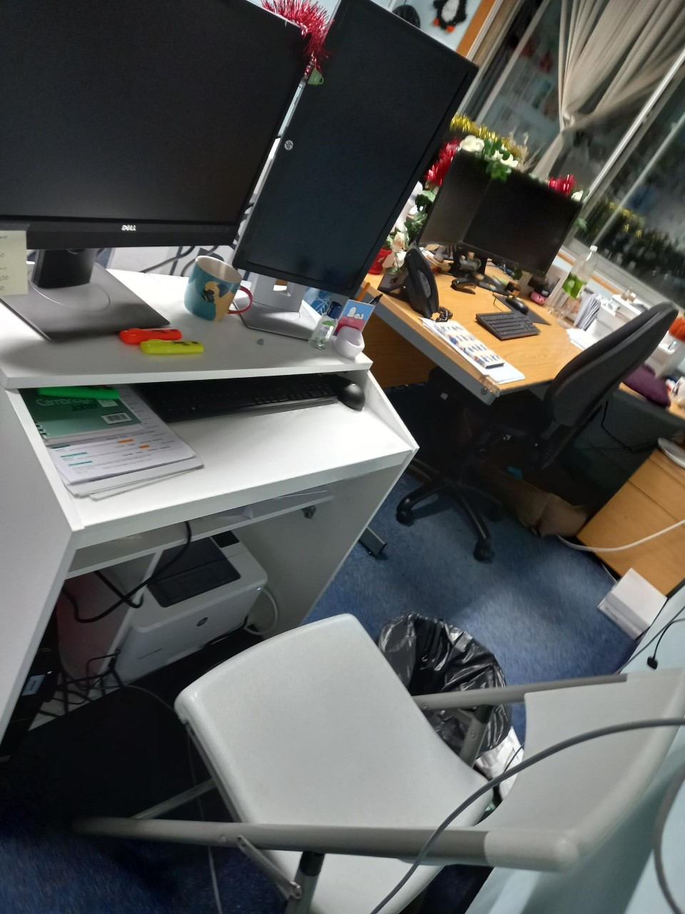
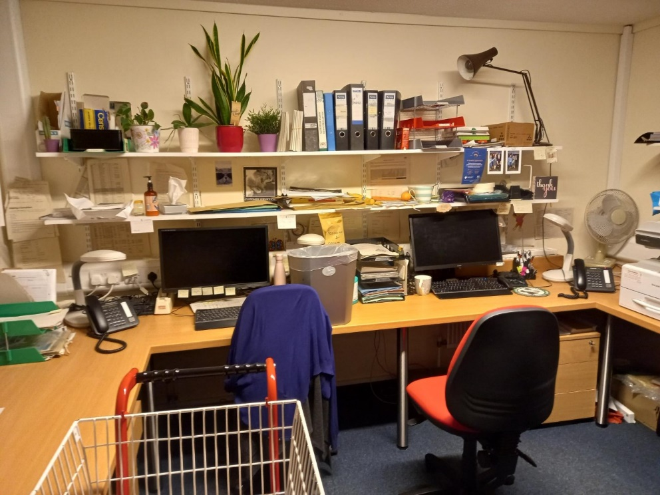
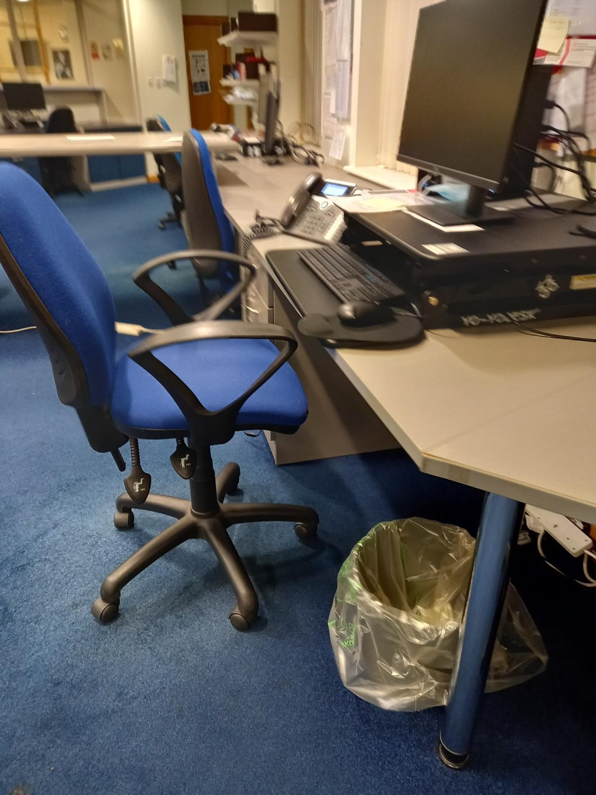
1B. Hazard Spotting - Sedentary Work

Slide 43
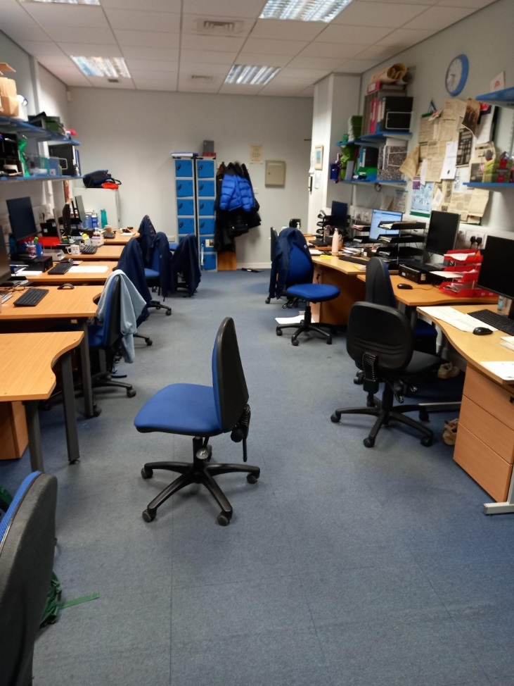
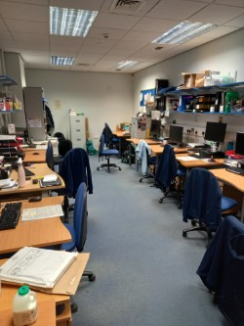
2A. Hazard Spotting – (same room, viewed from each end)
Plans to expand teams by 4 to 15
Health and well-being concerns raised by staff members
Flexible desk policy in place
Different workstation and seat types
Lack of suitable storage space
Critical phone communication in room with medical staff and patients on medication

Slide 44



2B. Hazard Spotting – What do these pictures show you about load hazard?

Slide 45



3A. Hazard Spotting – Feed in washing machine
Post lunch run ~ 60 mins
Team in photo – tray clearers (2) and feed-on (1)
16 food trolleys, ~300 trays
Food trolleys placed behind tray clearers
Trays light but varied handling heights
Cutlery trays heavier
Workstation – central sink to soak cutlery, chutes for food waste and non-recyclable waste
Other team members – trolley placement (1), take off (2) and trolley cleaning (2)

Slide 46

3B.Hazard Spotting – New Supplier
A
A Old supplier – 4 x 5L, soft carrying handle
B New supplier – 15L, bulkier load
B

Slide 47


4A.Hazard Spotting – Ward deliveries
Store staff deliver to number of wards in morning
Loads usually light but bulky
Some mixed loads with no markings
Deliveries left in corridor
Top-ups (afternoon) stored in ward storage rooms
Number of top-ups products increased recently

Slide 48


4B. Hazard Spotting - Grease Trap
Daily task
Six latches holding lid in place
Lid and basket removed and washed in sink
Loads light but bulky
Staff complaints!

Slide 49

5A.Hazard Spotting - Mail handling
Morning run
Normally 8-10 pickup sites
Bag weights ~ 5-7kg but occasionally 10-12kg
Mostly sack loads
Large site so bags on cage
Porter assembles cage

Slide 50


5B. Domestic -Deep Clean of toilet

Slide 51


6A. Hazard Spotting - Contaminated instrument packs
Wagons delivered 2-3 times over 24hrs
Each delivery ~ 4-5 wagons
Heavy trays and caskets
Four levels – close to ground to shoulder level
Double stacking on some shelves
Single handler
Trolley loaded and pushed through for kit strip down at good working height

Slide 52



6B. Hazard Spotting - What do these pictures show you about the load hazard?
Notes:
Danger gives you a hint – glass rather than your back!

Slide 53

Key processes for a sustained ergonomic culture
New processes / equipment – ‘close the back door’ with change management document
Staff engagement - departmental ‘links or look out lieutenants’
High compliance with suitable and sufficient risk assessments, prevention controls and standard operating procedures
Hierarchy of Controls – Avoid Assess Reduce Review
osha.europa.eu/en/publications/work-related-musculoskeletal-disorders-why-are-they-still-so-prevalent-
evidence-literature-review
Notes:
Compliance is key. Any risk reduction strategy needs training + RA. Training not to be a substitute for RA. Paper from the European Agency for Safety and Health at Work on why MSDs are still so prevalent.
Pulled out those most relevant for health & social care; Shift in sectors (hospital to home care), changing workplace policies (no-lift) shifts exposure from backs to shoulders, unhealthy lifestyles, physical inacativity and raising obesity rates
Changing workforce demographics (older workforce) and younger workforce coming to work with pre-growing proportion of sedentary jobs
Importance of psychosocial risks
Failure to reduce physical workforce hazards due to poor RAs and suitable control measures
Lack of adequate work organisation and / or work design results
Barriers and facilitators of preventing MSDs
Evidence of Effectiveness of various interventions

Slide 54

What’s on your mind?
kevin.tesh@nhslothian.scot.nhs.uk

Slide 55
Spare Slides

Slide 56

Anthropometry

Slide 57



Hazard spotting – mailroom, stationery etc.

Slide 58
Selected Anthropometric Data
1
2
{
7
3
4
5
6

Slide 59

Domestic Storage Room – Edinburgh Community

Slide 60

Industrial Exoskeleton Devices

Slide 61
Recent Exoskeleton Articles
https://www.bbc.co.uk/news/technology-44628872
https://www.cyberdyne.jp/english/
Current Picture
Exoskeleton devices combine increased worker’s strength capability with decreased risks associated with musculoskeletal disorders but;
upper limb exoskeleton system increases both muscle and joint loading on the lower back
Need to consider whole person – physical demands can be reduced but what about mental side – workers still need to think, process information and make decisions

Slide 62
Estimated 12 month prevalence of self-reported work related illnesses by disease (Hodgson et al 1998,
Jones et al 2000 and 2002)
Disease | Prevalence Estimate (1000s)
 | 1995 | 1998/1999 | 2001/2002
Musculoskeletal Disorders (including manual handling) | 980 | 562 | 632
Stress / Depression | 284 | 467 | 495
Breathing or Lung Problems | 108 | 52 | 58
Skin Problems | 61 | 30 | 30
Hearing Problems | 44 | 20 | 21

Slide 63
The work relatedness of back disorders: overview of the risk factors
Category of risk factor | Risk factor | Evidence
Physical factors
 | Heavy manual labour | ++
 | Manual material handling | +++
 | Awkward postures | ++
 | Static work | +/0
 | Whole body vibration | +++
 | Slipping and falling | +

Slide 64
The work relatedness of back disorders: overview of the risk factors
Category of risk factor | Risk factor | Evidence
Individual factors
 | Age | + / 0
 | Socio-economic status | +++
 | Smoking | ++
 | Medical history | +++
 | Gender | + / 0
 | Anthropometry | + / 0
 | Physical activity | + / 0

Slide 65
Estimated 12 month prevalence of self-reported work related illnesses by disease Great Britain (per 1,000)
Disease | 2001/02 | 2003/04 | 2004/05 | 2005/06
Musculoskeletal Disorders mainly affecting the back | 507 | 468 | 452 | 437
Stress / Depression | 548 | 557 | 509 | 420
Breathing or Lung Problems | 166 | 183 | 137 | 156
Skin Problems | 38 | 31 | 29 | 27
Hearing Problems | 88 | 81 | 74 | 68

Slide 66
Summary
Back discomfort is the most common ill-health problem at work
Physical activities such as awkward postures, manual handling and sitting are risk factors but others exist
Job risk factors are more than just the load!
Apply these sound principles outside your work
Latest evidence shows that most back problems are not serious so stay active
If you start to experience any discomfort at work please report early

Slide 67

Forceful and sudden movements

Slide 68

Team handling

Slide 70

Desirable Ageing Effects
Less turnover, higher loyalty
Work ethic, commitment
Experience, knowledge
Less Absenteeism
Higher dedication to work
Positive work values
Better communicators, mentors
Acquire and learn new skills
‘Older and wiser’

Slide 71

Correct work height for three types of tasks when sitting or standing
Type of Task | Work Height
Use of eyes: frequent Use of hands / arms: infrequent | 10-30cm below eye height
Use of eyes: frequent Use of hands / arms: frequent | 0-15cm above elbow height
Use of eyes: infrequent Use of hands / arms: infrequent | 0-30cm below elbow height

Slide 72
Useful resources
Bodyspace – Pheasant, S 2nd Edition Taylor & Francis 1986
Ergonomic Design for People at Work – Volume 1 and 2. Eastman Kodak Company. Wiley
Ergonomic Design Guidelines Auburn Engineers, Inc 1997
Ergonomics for Beginners – A quick reference guide 3rd Edition CRC Press
Humantech – The Handbook of Ergonomic Guidelines
The Ergonomics of Workspaces and Machines – a design manual 2nd Edition Corlett and Clark, Taylor & Francis

Slide 73






The Scope of Ergonomics
Six Focal Areas
2. Workplace Design
1. Musculoskeletal Disorders
3. Manual Handling
ERGONOMICS
6. Human Error
4. Fatigue
5. Working Environment

Slide 74



Slide 75
Do I sit that person or stand them?
Sitting
Standing
All items needed in the short-term cycle can be supplied and handled within the seated work space
Hands not required to work 15cm (on average) above work surface
No large forces required (weights <4.5kg)
Precision or visionally demanding tasks done for majority of the shift
No knee clearance for seated operation
Objects handled >4.5kg
High, low or extended reaches frequently required
Operations physically separated and require frequent movement
Downward forces exerted >4.5kg

Slide 76
Still not decided?
Sit / stand workstations
Priority Rules
Repetitive operations with frequent reaches >0.41cm forward and / or > 15cm above work surface
Multiple tasks are performed – some best sitting others best standing
Duration of each task assessed and those that make up majority take precedence
If critical visual tasks involved, workplace should be geared for them
If extended reaches and exertions are frequent then workplace should optimise them

Slide 77
FOM – Position Paper August 2004
‘Work has a positive impact on health and older workers have a right to work safely. Badly designed working conditions and a lack of training are the main factors that turn ageing into a handicap, rather than the natural process of ageing itself’
(http://www.facoccmed.ac.uk/pubspol/policy.jsp)

Slide 78

Hazard Spotting - Pallet Handling

Slide 79



Unusual loads

Slide 80


Hazard Spotting – Community Clinic
Outside large storage area (left)
Internal storage (right)
Handling issues, Oct-Mar
Trolley available but not usable

Slide 81


Hazard Spotting – Hospital storage rooms

Slide 82


Slide 83


Clearances in the office

