Slide 2
Why things go wrong (and right) in complex systems
Mark Johnston
Specialist Lead
NHS Education for Scotland
mark.johnston@nes.scot.nhs.uk
0131 656 3258
@markjohnston71
Notes:
2

Slide 3
Housekeeping
Fire alarm
Toilets
Phones
Refreshments
Workshop protocol.

Slide 4
First principles for safety culture
Just Culture
Human error
Local rationality & ETTO
Performance variability
“The single greatest impediment to error prevention (in the medical industry) is that we punish people for making mistakes,”
Dr Lucian Leape
Notes:
The reason for offering to deliver these workshops is the result of work carried out by and on behalf of NES Patient Safety group. The realisation that employees of NHS Scotland and Social Care settings may be lacking in a complete understanding of what contributes to safer patient care. We cannot improve care in a person centred way using effective approaches if we do not understand the bullet points on the slide. This understanding then allows us to respond in an appropriate manner and that response is the subject of the second half day workshop. That then feeds into quality improvement efforts utilising a human factors approach. Human Factors is also covered on a third half day workshop. These three workshops provide a base understanding that will stand you in good stead when attending or working on quality improvement workshops.
Dr Lucian Leape has been at the forefront of early work to understand and quantify the nature of avoidable harm in healthcare. His contribution to reports such as “error in medicine”, “to err is human” and “crossing the quality chasm” have been groundbreaking in terms of a step change to harm in healthcare settings and mark him out as a leading proponent of the adoption of systems thinking and just culture

Slide 5
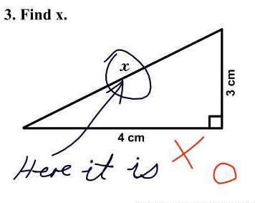
Quiz time!
Notes:
Patient safety quiz and terminology quiz

Slide 6
Culture
‘We cannot change the condition of those who do the work, but we can change the conditions within which they work’ culture
Reason
Notes:
6
Professor James Reason gives us a quote about the working environment, we can also adapt this to culture.
Show Berwick report interview 2013: NHS bosses should focus on listening and transparency (1:53) http://www.theguardian.com/society/video/2013/aug/06/berwick-report-nhs-transparency-video
Link to no-blame – human errors inevitable, so need org. recognition and acceptance of this, but not of reckless violations/negligence – responsibility and accountability.

Slide 7
Why is it called a “theatre”?
1889
1875
Notes:
Eakins – 1875 “The Gross Clinic” depicts the unhygienic approach to surgery at the time, compared to the 1889 Eakins picture – The Agnew clinic depicting the change in approach to surgery as the requirement for hygiene became clearer. What else is noticeable in the two pictures? Observers in the latter picture are all engaged and straining to see, a nurse is also present, those attending to the patient are gowned. This is all in stark contrast to the first picture where people are disengaged, leaning against a wall, arguably the depiction of the calm professional compared to the distressed “relative” is re-enforcing the heroic nature of leadership?
Observation of an environment and the body language and interaction of the people within it can quickly give us an impression of the culture.

Slide 8
Culture
“What's the bleeding time”!
http://www.youtube.com/watch?v=oVWjAeAa52o
Notes:
We have seen a representation of the “culture” of healthcare from the 19th Century through the paintings by Eakins. How about the 20th Century? This video clip from 1960s “Dr in the House” film series depicts the God like status of the senior consultant. Has anything changed in this example? Whilst it may be described as a piece of fiction designed to amuse audiences, society often holds a mirror up to us through the use of media. Comedy can be a non-threatening way to communicate how a profession is seen.

Slide 9
‘Blame culture’ vs ‘Just culture’
‘Blame culture’ counterproductive
Reduces learning
Reduces staff engagement
Reduces chances of effective change
Just culture improves:
Morale
Job satisfaction
Commitment to the organisation

Slide 10
What is “Just Culture”?
"...a culture in which front-line operators and others are not punished for actions, omissions or decisions taken by them which are commensurate with their experience and training, but where gross negligence, wilful violations and destructive acts are not tolerated.”
The combination of culture – “The way we do things around here…when no one is looking”.
And a balance between accountability and learning.
“The single greatest impediment to error reporting is that we punish people for making mistakes.”
Leape 1999
Human Error (don’t switch on lights) - Console
At risk (breaking speed limit) - Coach
Recklessness (drink driving) - Punish
Marx 2010
Notes:
The “just culture” helps to balance accountability and learning. Dekker (2008) says that the goal of just culture in reducing error is to encourage error reporting.
An excellent paper prepared for the United Kingdom Health and Safety Executive by Dr C Lekka in 2011 examines just culture within High Reliability organisations, (I have highlighted some key points expanded by Professor Sidney Dekker in a later slide when discussing the creation of a “Just Culture”):
“There is an open accident and near miss reporting system within the organisation, and individuals are supported and able to suspend work on safety grounds without fear of being penalised for their decisions. The notion of a just culture often encompasses a ‘no blame’ approach to mistakes. However, in developing a just culture a distinction must be made between unacceptable or blameworthy behaviour that requires disciplinary action and other types of behaviour (such as necessary violations arising from inadequacies in the equipment or workplace which make compliance with procedures unfeasible) (Reason, 2000, 2005). The development of a just culture requires a balance between supporting the reporting of incidents and near misses on one hand and not tolerating unacceptable behaviours on the other (e.g. Wreathall, 2006).”
David Marx articulates “Just Culture” as an organisational response in the aftermath of an error that focuses on what drove the adverse event (simple human error, at-risk behaviour, or reckless behaviour) and not upon the severity of the outcome. This means that a person exhibiting reckless behaviour faces punishment, irrespective of whether grievous patient harm occurs. Conversely, an event that leads to substantial harm is not "charged" to the professional whose simple human error reaches a patient undetected. Marx cycles the feedback loop around, holding leaders accountable for managing barriers to compliance and, when necessary, redesigning faulty systems so that the likelihood of a simple human error causing grave harm is substantially reduced.
Punishment deters those who consciously choose to disregard risk or intend to harm others, but has little to no impact on the individual who does not intend to make a mistake (Marx 2001)
Examples of just culture from everyday life
Human Error (don’t switch on lights) - Console
At risk (breaking speed limit) - Coach
Recklessness (drink driving) - Punish
All three of these behaviours can result in the same outcome in terms of severity, the likelihood of the behaviour leading to the outcome increases as we go up the scale. Deterrence in the form of punishment will discourage active reckless behaviour; for at risk behaviour we need to understand the contributory factors that increase the likelihood and design a system and process to reduce it.

Slide 11
Culture problems and solutions…
Groupthink
A group drive for consensus so strong that dissent is (intentionally and unintentionally) suppressed
https://www.youtube.com/watch?v=X_TLztvV4ns
Notes:
Groupthink is a phenomena found in team settings, particularly those run on hierarchical lines. Many people feel that this applies in some healthcare settings and thus can inhibit healthy function of the team and the contribution to developing a safe and just culture.
“Groupthink” was indentified as a contributory factor in the explosion that destroyed the NASA Space Shuttle Challenger in 1986. The “O” ring component failure that led to ignition of the fuel that destroyed the shuttle was found to not function safely at low temperatures. These temperatures were present at the launch site in Florida during January 1986 with icicles forming. A senior engineer at the private company that manufactured the “O” ring highlighted his concerns and these were discussed with NASA senior management. NASA at the time were subject to external pressure on its budget due to a number of aborted launches and it was felt this external pressure played a part in discussions moving from one where the “O” ring was identified as unsafe at low temperature to one where it was okay to launch. ABC nightline produced a 30 minute documentary called “Groupthink” dramatising the events and this can be accessed via Youtube

Slide 12
Symptoms
Belief that the group is impervious to threats
False perceptions of unanimity
Internal censoring of ideas
Peer pressure to conform to norms
Negative stereotyping of opponents
Rationalization of actions.
Notes:
Some of the symptoms that can indicate “Groupthink”

Slide 13
Cure
Having leaders remain impartial
Using different groups for different tasks
Using outside experts
Using a Devil's advocate to question all the group's ideas
Holding a "second-chance meeting" to offer one last opportunity to choose another course of action.
Notes:
Some suggestions to help combat Groupthink. Essentially the advice is to explore differences in a manner that encourages a frank exchange of views. “Red Flag” phrases can help to alert team members that one of the group has a concern.
The 1962 Cuban Missile crises is a good example of these ideas in practice. United States President, John F Kennedy asked principle members of his cabinet to discuss the crises and come up suggestions for him to consider. He remained outside of these discussions to ensure people were able to speak freely.

Slide 14
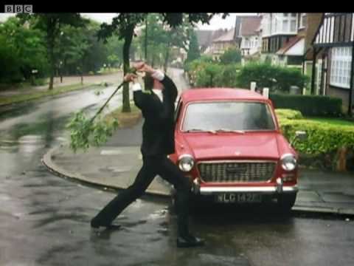
Job interview case study
Notes:
Perrow Job interview case study.To check their actual response to error

Slide 15
Error
"Failure to complete a planned action as intended, or the use of an incorrect plan of action to achieve a given aim"
Software and Legal, 2016
Notes:
Error is “normal” pathology for human beings. Its how we learn as a species. Trial and error. It’s a by product of some very useful cognitive abilities, such as prioritising items to automatic functioning as opposed to cognitive engagement. Daniel Kahneman referred to this as System 1 and System 2 thinking. System 2 is hard to do, it requires a lot of effort, we would rather default to our system 1 thinking. This freeing up of our mind allows us to attend to multiple stimuli but does have the drawback of increasing the risk of attentional slips and lapses…

Slide 16
Types of Error
Attentional slips of action
Unintended
actions
Skill based slips and lapses
Rule based mistake - treatment plan based on incorrect diagnoses.
Knowledge based errors - clinician is faced with an unfamiliar situation.
Lapses of memory
Error
Rule-based mistakes
Slips are observable
Lapses are memory based and are thus not observable
What can we do to reduce these errors?
Intended
actions
Mistakes
Knowledge based mistakes
Adapted from Reason
Notes:
This animated slide is designed to highlight the three sub categories of error; Intended actions, Unintended actions and Violations
Actions do not go as intended (skill based slips and lapses) A slip is observable for yourself and/or others. A lapse is not observable, such as a forgetting a step in a process; it is memory based.
Ask the group what can we do to reduce these types of errors?
Look for being aware of the system1 and system2 thinking and utilising tools (such as checklists) and team members to help us remember.
Activity at this point – Discuss in your groups, what do we mean by routine, reasoned and Reckless/Malicious violations?
Routine = we always do it a different way here OR everyone does it like this
Reasoned violations
- Situational (For this patient we need to do it a different way)
- Exceptional (if we don’t do it a different way the patient will suffer)
- Optimising (can do it better another way)
Reckless / Sabotage – deliberately do it differently knowing it is risky
Activity at this point – Discuss in your groups, what do we mean by Rule and Knowledge based mistakes, can you think of an example?
Mistake based errors have strong links with “action classification” of error as there is a failure of action involved.
Mistakes are essentially failures of planning. Plans have two stages – a process and an outcome. The wrong rule is followed or a lack of knowledge. An example of a rule based mistake would be making an incorrect diagnoses and then proceeding with a treatment plan based on that incorrect diagnoses. Knowledge based errors tend to occur where the clinician is faced with an unfamiliar situation
What can we do as individuals and teams to reduce mistake type errors?
Look for – be aware of the part bias plays in decision making
an unfamiliar situation could be described as a ‘wicked’ problem. Asking questions of others to seek expertise within the team may help
All staff should be free from discipline unless...
Premeditated or intentional acts of violence against people or damage to equipment/property
Actions or decisions involving a reckless disregard towards the safety of patients
Failure to report safety incidents or risks

Slide 17
Types of Error
Attentional slips of action
Unintended
actions
Skill based slips and lapses
Lapses of memory
Error
Rule-based mistakes
Intended
actions
Mistakes
Knowledge based mistakes
Adapted from Reason
Notes:
Actions do not go as intended (skill based slips and lapses) A slip is observable for yourself and/or others. A lapse is not observable, such as a forgetting a step in a process; it is memory based. Mistake based errors have strong links with action classification of error as there is a failure of action involved. (most frequent type of error)
Mistakes are essentially failures of planning. Plans have two stages – a process and an outcome. The wrong rule is followed or a lack of knowledge. An example of a rule based mistake would be making an incorrect diagnoses and then proceeding with a treatment plan based on that incorrect diagnoses. Knowledge based errors tend to occur where the clinician is faced with an unfamiliar situation.
Routine violations = we always do it a different way here OR everyone does it like this
Reasoned violations
- Situational (For this patient we need to do it a different way)
- Exceptional (if we don’t do it a different way the patient will suffer)
- Optimising (can do it better another way)
Reckless / Sabotage – deliberately do it differently knowing it is risky or seeking to consciously cause harm (premeditated)
All staff should be free from discipline unless...
Premeditated or intentional acts of violence against people or damage to equipment/property
Actions or decisions involving a reckless disregard towards the safety of patients
Failure to report safety incidents or risks

Slide 18
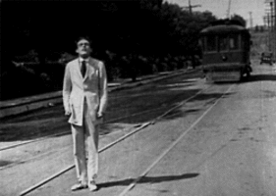
Near Miss
A situation in which an event or omission, or a sequence of events or omissions, arising during clinical care fails to develop further, whether or not as the result of compensating action, thus preventing injury to a patient
Software & Legal, 2016
“We must pay attention to those weak signals in our system, those near misses are all opportunities for learning”
Professor Sir Liam Donaldson,
WHO Envoy for Patient Safety
CHFG Spring Conference 2014
Notes:
Many industries, particularly those that can be described as safety critical recognise the importance of reporting and learning from “near misses”
This is the policy for the aviation industry
“What should be reported? - Any incident which endangers or which, if not corrected, would endanger an aircraft, its occupants or any other person. Accidents and serious incidents should also be reported to the AAIB as described above.”
Confidentiality - Occurrence Reports are treated confidentially to maintain full and free reporting from the aviation community and to protect the identity of the individual in accordance with EU legislation. (The Air Accident Investigation Board, Civil Aviation Authority.)
What can we all do in health and social care to see “near misses” as opportunities for learning instead of opportunities thank our lucky stars?

Slide 19
Violation
“A conscious failure to adhere to procedures or regulation (e.g., performing a checklist from memory).
Helmreich, 2000
“A deliberate deviation from standard procedure”
Amalberti 2006
Not always a bad thing!
Why?
Notes:
Procedure, process, protocol, guidelines; all are derived from what is considered best evidence at the time. Not always ‘academic’ evidence of course. They are always historical as soon as they are put into the work environment, it therefore follows that at some future point, the procedure will be found to be defunct. This could be due to new knowledge but is often a realisation that deviation from the agreed protocol is required because the reality of what is required does not fit with the agreed procedure, it could be argued that many of these conscious deviations are what actually keeps the system as a whole safe...
Variation of practice is therefore a welcome necessity if we are to encourage innovation. Standardisation is also a welcome necessity to ensure consistency of outcomes, but one should not be at the detriment of the other. Variation as a consequence of patient need is perhaps a useful way to approach this conflict. “Doing it because its how we work round here” is not a reason to stick with an outmoded procedure.
I have heard an anecdotal story of a Scottish hospital that required cyclists only to sign in at a security station, an inquisitive member of staff looked into the reason for this procedure and it turned out to be a method of monitoring the quantity of additional rations given to cyclists during the second world war!!
Routine violations - regular short-cuts in tasks made for convenience. They are accepted by the clinical team, and sometimes by management, normally because the procedure is badly designed.
Reasoned violations - occasional changes in procedure for good reason and with good intent. It may be an emergency or unusual situation. The change should be discussed beforehand wherever possible and always documented afterwards.
Reckless violations - unacceptable changes in procedure. Harm is likely but not intended. There is an active lack of care.
Malicious violations - deliberate acts that are intended to cause harm or damage. They are unusual but the outcome is likely to be very serious.
So violations are not always a bad thing, they could be a symptom of poor or out of date procedures. That variation needs to be highlighted to allow the system to adapt to the new reality and ensure other parts of the system are not conflicted by our reasoned violation.

Slide 20
Violation types
Routine
we always do it a different way here OR everyone does it like this
Reasoned
Situational (For this patient we need to do it a different way)
Exceptional (if we don’t do it a different way the patient will suffer)
Optimising (can do it better another way)
Reckless / Sabotage
deliberately do it differently knowing it is risky.

Slide 21
Summary
Culture is not done to us, we are all part of creating the culture we see
Error is not the same as negligence
Processes and tasks often depend on weak mental abilities, such as short term memory
Most violations are necessary adaptation.

Slide 22
Break

Slide 23
Human Error
“Human Error is inevitable. We can never eliminate it”
Prof Sir Liam Donaldson, WHO
World Health Alliance for Patient Safety

Slide 24
Human Error
Inaction, Breach, Violation, Loss of Situation Awareness
All are just substitute terms for ‘Human Error’ – the human component of the system failed to do something
Human Error is not the cause
Human Error is a symptom
Notes:
Ask the audience; how many of you got out of bed to cause harm? Forget something on purpose?
Human Error focuses blame on individuals whereas we know that the system influences behaviours and action/inaction that at the time seem reasonable. Hindsight always reveals the choices that were incorrect and led to a poor outcome, but the outcomes derived from those choices were not obvious in the moment. AND sometimes we did not have (or did not feel we had) a choice.

Slide 25
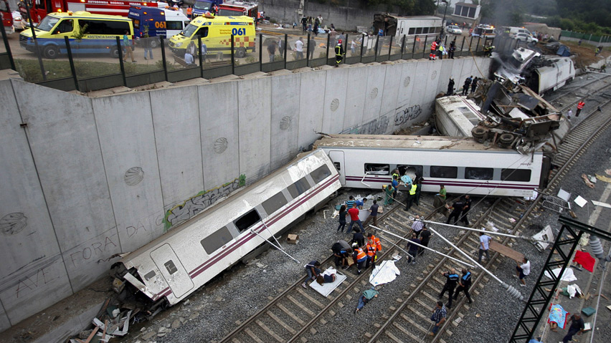
Santiago de Compostela derailment, Spain, 2013
“Although the causes of the crash are still unknown, early indications suggest that it is down to human error.”
Notes:
The headlines in the press and media were all too familiar

Slide 26
Human error
“Oh my God. I told those guys at safety that it was dangerous and one day we would lose concentration and pay for it. I already told those guys at safety that it was very dangerous! We are human and this can happen to us. This curve is inhuman!”
Statement by driver (Francisco José Garzón Amo) after being pulled from wreckage
Notes:
What the driver said when he was pulled from the wreckage was not reported however, but it immediately poses questions.
From Steven Shorrock’s blog – Humanistic Systems
“As is common in accidents and incidents, front-line staff immediately blame themselves, which does not mean they are to blame. Spanish press stated that immediately after the derailment, the driver allegedly said to officials at the railway station 3km from the crash “I ****** up, I want to die. So many people dead, so many people dead”.
In this case, the justice system will now need to determine if the driver’s actions crossed the line into ‘recklessness’. It is another issue as to whether or how justice will be served. But one only needs to look into the context of this accident to see that ‘human error’ or synonyms such as ‘lapse of concentration’ or even ‘carelessness’ do not seem reasonable to explain this terrible event. And if that is all it takes for such an outcome, then it could surely happen again. The ‘human error’ explanation does not seem to serve safety, so what does it serve? Perhaps it partly serves society’s need for simple explanations and someone to blame, while absolving society itself for its demands”

Slide 27
Alton Towers Rollercoaster (2015)
“The (in-house) investigation concluded that the incident was the result of human error culminating in the manual override of the ride safety control system without the appropriate protocols being followed.

Slide 28
Alton Towers Rollercoaster (2015)
“The investigation also identified areas where protocols and the training of employees should be improved. There were found to be no technical or mechanical problems with the ride itself.”
Classic “Blame and re-train” response
“Staff misunderstood a shutdown message and wrongly restarted the ride”
Notes:
No technical or mechanical problem – all that is left is the human, staff misunderstood a shutdown message and wrongly restarted the ride. Case closed or classic blame and re-train approach?

Slide 29
The view of the UK Health and Safety Executive…
…while the ride was mechanically safe, there were not systems in place to tell staff when a static ride was on the tracks…
…A static train was shown on the computer, but a member of staff did not see it and overrode the computer.
System is reliant on the human to keep it safe!
Notes:
No technical or mechanical problem – all that is left is the human.
staff misunderstood a shutdown message and wrongly restarted the ride

Slide 30
Human Error yes but…
Type of Error?
Caused by?
What contributed to the error?
Unintended Action
Attentional slip or lapse
System factors
Will blame and re-train prevent this
happening again?
Notes:
Going back to our error classification before (Reason slide)
Alton Towers was arguably an unintended action caused by an attentional slip. The attention of individuals was diverted due to factors unknown within the system. We know that attentional resource is limited and is subject to errors but no system mechanic for preventing override was incorporated into the safety system for this ride.

Slide 31
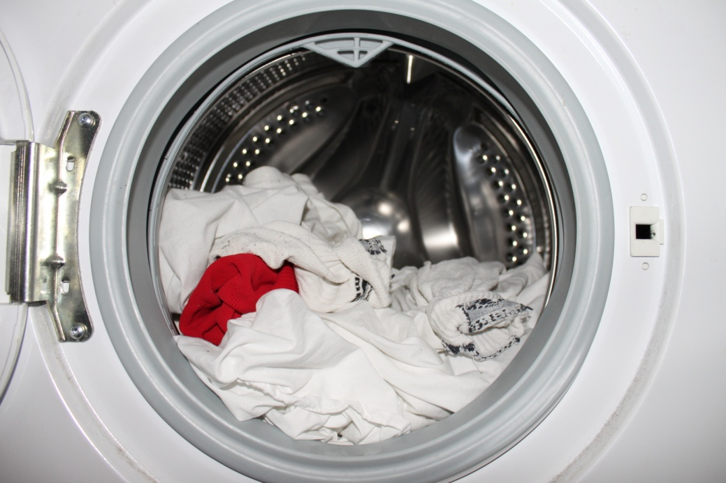
What are we thinking about when we say ‘human error’?
Is it the cause
that red die leaks from socks.
The event
putting the sock in the machine
The outcome
pink clothes!
Not meaningful term!
“It is the outcome that makes the cause bad” Dekker
Notes:
When investigating adverse events, investigators are aware of the outcome before they start the investigation. This results in a search for a suitable cause of the event. Serious events therefore need a ‘serious’ cause. As one safety expert states:
“It is the outcome that makes the cause bad.” Dekker
Is it the cause – that red die leaks from socks.
The event – putting the sock in the machine
The outcome – pink clothes
Its not a meaningful term because the same “human error” could have resulted in no effect other than expected operation.

Slide 32
Performance variability
Trainee GP read letter from a consultant stating,
“Please give Mr X his pneumococcal vaccination.”
The trainee discussed the vaccine with Mr X and then gave the vaccine. He then asked the practice manager how to code that this had been given and at this point they found that he had the vaccine last year.
Notes:
What is the error?

Slide 33
So…looking for a bad cause to a bad effect…
What was the error (root cause) identified in the Significant Event Analysis?
Giving the vaccine?
Letter from consultant?
Patient knowledge?
Coding systems in practice?
IT system ?
Human/computer interaction?
Induction for the trainee?
Notes:
Root cause analysis is from manufacturing industry. That kind of system can be described as cause and effect and its straight forward to apply this technique to find the faulty component and replace it. Trying to use it in a socio-technical system where cause and effect is not applicable, the linkages between one task and another are both tightly coupled and also not clearly defined and are dependant on many different factors often happening outside of the current timeframe.
We need a method to understand what was happening for the individual at each moment and why their actions or otherwise made sense for them.

Slide 34
Performance variability
As systems are so complex we cannot specify work precisely (end up with work as imagined)
Conditions vary, processes tightly coupled
Performance variability is essential to make systems function (work as done)
Performance variability (by humans) is what makes things usually go right.
Notes:
Variability is a term that may provoke some problems for the unprepared presenter. Quality Improvement as applied in NHS Scotland (specifically in Scottish Patient Safety Programme) seeks to reduce variation in a system. This is the message that may come across but if you speak to those qualified in Quality Improvement they will acknowledge that “common cause” variation is a feature of all systems. This sits comfortably with the point we are trying to make. Another point about variation, arguably the key point for culture change, is that it could be viewed as a symptom of problems; individuals are having to create adaptation, workarounds ect because of poorly designed or out of date process.

Slide 35
Alternative view – to understand everyday work
Availability of resources (time, manpower, information) may be limited and uncertain.
People adjust what they do to match the situation. Performance variability is inevitable, ubiquitous, and necessary.
Because of resource limitations, performance adjustments will always be approximate.
Performance variability is the reason why everyday work is safe and effective.
Performance variability is the reason why things sometimes go wrong.

Slide 36
Alternative view to understand the previous error
Variability occurs and usually things go right!
Usually this would have gone well and saved the patient time and pleased patient
Work as done as opposed to work as imagined
What is the protocol? Who designed it?
Protocols not designed to deal with all conditions
Notes:
Designed for nurses (probably by nurses) but what about everyone else? They have to adapt and that ability is cognitive resource dependant.
Ask audience to repeat back a sequence of numbers, try seven numbers first, then try nine. Try and remember more than 7 numbers, our short term memory has limited capacity. This is one example of cognitive resources that are affected by system interactions

Slide 37
Alternative view to understand the previous error
Local rationality - people only act on the information available to them
Doctor had limited information – letter and patient
Efficiency thoroughness trade off (ETTO)
Trying to save time in consultation, trying to save appointments.
Small steps are normalised – drift into failure
Giving fluvax opportunistically became normal, GPs doing extra to save return appointment is now normalised

Slide 38
Video
Why Things Go Wrong
https://www.youtube.com/watch?v=pYlIEMNhqM4

Slide 39
Performance variability
Own experience of deviations from protocols
What were the outcomes?
How is this handled?
Notes:
Important message for the trainer here is “you don’t” have the answer of how to solve this problem. Those involved in the actual work are the knowledgeable experts. The skill is developing the positive safety culture where realistic conversations about work as done Vs what is imagined can take place.

Slide 40
The effect of major and minor events on people
The degree to which they are recoverable seems dependant on two factors
A mindset that expects unpleasant surprises (mental)
The flexibility to deploy different modes of adaptation in different circumstances (action)
Both are resource limited
“You are a human being, not a human doing” - Dyer
Notes:
Major events can be corrected by the professionalism of the staff involved. However an accumulation of minor events leads to attrition and an eventual exhaustion of coping strategies
Crises consume available coping resources very rapidly. Only those people or organisations that have invested a considerable amount of preparatory effort in a sufficiently timely and appropriate manner so as to maintain the necessary resilience

Slide 41
Summary of key points
Local rationality - components of a system only act on the information available to them
Efficiency thoroughness trade off (ETTO)
Variability occurs and usually things go right
Human Error is a symptom not a diagnosis
Be curious about the reality of work.

