Slide 1
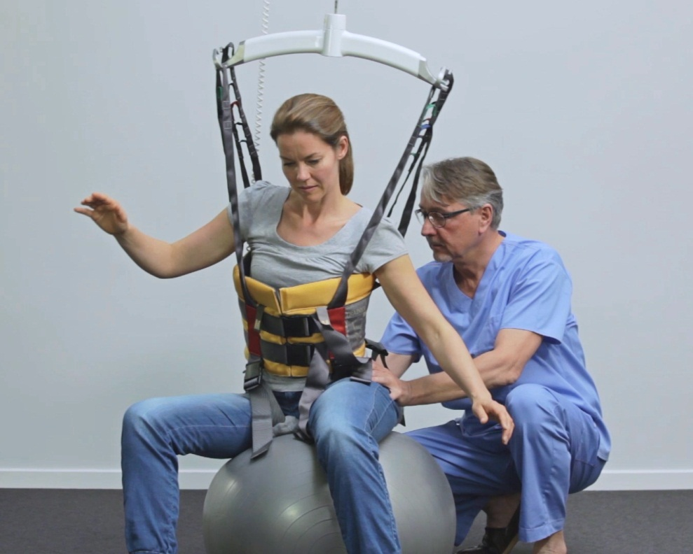
The World in between A - B
Anders Haugaard, Head of Guldmann Consulting
Physiotherapist

Slide 2
Short presentation of Guldmann
Challenges in moving and handling
The world in between A - B
Practical demonstration

Slide 3
V. Guldmann A/S was established in 1980
Presented our first ceiling lift in 1981
Over 30 years experience
Private company, consistent ownership
Close to 50.000 deliveries worldwide last year
Ownership over production facilities in Denmark and Ukraine
We have active patents and patents pending on parts and ideas
Employ over 315 people world wide

Slide 4
|Time to care|
The Guldmann approach
^{A delivery from Guldmann} ^{is not only a product}
^{– it’s a solution}

Slide 5
The Guldmann approach
^{Analysis}
^{Products}
^{Installation}
^{A delivery from Guldmann} ^{is not only a product}
^{– it’s a solution}
^{Financing}
^{Training}

Slide 6
Challenges in moving and handling
Staff perspective
Safe working environment
Patient perspective
Patient safety / Rehabilitation
Notes:
This slide just to illustrate the issues dealing with rehabilitation!
You will have to challenge the patient to let them go further in their capability.

Slide 7
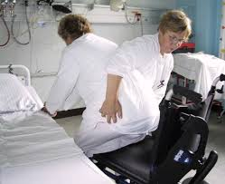
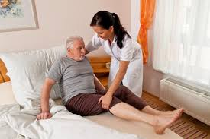
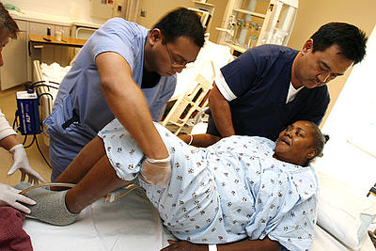
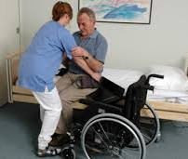
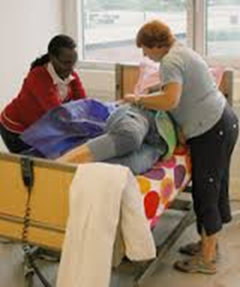
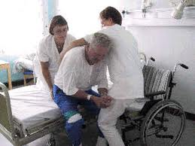
What we see!
Working Enwironment?
Patient safety/ Rehab.?

Slide 8
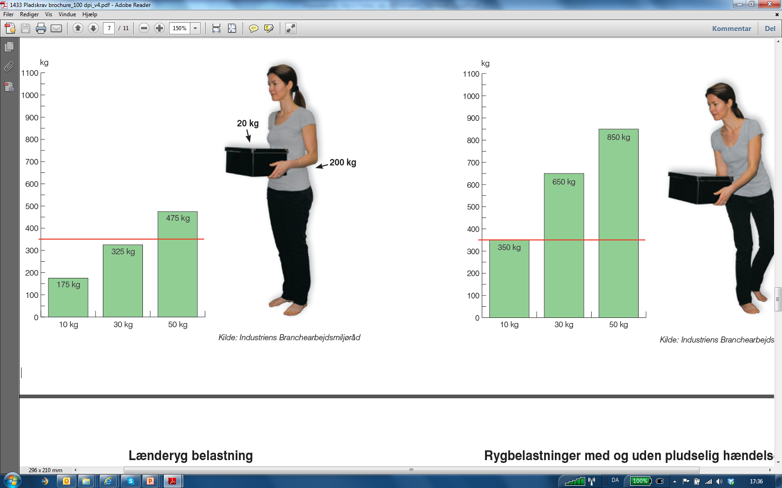
Biodynamics
NIOSH recommendations: Max. pressure on the spinal discs in the lower back 3.400 N (340 kg)
If the pressure is higher than 6700 to 10,000 N (670-1000 kg) the dicus begins to degenerate
Source: Industriens Branchearbejdsmiljøråd
Notes:
The following slides it to visualise the real work conditions and the risk involved

Slide 9
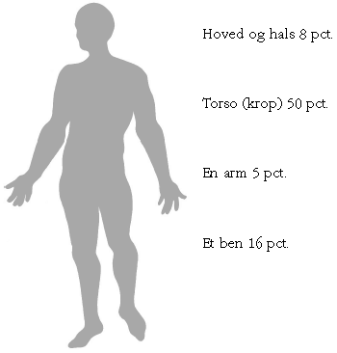
Mr. Schmit – 80 kg
Head and neck 8 %
6 kg
Body /Thorso 50 %
40 kg
One arm 5 %
4 kg
One leg 16 %
13 kg
Source: The Danish Working Environment Authority

Slide 10
Repositioning in bed
Notes:
Consequence of not using the right working technique and appropriate work tools

Slide 11
Legs back in bed
Notes:
Consequence of not using the right working technique and appropriate work tools

Slide 12
When does a transfer / support / guidance turn into a
LIFT?
L
I
F
T
What is acceptable ?
TRANSFER / SUPPORT / GUIDE
Notes:
When does a transfer slide into a lift
We know what load becomes dangerous but often it is difficult to assess when a load transits' from a transfer into lifting when performing nursing or rehabilitation.

Slide 13
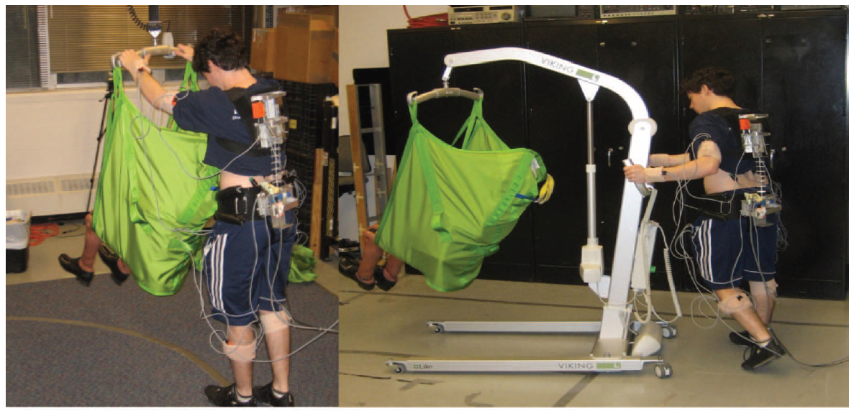
The consequence of design
Experimental design
Ceiling Hoist
vs
Mobile Hoist
Notes:
2.3. Experimental design
The floor-based system was tested using two different wheel configurations (large wheel configuration – 5 inch (0.127m) diameter rear wheels and 4 inch (0.1016m)
Diameter front wheels composed of hard rubber; small wheel configuration–3 inch (0.0762m) diameter rear wheels and 2 inches (0.0508m) diameter front wheels composed of hard rubber). All wheels used in this study were previously used on patient lift systems in healthcare facilities in order to provide systems with realistic wear chacteristics. The use of the floor-based systems was also evaluated while the patient handling devices were used under two different floor conditions (hard floor surface and (short pile) carpeted floor common in assisted living facilities. Thus, the floor-based system was tested under four different wheel–floor surface combinations.
Patient weight could also potentially influence the degree of caregiver spine loading during patient transfer activities and, therefore, was also used as an independent variable. Patients were represented by anthropometric ‘dummies’ of different mass. In order to simulate arrange of patient weight conditions, three patient weights were selected consisting of 125lb (56.8kg),160 lb (72.7kg) and 360 lb (163.6 kg).The patient was obviously non-weight bearing as would be expected under patienthandling device conditions.
Recently, the model has also been adjusted to be sensitive to pushing and pulling activities such as would be expected during the use of patienthandling mechanical lifts. The model used in this analysis has been thoroughly described previously and will not be repeated here (Theado et al.
2007, Knapik and Marras 2008).

Slide 14
Task

Slide 15
Results
NIOSH:
Max. Shear force:
Red line
Recommendation:
Green line

Slide 16
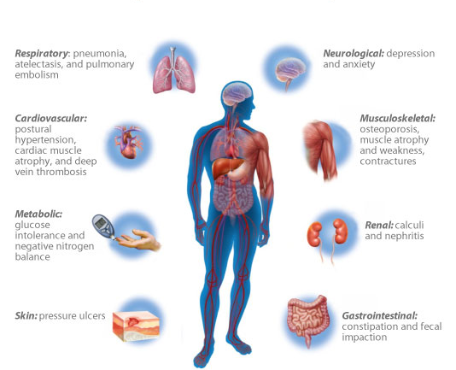
Patient perspective
Potential Complications of Immobility

Slide 17
Potential Complications of Immobility
The detrimental consequences of physical inactivity and bed rest are significant:
Muscle strength decreases 3-4% daily (up to 20% the first week)
Condition / Physical fitness will fall 1-2% daily for the first week
Source: Inactivity and immobility, Nina Beyer, Handbook of physical activity SST)
Twenty-Four-Hour Mobility During Acute Hospitalization in Older Medical Patients. Pedersen M, et al. J Gerontol A Biol Sci Med Sci. 2013 March;68(3):331-337
Notes:
Jeg har ikke verificeret de to første påstande endnu – Det er ikke så ligetil at tjekke Nina Beyer.

Slide 18
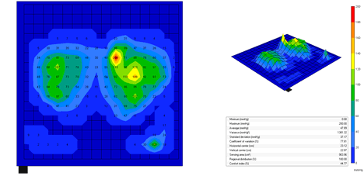
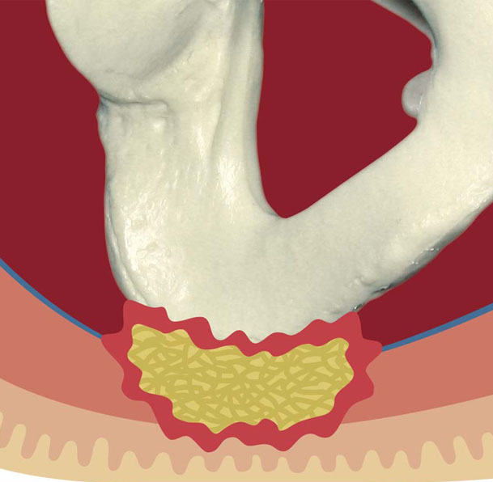
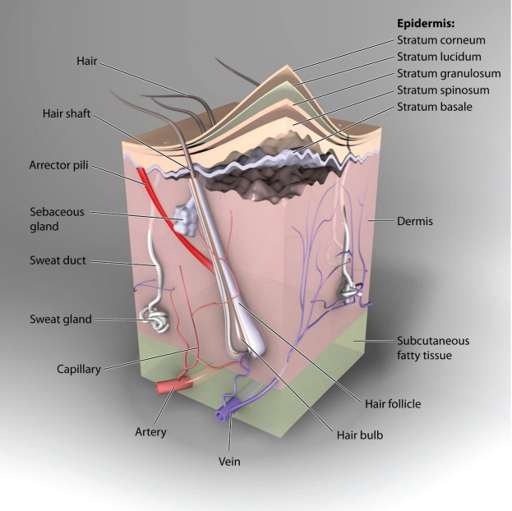
Shear Force - Decubitus

Slide 19
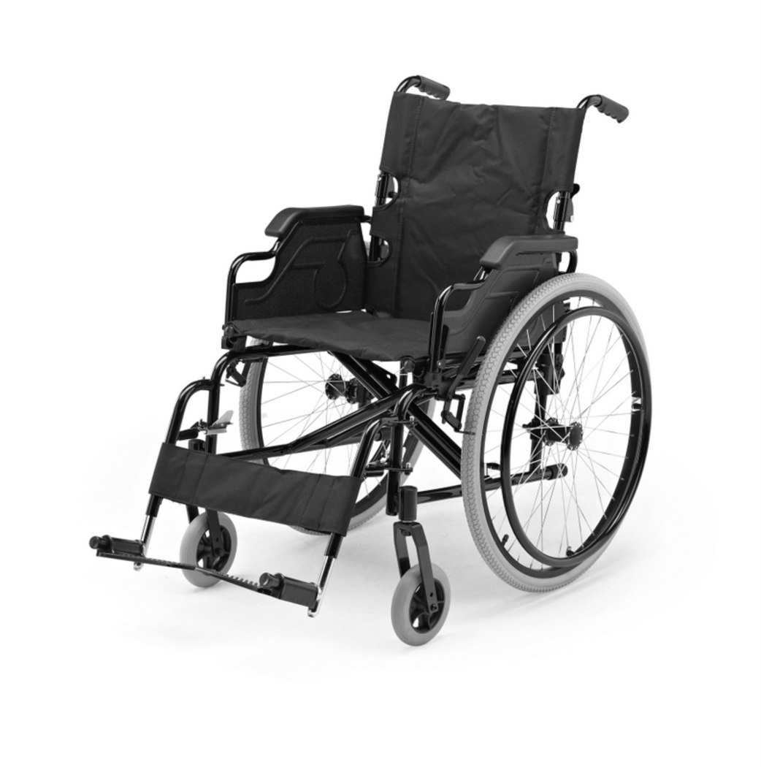
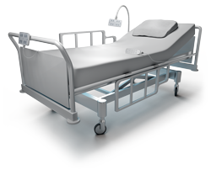
Using Cieling Hoist
Transfer
A
B
and
it’s
Passive

Slide 20
But there is a World in between A - B
A
B
?
and
it’s
Passive Active

Slide 21
www.guldmann.com

