Slide 1
Scottish Manual Handling Forum Survey
Notes:
Introduction
Good morning
Thank you to everyone who managed to find time to complete the Survey Monkey.
The forum is run for and by members and the Core Group are always looking for new and interesting ideas for what is included in the study days or conference.

Slide 2
Topics
Format of study days
Subjects included and methods of delivery
Interest in Project Groups
Affiliation to the NBE
Notes:
We asked you to consider the:
Format of study days and conference
Subjects included and methods of delivery
Interest in Project Groups
Affiliation to the NBE

Slide 3
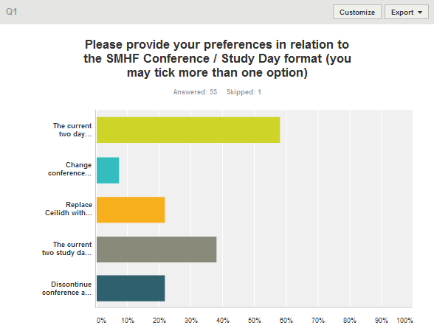
Notes:
As you will see a large proportion of respondents felt happy with the existing biannual conference with 2 study days in the intervening year.
The core group had been considering reducing the second day of the conference to a half day and replacing the Ceilidh with a drink reception on the first night where delegates can view the exhibitor’s stalls. We would appreciate members views on this proposal as the survey did not confirm this was a good idea

Slide 4
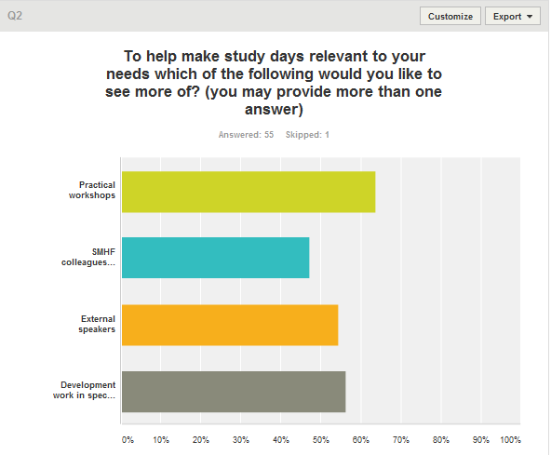
Notes:
You will see where we asked ‘what respondents wanted to see more of’ that 64% wanted to see more practical workshops. However this was closely followed by more speakers and involvement in development work in special interest groups

Slide 5
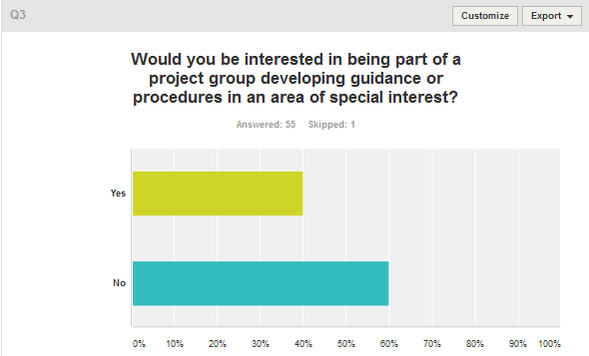
Notes:
In the previous question a good number of respondents wanted to see the development of procedures and guidance from special interest groups.
Although not everyone wants to be involved, 40% of respondents did show an interest.

Slide 6
Project Group Ideas
Community
Assessment & provision of community equipment
SMHP modules
Dementia handling (older people / building design)
Bariatric Patient
Theatre
Safer moving& handling (Unpaid Carers)
Low level working in the community
Equipment Evaluation
Mental Health / Learning Disability issues
Hedgehogs
Emergency Evacuation – children
Emergency Care
Notes:
Suggestions for these project groups are listed here:
One individual expressed a wish to be involved in the Core Group. Please let yourself be known to one of the Core Group.

Slide 7
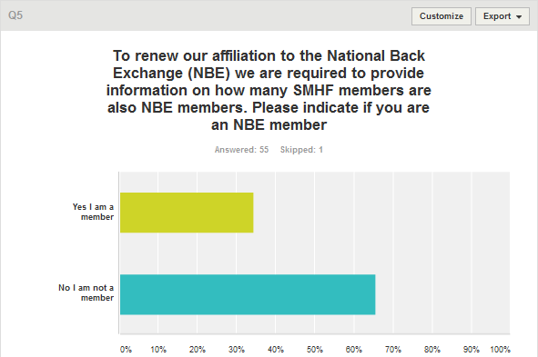
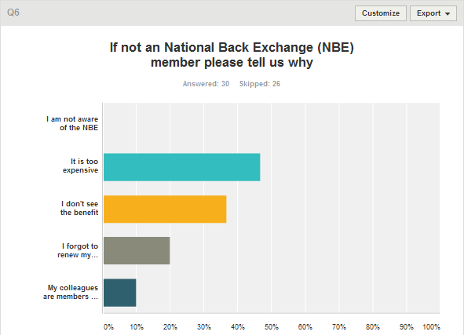
Notes:
At present the Scottish Manual Handling Forum is affiliated to the National Back Exchange.
35% of respondents told us there were members with 65% not. Of those who were not they thought it was too expensive, didn’t see the benefit or forgot to renew their membership.
The Core Group support the affiliation to the NBE and will feedback to their executive the findings of the survey.

Slide 8
Future Development Ideas
Positive feedback
Sort out booking process
Local groups
Ongoing updates from the Core Group
Notes:
We asked if members had any comments they would like to make regarding future developments in the SMHF.
The comments were positive.
With individuals passing on that they thought the forums were valuable and they were happy with the current set-up.
There seems to be issues booking places onto the study days and conference, and this is something we will explore.
A number of people talked about local groups and more regular updates from the Core Group. To that end we are looking at the development of special interest groups, working more closely with the NBE with work in the pipeline to review handling techniques using a newly developed tool.
We have also agreed that Core Group minutes will be added to the SMHF website so that you can keep up to date with developments.

Slide 9
Notes:
Once again thank you for taking part and remember that the SMHF is always looking for individuals and groups to get involved.

