Slide 1
Scottish Manual Handling Forum 2022
Mark Flattery - Dynamic risk assessment for Patient Handling: Enabling the Variable Client

Slide 2
Mark Flattery - Dynamic risk assessment for Patient Handling:
Enabling the Variable Client

Slide 3
Mark Flattery - Dynamic risk assessment for Patient Handling: Enabling the Variable Client

Slide 4
When is the last time you carried out a Risk Assessment?

Slide 5
When is the last time you carried out a Dynamic Risk Assessment?

Slide 6
What is a Dynamic Risk Assessment?

Slide 7
Dynamic Risk Assessment
“A dynamic risk assessment assesses risk for employees in changing circumstances.”
(HSE 2022)
Examples include employees who:
How:
Work alone
Work in environments with potential for aggression and violence
Deal with manual handling activities
A dynamic risk assessment is carried out informally. Issues identified must be addressed and reported to the manager.

Slide 8
But what is Risk?

Slide 9
But what is Risk?
The PMBOK® Guide describes risk as,
“An uncertain event or condition, that if it occurs, has a positive or negative effect on a project's objective.”
The key element of this definition is that the effect of the uncertainty, if it occurs, may be positive or negative on the objectives of the planned endeavour.
PMBOK (PMI.org)
Notes:
Lady in bed that ended up not walking

Slide 10
What does it mean in practice?

Slide 11
What does it mean in practice?
Dynamic risk assessment is the practice of mentally observing, assessing and analysing an environment while we work, to identify and remove risk.
The process allows individuals to identify a hazard on the spot and make quick decisions regarding their own safety.
(Richard Bedworth) staysafeapp.com/blog/dynamic-risk-assessments/

Slide 12
Who uses a Dynamic Risk Assessment?

Slide 13
Used by
Nurses
Occupational Therapists
Physiotherapists
Doctors
Manual/Patient Handling Instructors
Service Users
Family Members
Health Care Assistants
Home Support Workers

Slide 14
When do we use a Dynamic Risk Assessment?

Slide 15
Hospitals
This Photo by Unknown Author is licensed under CC BY-NC-ND

Slide 16
Hospitals
Turning a patient, especially post surgery
Sitting a patient up
Turning a patient to sit at the side of the bed
Standing a patient
Walking a patient
Sitting a patient
Rehabbing a patient
Degenerative Diseases
Hoisting, particularly “Toileting Sling”
Sit-to-Stand Hoisting
This Photo by Unknown Author is licensed under CC BY-NC-ND

Slide 17
Home Environment

Slide 18
Home Environment
Rolling a patient
Sitting a patient up
Turning patient to sit at side of bed
Standing a patient
Walking a patient
Sitting a patient
Rehabilitating a patient
Degenerative Diseases
Hoisting, “particularly Toileting Sling”
Sit-to-Stand Hoisting

Slide 19
Activities to be assessed
Rolling
Sitting
Turning
Standing
Walking
Sitting
Rehabilitation/Therapies
Degenerative Diseases
Hoisting, particularly “Toileting Sling”
Sit-to-Stand Hoisting

Slide 20
It’s Dynamic. What’s important in an emergency?

Slide 21
It’s Dynamic, What’s important in an emergency?
Care Professional/Family
The Back, (Discs)
Service User
Brain, Heart, Lungs

Slide 22
Principles of Manual Handling
How many are there?

Slide 23
Principles of Manual Handling
Reduced to three:

Slide 24
Principles of Manual Handling
Reduced to three:
Shoulders over Hips

Slide 25
Principles of Manual Handling
Reduced to three:
Shoulders over Hips
Straight Arms

Slide 26
Principles of Manual Handling
Reduced to three:
Shoulders over Hips
Straight Arms
Head Up

Slide 27
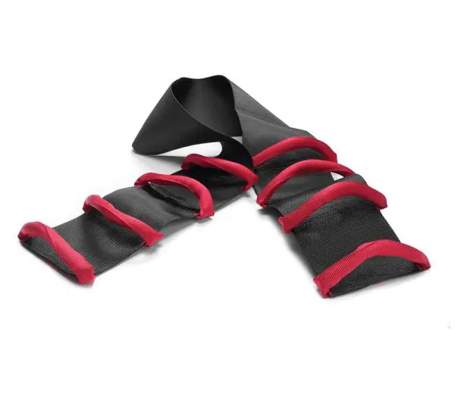
Sitting Up and Turning
Lengthens the Arm
Allows Carer to stand straighter
Gets Shoulder “behind” Hip
WendyLett Inco Sheet for “high needs”

Slide 28
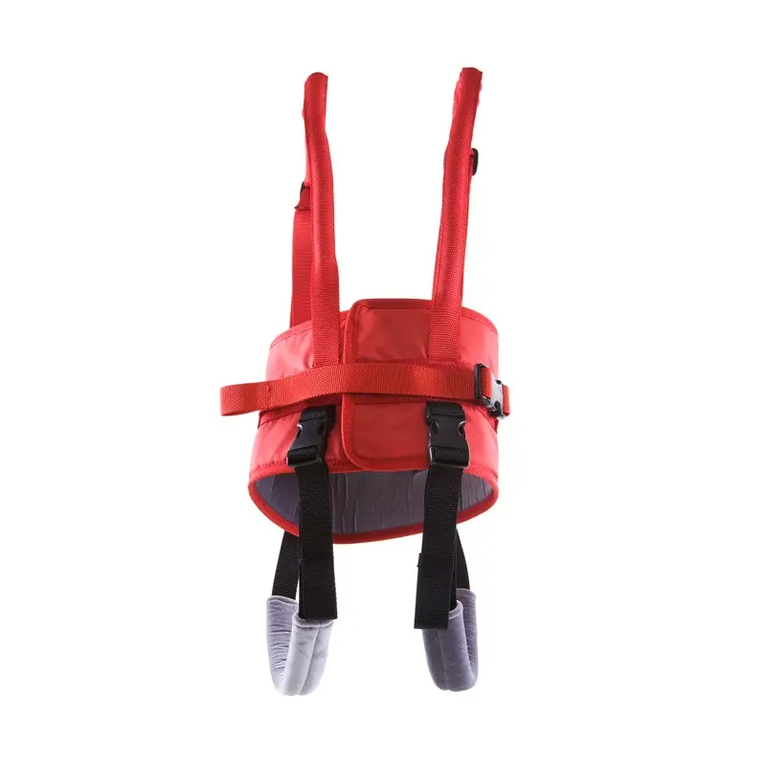
Standing
Lengthens the Arm
Allows Carer to stand straighter
Gets Shoulder “behind” Hip
Can conduct Dynamic Risk Assessment
Assess for Standing ability and Walking ability

Slide 29
Walking
Lengthens the Arm
Allows Carer to stand straighter
Gets Shoulder “behind” Hip
Can conduct Dynamic Risk Assessment
Assess for Standing ability and Walking ability

Slide 30
Sitting
Lengthens the Arm
Allows Carer to stand straighter
Gets Shoulder “behind” Hip
WendyLett Inco Sheet for “high needs”

Slide 31
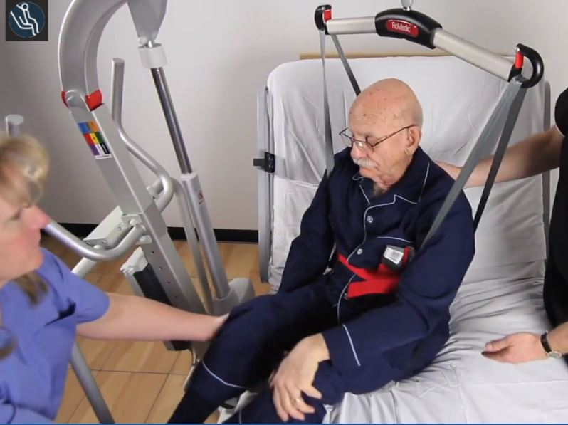
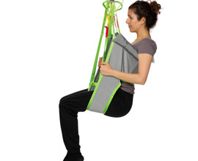
Toileting Slings, are not Toileting Slings
Dynamic Risk Assessment
Balance
Tone
Co-Operation
Understanding

Slide 32
Hopefully we have all learnt something ☺
Thank You!!

