Slide 1
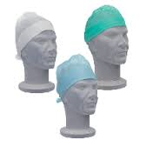
Reducing Manual Handling Risks in the Operating Theatre
Angela Bennett
Sue Harrington
Nicky Sharpe

Slide 2
How does this make you feel?

Slide 4
Differences
Policy
Risk assessments
Equipment
Environment
Unconscious patient
Task / postures
Number of people
Hierarchy
Consequences
✓
✓
✓
✓
✓
?
?
?
☹

Slide 5
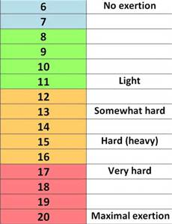
Borg RPE 1985

Slide 6
Retractor Holding

Slide 7
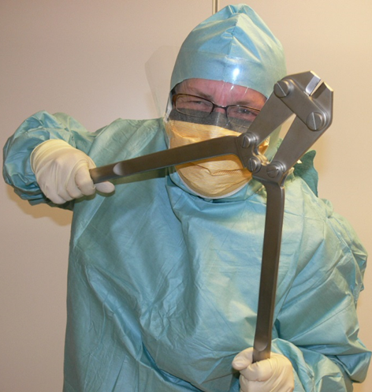
Staff Perception
Retractors
Patient transfer – bed / trolley
Moving beds / trolleys
Prone positioning
Instrument handling
Supporting legs
Supporting arms / head
Endoscopy
Cameras
Cannulation
Dressing / POP
Lithotomy
NBE Theatre Special Interest Group Survey 2004

Slide 8
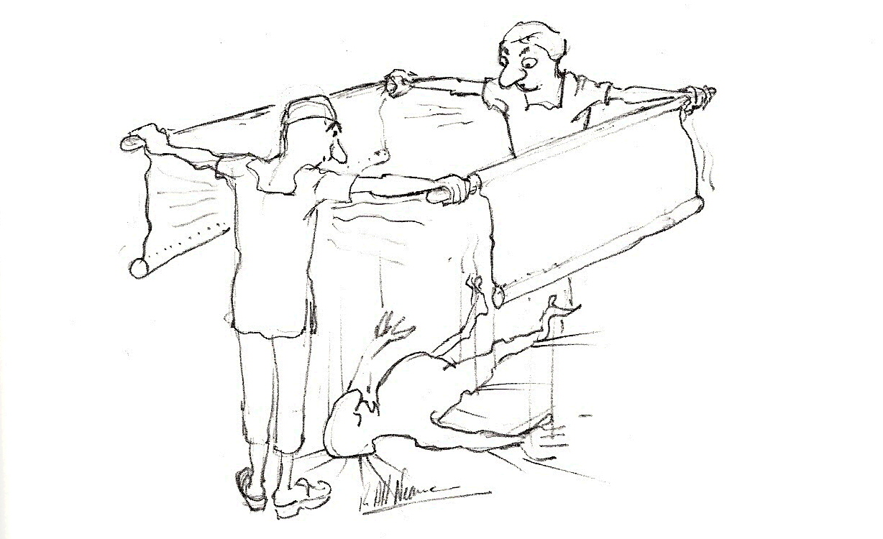
Practical

Slide 9
Key Learning Points

Slide 10
Key Learning Points

Slide 11
Change?
Key stakeholders
Easy wins
Nudge
£’s
Evidence base
Patient Care

