Slide 1
Moving and Handling Small Children and Babies
Aimee Gilhooley

Slide 2
Objectives
Reinforce the current Scottish context for small child handling
Module Development
Share Optional Module G - Moving and Handling of Small children and babies

Slide 3
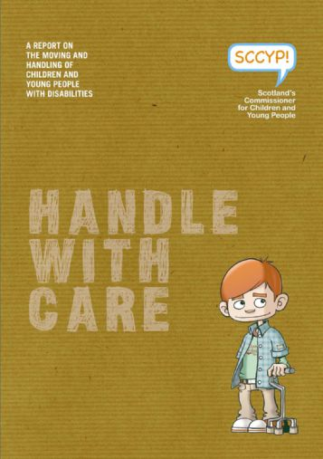
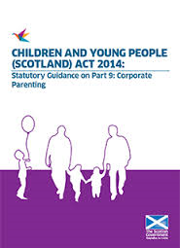
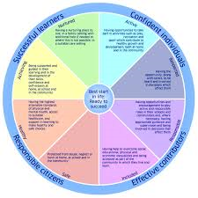
Moving and Handling Small Children and BAbies
Background information
Evidence
Key drivers

Slide 4
Optional Module G Development
Lead Person/Co-ordinator Identified
Review group to be formed from wide range of organisations
Moving and Handling Training Needs Analysis form to be developed for evidence gathering by review group
Appropriate contact list for distribution of Training Needs Analysis to be developed ensuring wide range of organisations are represented
Training needs analysis Questionnaire to be sent out to developed contact list
Draft module to be developed and circulated to contact list and SMHPS Monitor/Review group

Slide 5
Training Needs analysis outcomes

Slide 6
Training Needs analysis outcomes
Question 2 | Lifting, handling and carrying of young children
Question 14 | Assisting a child to stand up and/or sit down
Question 1 | Lifting, handling and carrying of babies
Question 3 | Staged lifting of small child to/from floor
Question 15 | Assisting a child with walking
Question 31 | Working at low levels
Question 33 | Pushing/pulling wheelchair or buggies
Question 4 | Lifting small child to/from floor to standing one member of staff
Question18 | Assisting a child to reposition themselves in a chair
Question 32 | Assisting a child to transfer from the toilet
Question 17 | Assisting child to transfer from one seat to another
Question 20 | Assisting a child who is standing with persona care activities
Question 7 | Manual lift of small children from one seated position to another
Question 26 | Assisting with a child’s movement on a changing bed e.g. too roll or turn
Question 13 | Assisting a child to eat or drink
Question 10 | Bathing/nappy changing

Slide 7
Optional Module G – Moving and Handling Small Children and Babies

Slide 8
Moving and Handling Small Children and Babies
Cameron Raeburn

Slide 9
Progress
SMHP document – August 2014
Creating a new module
Small Children and Babies module
Changes made:
Module changed to Small Children and Babies
‘Describe the key areas of risk assessment….’ is now ‘Demonstrate an understanding of the hazards …..’
Added ‘Identify the key areas of undertaking a risk assessment for lifting and carrying a small child and baby’
Notes:
1st bullet –
- 2 ½ years, for some this will be a whole new world and therefore just starting to bed in
- Endorsed by HSE who are starting to refer to it in their inspections / enforcement actions
- Need to do some benchmarking and evaluation of the existing document
- Register of participating organisations taking shape and taking time
2nd Bullet –
The review group used the Small Children and Babies as a guinea pig to develop a template for folks want to develop future modules and significant learning has occured, for example, one of the things we thought we wanted was new modules to replicate existing modules and whilst this is desirable if applied rigorously is can be detrimental to the new modules
3rd Bullet –
Thank you to Aimee and all who have taken time to input to the development of the module
Cant make changes to existing passport document and the foundation modules until a formal review therefore when module is finalised it will sit as an associated module which can be referenced by participating organisations
4th bullet – after receiving feedback from the final draft that was circulated about a month ago, Sue, sarah and myself met to discuss the comments received and make changes in time to present here. One of the key considerations we had was to highlight what the module brought to the table that we felt was unique and could not be covered in the other practical modules.
- option of just Babies only module removed as too small with no particular specialist MH techniques associated with it
Changed as risk assessment mentioned elsewhere (A5 and C3) therefore wanted to make it specific to this module and focus on the hazards associated with low levels and their control measures. We recognise that other staff groups also work at low levels so will need to consider this aspect for other modules eg B at next review
added RA for lifting and carrying as do not consider potential to lift and carry a ‘person’ in any other module

Slide 10
Progress
Changes made:
‘Demonstrate competence …’ is now ‘Demonstrate the ability to undertake..’ and ‘Demonstrate an understanding..’
Combined references to manual lifting one practical element
Added the word ‘Manually’ to assisting a small child to transfer and stand / sit
Removed the walking component
Notes:
Practical elements Changed as felt mannequins did not allow competence to be shown
Combined the points relating to ‘staged lifting’ and ‘lifting and carrying’ into one item as both related to manual lifting, which is not something covered in any other module
Added the word Manually to make it clear that there may be more manual assistance being provided than would be considered in the other adult orientated modules without the use of equipment, and we gave examples that would be specific to this module, for example, slide transfer onto knees and sit / stand from the floor, low surface or buggy.
Removed walking component as felt this wouldn’t be a core activity of people working with children and would most likely be undertaken under the instruction of a therapist

Slide 11
Next Steps
Final draft to go to Review Group and Module Working Group for agreement on changes
Module to go to stakeholders represented by review group members (NHS Leads, LAs, 3rd Sector) and SMHF
Agree wording of relationship with Passport document and host on SMHF website
G&T – Large!

Slide 12
Thank you for Listening

