Slide 1



QI & HFE: Complementary Practice?
March 2019
@SPSP_PC
Improvement Hub
Enabling health and
social care improvement

Slide 2
Welcome
Lindsay Wallace
Improvement Advisor
Primary Care Improvement Portfolio
Improvement Hub
Enabling health and
social care improvement

Slide 3

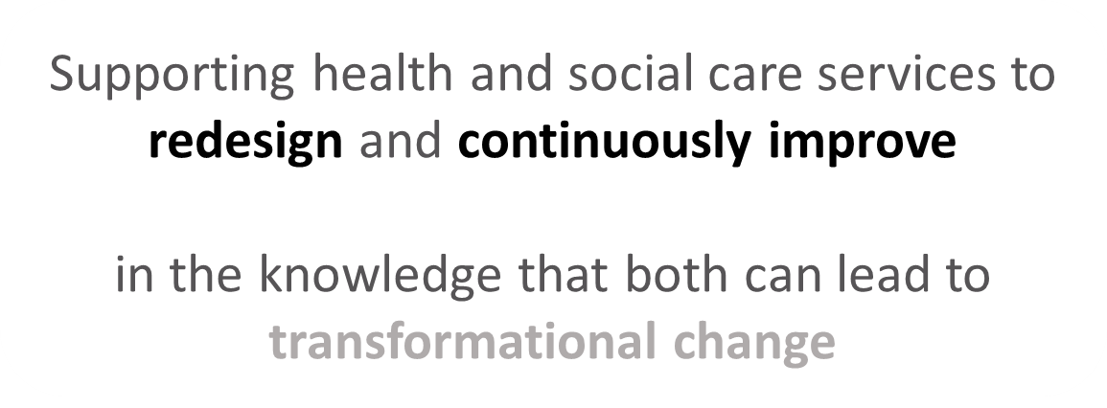
Our Aim
To deliver targeted improvement support to optimise care and service redesign across primary care in Scotland
Notes:
Aims for this session:
To provide an overview of “improvement science” and its background
Offer insight into QI methodology, in particular the Model for Improvement
Highlight the synergy and differences between QI & Human Factors/Ergonomics
Consider how QI methodology could compliment your service aims

Slide 4

Quality Improvement is defined as
The application of a systematic approach that uses specific techniques to improve quality
Health Foundation 2014
Notes:
Quality improvement is not new and there are many, many definitions of what this is. This is the most useful definition by the Health Foundation in terms of our approach to this within Scotland.

Slide 5

What is Scotland’s approach to
Quality Improvement?
Scottish Patient Safety Programme 2007
Improvement Framework for Scotland’s public services 2013
Improvement Route Map for Health & Social Care services 2011
Notes:
Brief summary of health then social care then Government took this a step further by producing the 3-Step Improvement Framework for ALL Scotland's Public Services.

Slide 6
All approaches have the following in common
Cycle of improvement involving data collection, problem definition & diagnosis, generation & selection of potential changes, implementation & evaluation of these changes
Set of tools & techniques that support implementation of changes
Recognition of importance of organisational context & senior clinical & management leadership
Recognition of central importance of engaging those who deliver the service in improvement of that service
QI
Notes:
Slide is animated – brings up QI + circle, then one item at a time
Lead facilitator
Though there are a range of different approaches that fit under this umbrella they all have the above in common.
To develop the skills needed for quality improvement, we need to work with a number of tools, techniques, and approaches that support the implementation of changes designed to achieve improvements.
Two major concepts that we will use are Deming’s System of Profound Knowledge and a model that provides a framework to guide improvement work.: the Model for Improvement We are going to start looking at the Model for Improvement now, and will come to the System of Profound Knowledge in a later session.

Slide 7
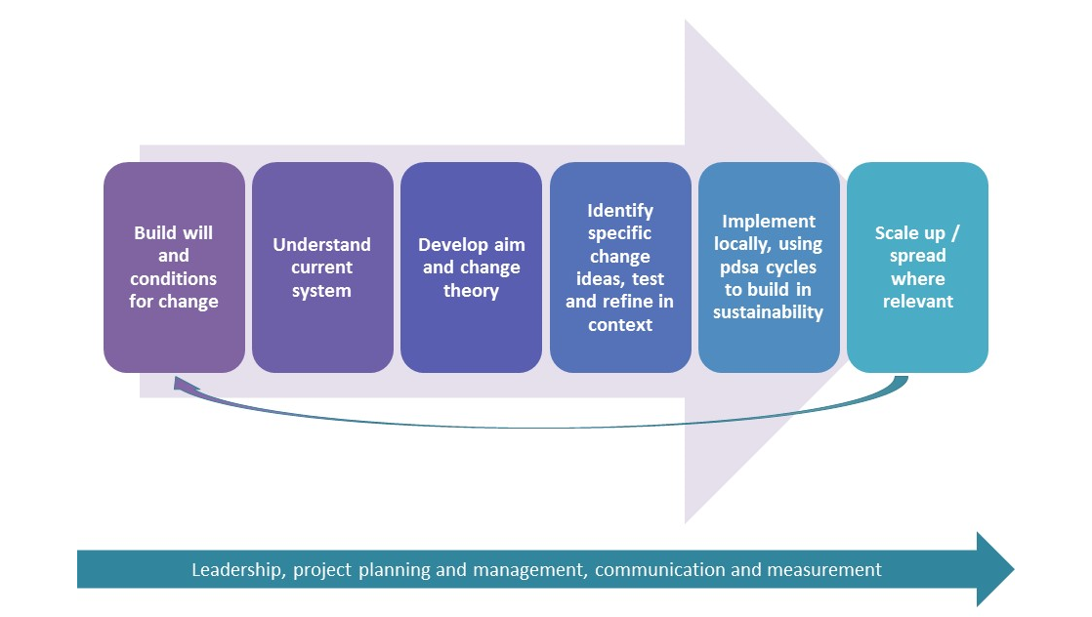
Improvement journey
Notes:
Briefly talk through the Improvement journey first, then highlight how what has been covered in this session fits with the journey.

Slide 8
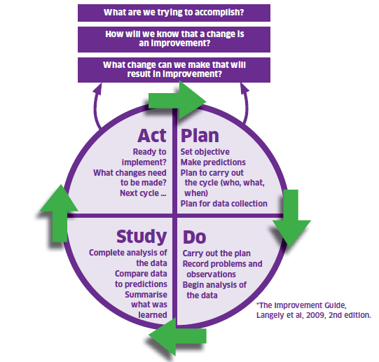
The Model for Improvement
The Thinking Part
The Doing Part
Notes:
The model is split into two parts. The first being the thinking part and the second being the doing part. We will be taking you through the two distinct parts in some detail with practical exercises to get everyone used to using the model and be able to describe and direct others in terms of our support function within the Unit.

Slide 9

Why is an aim statement important?
Framework
Focus
Scale
Team membership
Communications.
Notes:
Constructing an aim statement helps us to answer the first question in the Model for Improvement: What are we trying to accomplish?
It provides a framework to think through all aspects of the proposed improvement project
It keeps improvement activity focussed on the original purpose
It makes clear the scale of improvement expected from this project
It helps to select suitable team members for the improvement work
Communications – make it as easy as possible for everybody (including/particularly senior leaders) to understand what you are trying to achieve. And you need to think about communications from the beginning – who needs to know what, why and when?
Aim
This is your ‘elevator speech’: a brief statement (2-3 sentences max) of what you intend to accomplish. Outline how much better you want the area for improvement you are addressing to be. And when you expect to achieve this by. Be realistic here. Your aspirations must be balanced by some idea of how you can get there.

Slide 10

First Define
Your Rationale and Scope
What’s the problem?
How do you know?
How big is the gap?
Who will be affected?
Strategic fit?
Expected impact?
Realistic timescale -why?
Notes:
Slide is animated
Things to consider before writing the project aim statement
Outline why the area for improvement you are focussing on is important. What problem will it solve and what is the impact of doing nothing?
How do you know this is a problem and what is your starting position (e.g. what baseline data do you have that tells you how your system and processes are currently working?).
How big a gap is there between where you are and where you want to be?
Who, specifically, will be affected by the success or failure of this project (children impacted by your services, staff, patients, community, etc.)?
How many people/how large an area will be affected by your project?
How does it fit into the strategic vision of your organisation?
What is the expected impact (outcomes, benefits, cost)
Why do you believe the timescale you have set is realistic?

Slide 11



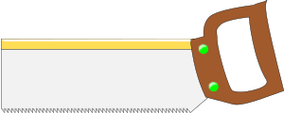
Service User
Feedback
Fishbone Diagram
Pareto Charts
Process Mapping
CORE IMPROVEMENT TOOLS
Notes:
The toolbox has many things in it, some you use all the time, some you use occasionally and some you have never used yet but know it is there.

Slide 12
The Three Questions
What are we trying to accomplish?
How will we know that a change is an improvement?
What change can we make that will result in improvement?
Notes:
Question 3

Slide 13

Value Adding Activities
What would allow us to do the work better? More efficiently?
What do we need to do to eliminate waste?
What do we need to do to ensure quality?
Notes:
From the organisation’s perspective
Of course there are some activities in the systems we work in that are not directly experienced by service users that we cannot eliminate completely. Those can also be targets for change – to reduce wastes relating to those steps.

Slide 14
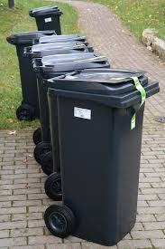
Waste
Transportation
Inventory
Movement
Waiting
Overproduction
Overprocessing
Defects.
the week after next
the week after next
Staff
Notes:
On waste:
Aim to minimise/eliminate waste
These are areas of waste that we need to consider
Some examples: (don’t give the same example here that’s used in the next activity – ok to use the underlined example).
Transportation
Moving a patient to an inpatient bed for review at post-op ward round and then to another ward for discharge
Moving a patient for tests or to see the physiotherapist.
Moving ‘stuff’ – any kind of equipment, medication etc eg patient records from one place to another, information leaflets, paper for printers.
Inventory (ie stock)
Using inpatient beds for patients who are waiting for tests but could be discharged safely
Ordering excess material because the supply is unreliable
Retaining material beyond its useful life eg an audiology unit may have 6000 moulds, many of which are useless because they shrink over time.
Movement – unnecessary movement of staff
eg around a room, from room to room, from building to building
Eg a Health Care Support Worker moving around the sluice to clean and replace a commode
Waiting
Patients waiting in queues at the surgery
Patients or staff waiting for tests
Making sure all the equipment is ready for an operating list
Children and parents waiting for test results
Overproduction
Requesting tests and referrals to outpatient clinics ‘just in case‘
Carrying out tests/assessments in order to cut waiting lists, but not having capacity to follow through once results of tests/assessments are available.
Overprocessing
Things we find ourselves doing that don’t add value for the patient eg re-testing, chasing late paperwork
Defects – Things that are not right and need fixing
in orthopaedics you may have prostheses that are damaged or missing or don’t fit/wrong.
This is the standard list of Lean ‘wastes’. Some people add another:
Staff – ie untapped potential
Staff having the capacity to work in a more effective way, but the system (structures, processes, culture) doesn’t allow them to do that.

Slide 15
Waste
Transportation
Inventory
Movement
Waiting
Overproduction
Overprocessing
Defects.
Your turn! With your neighbour how many service “wastes” can you think of?
the week after next
the week after next
Notes:
On waste:
Aim to minimise/eliminate waste
These are areas of waste that we need to consider
Some examples: (don’t give the same example here that’s used in the next activity – ok to use the underlined example).
Transportation
Moving a patient to an inpatient bed for review at post-op ward round and then to another ward for discharge
Moving a patient for tests or to see the physiotherapist.
Moving ‘stuff’ – any kind of equipment, medication etc eg patient records from one place to another, information leaflets, paper for printers.
Inventory (ie stock)
Using inpatient beds for patients who are waiting for tests but could be discharged safely
Ordering excess material because the supply is unreliable
Retaining material beyond its useful life eg an audiology unit may have 6000 moulds, many of which are useless because they shrink over time.
Movement – unnecessary movement of staff
eg around a room, from room to room, from building to building
Eg a Health Care Support Worker moving around the sluice to clean and replace a commode
Waiting
Patients waiting in queues at the surgery
Patients or staff waiting for tests
Making sure all the equipment is ready for an operating list
Children and parents waiting for test results
Overproduction
Requesting tests and referrals to outpatient clinics ‘just in case‘
Carrying out tests/assessments in order to cut waiting lists, but not having capacity to follow through once results of tests/assessments are available.
Overprocessing
Things we find ourselves doing that don’t add value for the patient eg re-testing, chasing late paperwork
Defects – Things that are not right and need fixing
in orthopaedics you may have prostheses that are damaged or missing or don’t fit/wrong.
This is the standard list of Lean ‘wastes’. Some people add another:
Staff – ie untapped potential
Staff having the capacity to work in a more effective way, but the system (structures, processes, culture) doesn’t allow them to do that.

Slide 16
Service User
Feedback
Fishbone Diagram
Pareto Charts
Process Mapping
CORE IMPROVEMENT TOOLS
Notes:
The toolbox has many things in it, some you use all the time, some you use occasionally and some you have never used yet but know it is there.

Slide 17

Value Adding Activities
Do service users experience it?
Do they want it to happen?
Would they care if you changed it?
Notes:
From the service-user’s perspective
For a step in a process to be value adding, each of these questions should get a ‘yes’ answer.
So, we should be looking to remove as many steps as possible that are not directly experienced by service users. If they don’t want something to happen, or if they would like it to be changed, it is a suitable focus for improvement.

Slide 18
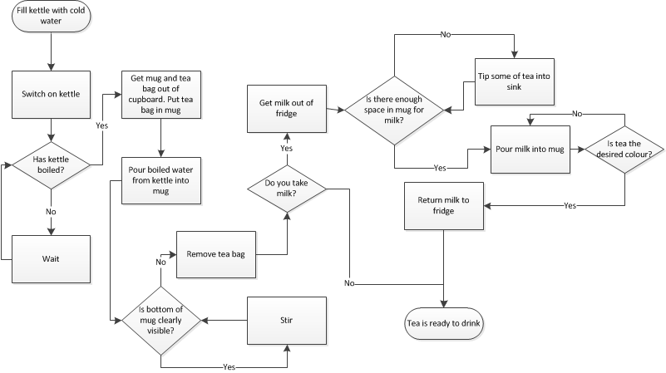
Making a cup of tea
Notes:
Then tidy it up.
A process = sequence of actions
There are many different ways to represent a process. These are some common conventions:
Square/rectangle = action
Diamond = decision point – always ask a yes/no question
Curved shapes – beginning/end
Elicit – hands up or Chat
How many action steps are there here? (10)
How many decision points are there here? (5)
Then analyse
Hands up if you do not make tea this way.
Which steps don’t add value? Use Pen to draw a line across. If no pen tool, do this in Chat

Slide 19
What is a Fishbone Diagram?
Notes:
Talk through.
Facilitator draw fish outline with pen tool or Powerpoint pen.
This is a work-in-progress fishbone diagram with possible causes that may contribute to the effect/problem

Slide 20
Forcefield analysis
Present state
Desired state
Forces for change | Forces against change
Lewin 1943/1997
Notes:
Talk through principles
Example: Eric’s new healthier me project eg:
Forces for change:
Has a reason to want to change – Easter holiday
Close friend is doing Joe Wickes plan so can buddy up
Forces against change:
Hasn’t done any exercise for 15 years
Hates cooking
Family prefers readimeals

Slide 21

Forces |  | For | Against
1 | Aversion to changing shift patterns
2 | Aware of improvement needed
3 | Negative past experience with change
4 | Personal needs not addressed
5 | High level of commitment by management
6 | High staff turnover
7 | Resources are available for training
Notes:
Do you think these would be forces for or against change?

Slide 22
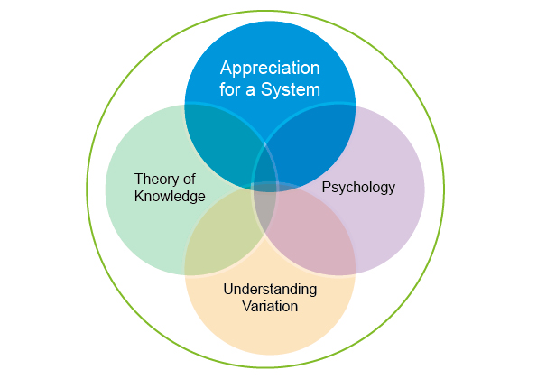
System of Profound Knowledge
Deming 2000
Notes:
Let’s first look at Appreciation for a system.
The first question is then What is a system?

Slide 23
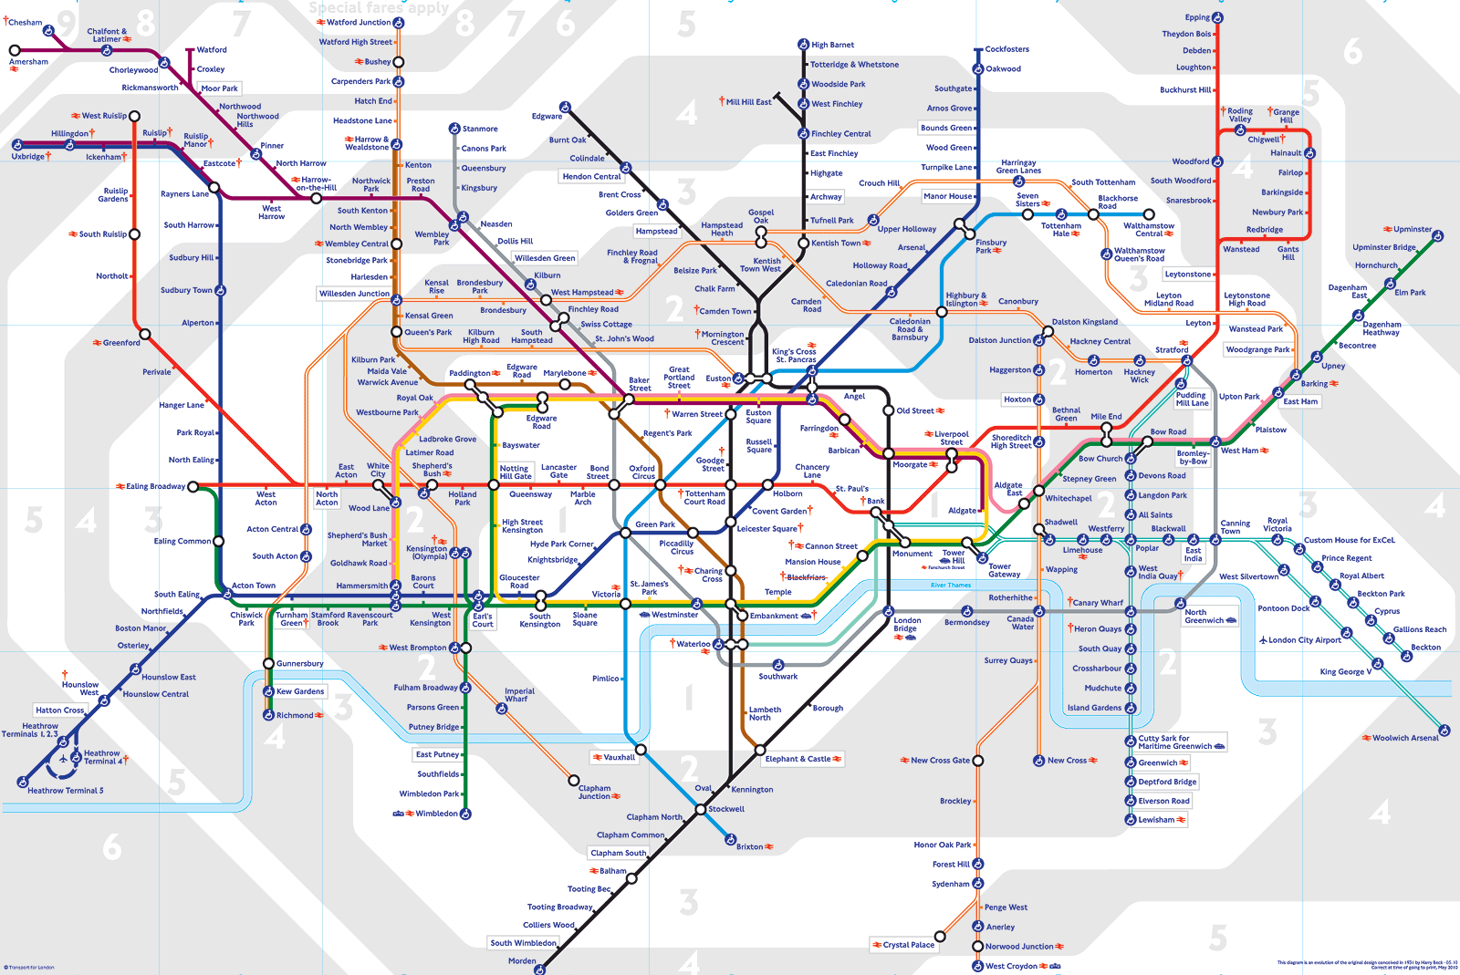
“Interdependent group of items, people, or processes working together toward a common aim”
Notes:
Common Aim: Transport passengers safely and efficiently to their destination
Items - Trains, tracks, stations, ticket machines
People: Drivers, Engineers, Security, Cleansing, Maintenance, Passengers
Processes: Driving the train, Timetabling, Cleaning, Train Maintenance, Track Maintenance, Security, IT, Ticketing staff, construction
All interdependent, sometimes never touching, but they are all inter-linked. You cannot run a train without a driver, you cannot drive a train without tracks, you cannot board a train without a ticket, you cannot get a ticket without a ticketing machine. Each of the parts needs to work for it’s own purpose, and each needs to compliment and interact with the other to achieve the shared purpose.
Critical thing is, when the parts don’t work together you can quickly see or feel it…
Inputs – technology improving/population shifts/working pattern shifts

Slide 24
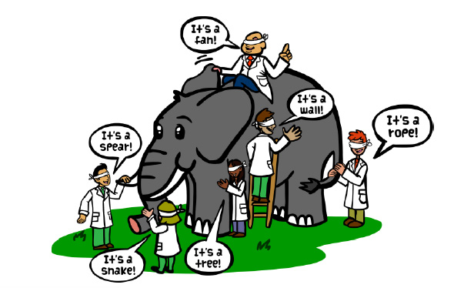
To Improve It - We Must See The System As A Whole
Notes:
From the Elephant and the Blind Man
Silo working only see what part of the process we are involved in and not the whole and you need to understand the whole in order to improve it. Need to think about your system as:
A system has an aim or purpose
A system is a set of interrelated parts that work together to achieve a common purpose
What’s in a system: structures, processes, culture
Interdependence, interactions
Whole is greater than the sum of its parts
It is dynamic. To improve outcomes there is a need to understand system dynamics.
A system has an aim or purpose
A system is a set of interrelated parts that work together to achieve a common aim
What’s in a system: structures, processes, culture
Interdependence, interactions
Whole is greater than the sum of its parts.
It is dynamic. To improve outcomes there is a need to understand system dynamics.

Slide 25

What you know
What some might know
(and what most really need to find out)
What you REALLY should know
What you may never know
THE UNKNOWN
Notes:
Keep this brief.
We have already begun to build your theory of knowledge with your developing improvement projects. The iceberg is a good illustration that in terms of knowledge you need to pull resources from a team in order to see the full picture.
That is you will have some, some others in the team will know more, your experts may then know even more beneath the surface. All of this supports your theory of change.
You also need to accept that there are things you may never know and things you haven’t even considered. So you need some caution that you do not want to waste time trying so hard to find out every last bit of knowledge that you miss working on the big parts of the iceberg you do know!

Slide 26


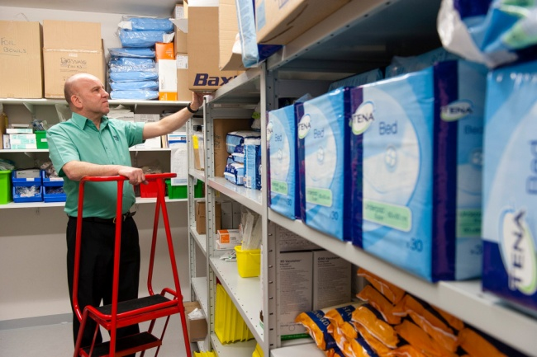
The typical approach
Conference Room
APPROVE
DESIGN
DESIGN
DESIGN
DESIGN
Real World
IMPLEMENT
Notes:
Key messages
Practical differences between the typical approach to change in organisations, and the QI approach.
Traditionally we have not been good at making change for improvement reliable – because after designing a change we don’t test whether it will be delivered appropriately in various conditions and environments before we expect all to implement and make part of every day business.
e.g. previous experience of launching new protocols/guidelines – as of Mon am….. expect all to comply fully without really knowing that it’s practical for every system. Then we wonder why people don’t comply and the system is unreliable.
Task: Think of a change programme that you have experienced that used this approach. How did it feel? In what way was this unhelpful? What would have been better?
Hands up if you would like to share that experience – will ask a couple of people.
Audio – 2 - 3 participants.

Slide 27

The Quality Improvement approach
Conference Room
DESIGN
APPROVE
IF NECESSARY
Real World
START TO IMPLEMENT
TEST & MODIFY
TEST & MODIFY
TEST & MODIFY
Notes:
In contrast, the Quality Improvement approach focuses on where the work is done at the front line.
Design: potentially = strategic drivers/alignment, evidence base.
Ideas are created and tested by front line staff where the work is done, through small scale testing and learning from each small scale iterative test.
We make continuous improvements until our degree of belief is increased enough for testing under a wider set of conditions, until we are sure that we can make the change part of daily work i.e. implementation.

Slide 28
The Model for Improvement
Notes:
This is how we generate that knowledge.

Slide 29
The Three Questions
What are we trying to accomplish?
How will we know that a change is an improvement?
What change can we make that will result in improvement?
Notes:
In the Model for Improvement, we are now looking at Question 2.

Slide 30

Measurement: why?
Without DATA
YOU are just
another person
with an OPINION
Deming
To make improvement visible
To plan
To monitor progress
To tell an improvement story
To use a shared language
Notes:
Aim
Participants to be able to describe why we need data to support improvement work.
Key messages
We measure so that we can know whether a change we have introduced into our system is an improvement.
Measurement is not an end in itself – we should spend as little time as possible dealing with measurement, but enough time to get the information
Click (brings up bullets): now thinking about measurement in our work contexts:
Compare with and build on what participants said.
What does ‘better’ look like? We need to know at all stages. So we can plan for it, and so we will recognise it when it happens.
“Measurement as a language helps translate complex and often nebulous concepts into a more precise form” (Kaplan & Norton The Balanced Scorecard)

Slide 31
3 Step Framework: Create The Conditions
1
Aim
Is there an agreed aim that is understood by everyone in the system?
2
Correct changes
Are we using our full knowledge to identify the right changes and priorities those that are likely to have the biggest impact on our aim?
3
Clear change method
Does everyone know and understand the method(s) we will use to improve?
4
Measurement
Can we measure and report progress on our improvement aim?
5
Capacity and capability
Are people and other resources deployed in the best way to enable improvement?
6
Spread plan
Have we set out our plans for innovating, testing, implementing and sharing new learning to spread the improvement everywhere it is needed?
Notes:
Measurement is part of creating the conditions for improvement – not an end in itself.
The six questions to be asked of EVERY change programme:

Slide 32

Driver diagrams
Notes:
A driver diagram:
Visually presents a team’s theory of how an improvement goal will be achieved or a team’s theory of what “drives” and contributed to reaching the defined project aim.
It articulates what parts of the system need to change, and in which way, and includes ideas to make this happen.
It is used to help plan improvement project activities and ensure team engagement.
So, it is very helpful in giving a clear picture of a team’s shared view and is a useful tool for communicating to a range of stakeholders.

Slide 33
Key features of driver diagrams
Aim
Primary driver
Secondary driver
Secondary driver
Primary driver
Secondary driver
Secondary driver
Secondary driver
Secondary driver
Primary driver
Secondary driver
Secondary driver
Primary driver
Change idea
Change idea
Theory based on:
Experience
Knowledge
Existing evidence
Change idea
Change idea
Change idea
Change idea
Change idea
Notes:
There are three key features of driver diagrams to consider:
Primary Drivers
Secondary Drivers
Change Ideas
This slide shows an example of how you would set this up, with your aim statement clearly defined on the left so you know where you are headed!

Slide 34
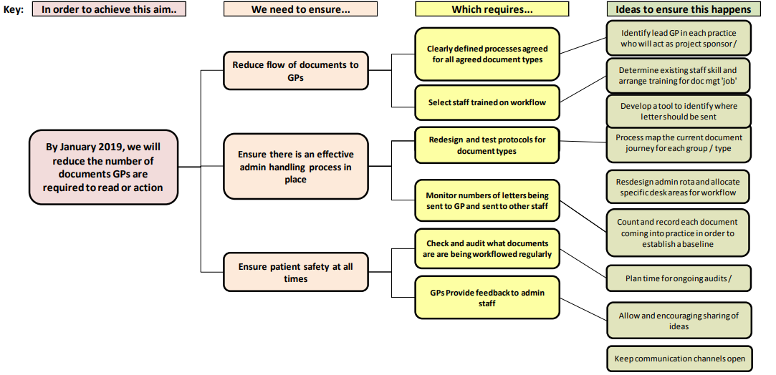
Primary care example
*Three primary drivers
Notes:
The vision here is to be able to free up GP time for patients and to upskill already competent practice teams to help to action documentation that does not necessarily need to go through the GPs.
There are three key drivers here – slide is animated to bring up red boxes - around reducing the document flow to GPs, having an effective admin handling process in its place and ensuring and safety netting patient safety at all times.

Slide 35




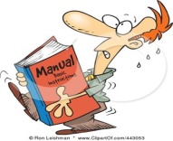











Driver Diagram: Tips on Facilitation
Gather together the subject matter experts.
Brainstorm “to achieve our aim the things we need to improve are...”
Cluster the ideas to see if groups represent a common driver.
Expand the groups (or single ideas) to see if new drivers come to mind.
Logically link together the groups into a driver diagram format.
Work backwards from ideas of change if that helps.
Notes:
You will want to start your DD with your work group or team so remember the principles of good facilitation for brainstorming sessions like this. The tips on this slide can help you and after you have a paper version you can transfer to LifeQI and further tweak and adapt – plus be able to download, print and share with your team.

Slide 36

Getting started with Measures
Describe, in quantifiable terms, what to measure and the steps to follow to measure it consistently.
Communicable meaning to a concept
Clear and unambiguous
Specifies measurement methods and equipment
Identifies criteria
Notes:
To summarise and slightly extend from key messages from earlier slides

Slide 37






Data - Things to consider
Who will be responsible for data collection?
What is the data source / how will the data be collected?
Frequency of data collection, and timings?
Equipment needed to measure?
How can data collection be integrated with work?
What factors might influence the measure?
Notes:
How will data collection fit with other tasks? Make it easy to do.
Is there a trade off between the quality & the time taken to collect the data?
What do we do with the data?
Add to this depending how things are going:
Is sampling needed – if so, what is the approach?
How will you test the measurement process?
How will the data be analysed and presented?

Slide 38

New Healthier Me: Lindsay’s personal project
Aim
To lose 10 lbs by the end of March 2019
Notes:
He’s been collecting data for this measure for a good few weeks, and it’s showing no improvements at all.
Why do you think this might be? Hands up, audio, or chat box??
Debrief should include:
There hasn’t been enough time yet to see an impact on outcomes
Our theory is wrong – we haven’t made the right change that will enable us to accomplish this
The changes that we have made might be the right changes, but we haven’t applied them in a reliable way.
So, what he needs are some different measures, to help him to understand if he’s made the right changes, or if he’s applied the changes reliably.

Slide 39
New Healthier Me: Lindsay’s change ideas
Cook evening meals from scratch
Use gym at work at end of day
Walk to a daily step target
No alcohol Monday to Thursday
Keep to shopping list
Reduce portion size
Max 1 juice or soft drink per day
Replace biscuits and cakes with fruit
Get up from desk to talk, instead of using phone or email
Swim at least twice a week
Notes:
That is not the only change idea that Eric has come up with. Here are some more.
We’ve already looked at this one. [Pointer to replace biscuits …]
Select one of the ideas, and think for a moment about what the measure would be for that, and would Vanessa want the data to go up or down.
Audio: 2 – 3 participants say which change idea, and their measure.
Possible answers:
Number of items bought not on shopping list (want it to go down)
Readimeals eaten per week (down)
Steps per day (up)
Flights of stairs climbed per day (up)
Days between eating cake (up)
Units of alcohol Mon – Thurs (down)

Slide 40
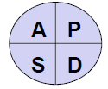
Lindsay’s PDSA Parallel Ramps
Only buy 7 cartons of juice via online order.
Use smaller cereal bowl.
Walk with dog to the forest at weekend
Have a cup of black tea after dinner.
Test smaller plate at lunch.
Parking car in main car park. Walk of 5 mins to base
Take no change to work to deter from using juice machine.
Add more veg and less carbo.
Walking the dog an extra 10 mins in the evening
Take water to work to stop buying extra juice.
Divide plate into protein/veg/carbo.
Taking the stairs at work no lift allowed
Have carton of juice at lunch only.
Use a smaller dinner plate.
Baseline steps data gathered with pedometer
Max 1 juice/soft drink per day
Reduce portion size
Step target per day
Test Ramp 1
Began with a small change I could achieve. Lost a small amount of weight week 2
Test Ramp 2
I was not eating unhealthily but just too much. Tried smaller portions from week 3 rather than cutting out certain foods.
Test Ramp 3
At week 5 realised to increase the pace of weight loss I need to include more exercise
Notes:
Gives an explanation of why things were chosen and in which order to support the overall aim of losing 10lbs by the agreed date. Hopefully that applies some logic for you and a realisation that one change idea is unlikely to get you to the aim by the timescale you have set.
Note of caution you need to work through your first change to see if it is actually making a difference and then consider what else is needed to get you to your aim. You don’t want to begin by testing multiple things at the same time from the outset (if they use the same/similar process measures) as it will be difficult to then work out what actually made the difference. If they use very different process measures, it’s fine.
It is vital then to also really consider your measures and data collection. Collecting data for too many measures can reduce the time people have to devote to testing changes – so remember collect just enough data.
Likewise if you have abandoned a change because it wasn’t working then be clear about that so it doesn't look like you begin by testing one thing and change your mind without the data and learning to back up your decision.
Also remember to collect qualitative as well as quantitative data, particularly during very small scale tests - V small scale means that changes in quantitative measures may be v small. So for Eric I would suggest we collect something around how he is feeling about theses changes i.e. Mood, motivation, well-being etc. He could then also ask her family re their feelings about the change he is making.

Slide 41
Three types of measure
Outcome
Tells a team whether the changes it is making are helping to achieve the stated aim
Process
Tells a team whether a specific process change is having the intended effect
Balancing
Makes sure that changes to improve one part of the system are not causing problems in other parts of the system
Units of alcohol Mon to Thurs
Hours of sleep per night
Weight in pounds
Notes:
If any participants came up with balancing measures re this process, mention them here.
If not, options could include eg: long hours in cinema (to avoid sitting at home with a bottle of wine), missing out on social life (meeting friends is when you usually drink alcohol), hours of sleep (eg due to going out to cinema or theatre more often and that lasts longer than a glass of wine)
Hours of sleep – it might go down due to staying out later
However, quality of sleep might go up without alcohol
Balancing measures are not necessarily bad – could be good, just not something you are aiming to achieve through your change ideas ie could be unintended benefit
Trade offs – if they are unwanted, does that make them completely unacceptable? You need to decide what is acceptable eg for Vanessa she may feel it’s worth losing a few hours sleep by sitting through long art house movies for a few months, in order to break the habit of drinking alcohol during the week. More than a few months though may not be acceptable.

Slide 42

A basket of measures
Process 2
Balancing
Outcome
Process 1
Notes:
We call this a basket of measures (or family of measures)

Slide 43

So is there a connection?
QIS and HFE developed from similar origins in the 20th century
They diverged with QIS focussing more on process issues (eg, production quality control) and HFE focussing on wellbeing (occupational health and safety) and performance.
Both have been used in healthcare for many years, with several recent papers discussing confusion about jargon in one or both disciplines
Notes:
* QIS and HFE developed from similar origins in the 20th century to engage workers in the identification of problems and development of solutions.1

Slide 44
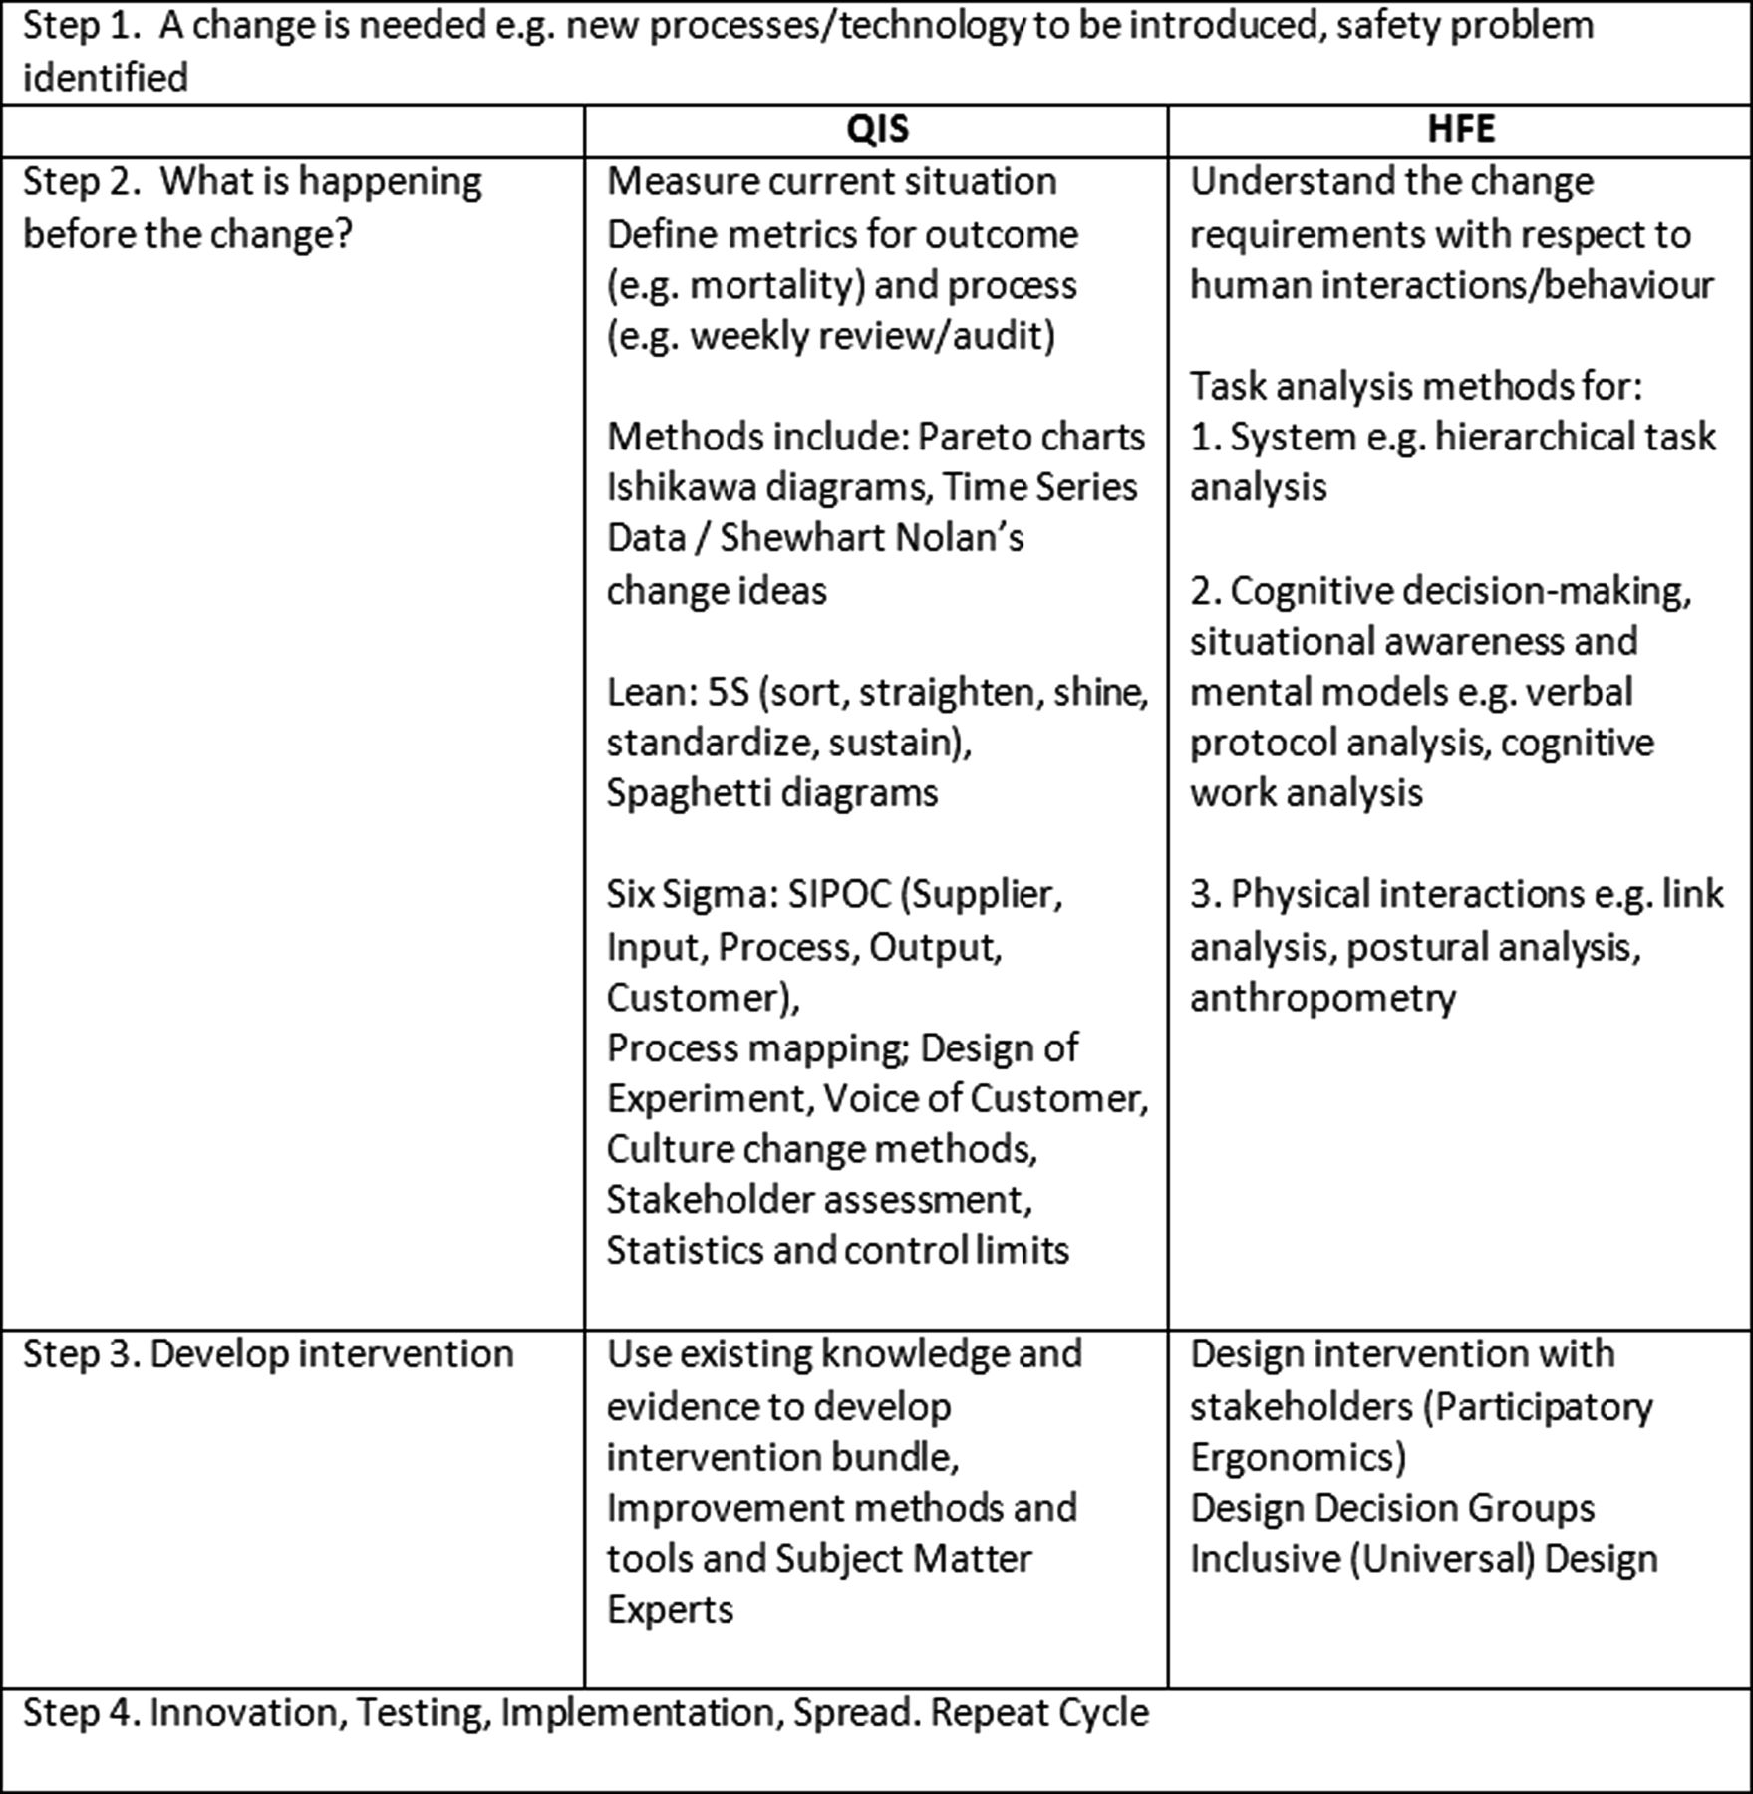

Integrating QIS (quality improvement science) and HFE (human factors and ergonomics) professional practice.
Sue Hignett et al. BMJ Qual Saf 2015;24:250-254
Copyright © BMJ Publishing Group Ltd and the Health Foundation. All rights reserved.
Notes:
This model proposes an approach for integrated working based on an Institute for Healthcare Improvement (IHI) model for Improvement Science11—but could also have used other QIS and HFE frameworks. When a need for change in healthcare is identified, both QIS and HFE projects can be initiated (Step 1). This could be in response to a patient safety event, but it could also be when a new procedure is to be implemented, or a new piece of equipment introduced, or both. In our opinion, the division of Steps 2 and 3 into defining and exploring, design with stakeholders and methods for implementation offers potential for considerable advances in patient safety. The approaches, methods and tools are mostly different so integrating QIS and HFE will provide a framework to:
Explore and define a problem by looking at the humans and the rest of the system (HFE and QIS),
Redesign the tasks, interfaces and system (HFE),
Define the elements of the intervention and process measures (QIS and HFE),
Implement the change using expertise in improvement methodology, facilitation and coaching skills, and recognition and reworking of barriers (QIS and HFE).

Slide 45
So is there a link?
Much can be achieved by exploring how QI and HFE may be used synergistically (Hignett et al. 2015).
HFE, with its understanding of (1) human capabilities and limitations and (2) how humans interact with complex sociotechnical systems, is well placed to identify needs and develop interventions,
The scientific theory informing HFE practice can act as a discipline role model supporting QI as it matures,
while the broad acceptance of QI within healthcare can smooth the way for the arrival of wider HFE use.
a combined approach could explore real-life problems within the context of a complex sociotechnical system, to inform more meaningful design and evaluation of improvement interventions.
Twelve tips for embedding human factors and ergonomics principles in healthcare education – Helen Vosper, Sue Hignett, Paul Bowie (2017)

Slide 46
Want to Learn More?
Human factors and ergonomics and quality improvement science: integrating approaches for safety in healthcare – S Hignett et al (2014)
IHI Quality Improvement Essentials Toolkit: http://www.ihi.org/resources/Pages/Tools/Quality-Improvement-Essentials-Toolkit.aspx
The Health Foundation: https://www.health.org.uk/
NES TURAS: QI Zone - https://learn.nes.nhs.scot/741/quality-improvement-zone
HIS: http://www.healthcareimprovementscotland.org/

Slide 47

Thank you for listening

