Slide 2
Managing Staff Health and Fitness to Reduce Musculoskeletal Injury Risk in the Scottish Fire and Rescue Service
Joseph Passant BSc (hons), MSc, ASCC
Notes:
I work within Health and Wellbeing within a team of comprising of Occ health and fitness professionals my role is to oversee the fitness team
My remit is for managing staff fitness in the SFRS to ensue individuals can safely and effectively undertake their roles
Number of strands to this including routine assessments, staff engagement, self/management referrals broader health promotion within service development of policies and procedures
Ultimately me and my colleagues are there to make staff fitter and healthier to reduce risk associated with poor health and fitness
My background in in sport science and S+C – essentially coaching movement and application/acceptance of force
Injury prevention played a very large role in my previous work with athletes and particularly youth athletes where the focus is on developing physical literacy and robustness to tolerate more demanding training/ competition without injury. More recently this has become a larger part of my role within the SFRS.
I am likely to be approaching injury prevention from a slightly different perspective than others but hopefully this will be of value to you…

Slide 3
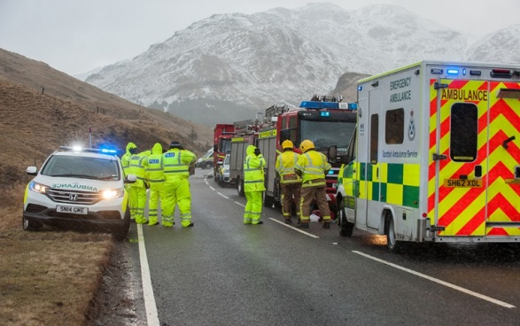
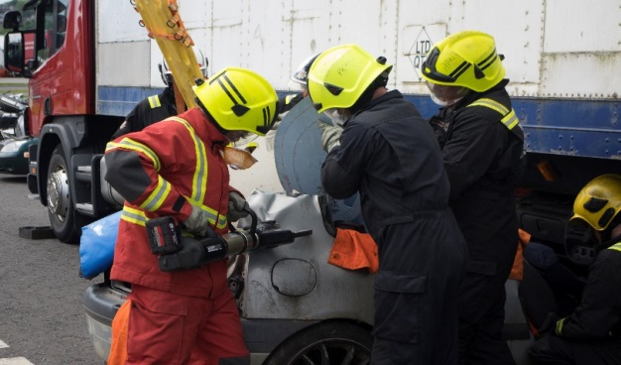
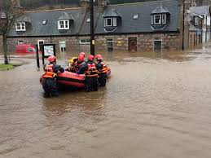
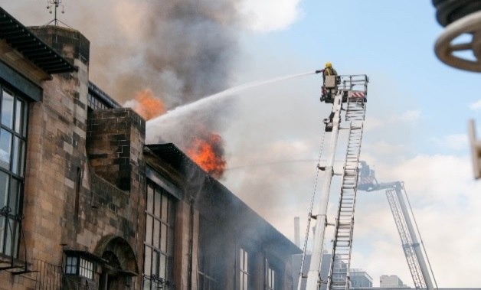
Scottish Fire and rescue Service
Established April 2013
Circa 8000 staff
Staff groups:
Uniformed
Wholetime
Flexi duty
Day duty
Shifts
Retained Duty System
Volunteers
Operations Control
Support
Notes:
What types of activities are undertaken in:
wholetime /rds /volunteers
control
workshops/stores/office based
Broad spectrum of staff groups from very active with frequent participation in physical activity/ lifting handling to almost entirely sedentary office based staff with minimal heavy lifting but generic lifting tasks

Slide 4
Musculoskeletal Injuries in the SFRS
Notes:
Approximately 40-45% of all absence is due to msk injuries
In 17-18 42% of man refs due to msk injury
This has a significant impact on the service so there is obviously a drive to reduce the occurrence of msk injuries and the impact that they have

Slide 5
Musculoskeletal Injuries Risk Reduction Working Group
A cross-directorate musculoskeletal injuries risk reduction working group has been established to prevent occurrence of musculoskeletal injuries in the SFRS
lines of enquiry:
Fleet and Equipment
Bariatric Casualty Handling
Manual Handling Training
Person Centred Preventative Strategies
Notes:
Approximately 40-45% of all absence is due to msk injuries
In 17-18 42% of man refs due to msk injury
This has a significant impact on the service so there is obviously a drive to reduce the occurrence of msk injuries and the impact that they have
I have been involved in looking at preventative strategies. Broad title but the brief I had for this was to look at person centred interventions to reduce risk – it is work stemming form this group and work package that I am going to discuss
Emphasis that this is not all that the service is doing

Slide 6
Musculoskeletal Injuries Risk Reduction Working Group
Improved Data Collection
Who is being injured?
When and where are they being injured?
How are they being injured?
What injuries are they suffering?
Research
Are there any common individual characteristics of those suffering injury?
Design and Implementation of Preventative Strategies
Notes:
Initial data from absence and health and safety and self/management referral reporting could not tell us everything we needed to know about msk injuries suffered
Because of this we chose to improve our own recording of data within health and wellbeing based upon self and management and self referrals – this comprised all work related injuries, any work related injuries that resulted in absence and all other self referrals for physioteherapy – i.e. smaller injuries but that still required intervention
We wanted to know who is being injured, when and where they are being injured what they are doing when they become injured and what injuries they are suffering
We completed a research project to explore what characteristics are associated with injury within our high risk staff groups
Finally we considered the outcomes of both these tasks and identified strategies / interventions that would hopefully minimise the risk of injury
This was only completed at the start of the year so still in process of implementation but hopefully ill outline my vision for what we will be doing

Slide 7
Who is Being Injured?
Notes:
By far the highest rate of injury is within the wholetime staff group
Consider the duration of time spent working rds and vole this is also significant – most rds /vol by definition have fewer responses and only 2-3 hours training a week for rds
Also need to consider the size of the staff group – the rate is important but so is the total number -
And if we combine the rds/volunteer staff groups the uniformed staff group as a whole

Slide 8
When are They Being Injured?
Notes:
Then looked at when injuries were actually suffered – so these are injuries that resulted in absence or are having a sig impact on work
What we see is that the majority of these injuries are not suffered at work / in the SFRS
Further to this the largest group are not directly attributable to a single event such as e.g. non specific back pain other aches and pains etc.
Emphasises the need to look at broader approaches and not than just the specifics of work related tasks and how these are performed or the environments they are performed in
Despite occurring outside of work these still have a large effect on individuals and the service
What influence can we have over injury risk where these occur outside of work?
I felt that this reinforces the value/ need of that line of enquiry – the only constant between injuries suffered both inside and outside work is the individual
Policy procedure / working environment obviously very important in protecting individuals and employers but also need to address the individual and their characteristics

Slide 10
What Injuries are they Suffering?
Notes:
Chart shows all injuries – suffered in work and outwith work
Muscle strains are the primary cause of injury
What we see when looking at work related injuries is that manual handling and body movement injuries are predominantly resulting in muscle strains – whereas slips trips and falls are more likely to result in skeletal injuries – fractures dislocations etc.
Again reiterate that muscle strains and sprains are preventable – muscle strains occur when the muscle is overloaded – if we can develop the strength of muscles it means they will less likely to be overloaded and if we can develop mobility / and coordination of movement it means muscles are less likely to be put into weaker positions where they are likely to become overloaded in the first place.
Again emphasise the need to focus on more than just the working environment and training
From this point we wanted to know what was actually related to injuries the sfrs
Because we have such distinct groups and causes of injury – we have initially focussed on the operational staff group as this is the largest staff group leading to the most referrals and who are most likely to suffer injury

Slide 11
Characteristics associated with injury
Incidence and Severity of MSK Injury
Age
Gender
Role Demands
Aerobic Fitness
BMI
Movement Ability
Physical Activity
Sedentary Activity
What characteristics are associated with MSK injury in other population?
What can be practicably be measured in SFRS and at the time of routine assessments?
Notes:
Following on from this we wanted to explore just what factors are associated with injury in the SFRS
Focus on operational firefighters – as very distinct staff groups within service, this is our largest staff group and the group most likely to suffer injury
Looked at research to see what characteristics are associated with MSK injury in occupational / sporting population and looked to measure these where practicable in the SFRS
All data collection needed to fit into timescales of routine assessments - Considered what could practicably be measured at this time
Not saying these are the only factors that matter or that are related to injury
Limitation in terms of applied research – balance between validity/control/ time and resource demands
Not perfect but aware of limitations and these considered in regard to recommendations
* How did we define injury

Slide 12
Characteristics associated with injury
Incidence and Severity of MSK Injury
Age
Gender
Role Demands
Aerobic Fitness
BMI
Movement Ability
Physical Activity
Sedentary Activity
Incidence of Injury
Self-reported MSK injury in past 3 years
Severity of Injury
Self-reported absence due to MSK injury in past 3 years
Notes:
We looked to identify if there was any association between these factors and self reported injury and absence due to injury in the past 3 years

Slide 13
Characteristics associated with injury
Incidence and Severity of MSK Injury
Age
Gender
Role Demands
Aerobic Fitness
BMI
Movement Ability
Physical Activity
Sedentary Activity
Movement Ability
Functional Movement Screen
Identifies limitations in mobility, stability and coordination of movement in functional movement patterns
Notes:
Already mentioned what I see to be the importance of good movement – looking at mobility, stability and coordiantion etc
So we wanted to measure this
We looked at a number of movement screening tools. There are a number used within sport but these are typically focussed towards a specific injury concern for example using jump/landing assessment to assess knee stability which is associated with ACL injury or can be subjective
I felt the benefit of the fms is that it is assesses movement of the whole body and it is scoring is objective / it has good inter rater reliability – this was important for the research purposes but also for its fair application if we came to adopt this within the sfrs
What is the link between movement and injury
How can this be measured?
Why the functional movement screen

Slide 14
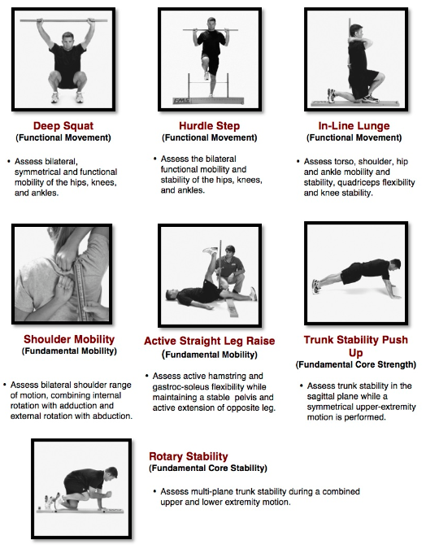
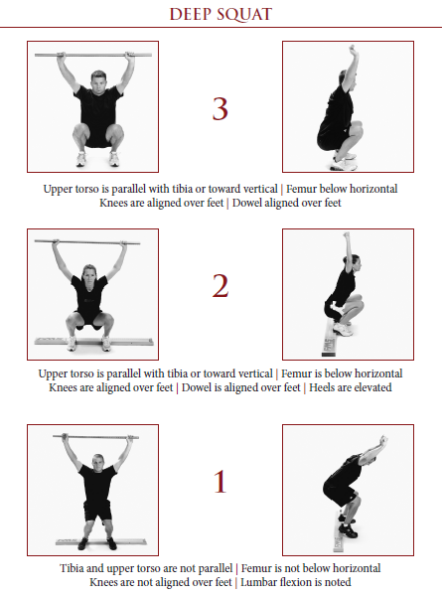
Functional Movement Screen
Notes:
This comprises of 7 different movements looking at functional movement such as squatting stepping and lunging mobility of the shoulder and t spine and hip and trunk stability and anti-rotational stability.
These movement are designed to place people in extreme position to make limitations to movement more obvious
Each of these movements is scored on a scale of 0-3
3 can perform the movement according to instruction
2 can perform the movement with minor compensation / limitations
1 cannot undertake the movement as instructed
0 pain during the movement
Overview of the deep squat
This gives a total possible score of 21
We can also look at the differences in scores between the left side of the body and right – significant asymmetries – differences in mobility and strength have been associated with increased injury risk
This is initially designed as a screen to guide training prescription but there is a body of research looking at the screen and its association with injury
Findings have been mixed across all pops but it has been seen to be associated with injury in firefighting populations which gave further reason for its use
A score of 14 or below is commonly seen as the criteria for being at risk but
Awareness of body/movement
Ability to solve movement problems
Note moving well and this isn’t necessarily about maximum strength just about he mobility and strength to control the body.

Slide 15
Characteristics associated with injury
Incidence and Severity of MSK Injury
Age
Gender
Role Demands
Aerobic Fitness
BMI
Movement Ability
Physical Activity
Sedentary Activity
Role Demands
Firefighters
Supervisory Managers (Crew Managers and above)
Notes:
Is injury risk different for firefighter/supervisory managers – we had seen that this staff group was most likely to suffer injury but wante to look at difference within this staff group
Inferred role demands form their role/rank within the service
We didn’t actually quantify differences in tasks undertaken etc.
Reasonable assumption that FF have more physically demanding roles, grunt work at incidents whereas supervisory managers are more likely to oversee rather than do at both operational incidents and in training and have more administrative tasks whilst on station
Didn’t measure/quantify specific differences in role e.g. types of activity undertaken, postures etc. other than other characteristics measured

Slide 16
Characteristics associated with injury
Incidence and Severity of MSK Injury
Age
Gender
Role Demands
Aerobic Fitness
BMI
Movement Ability
Physical Activity
Sedentary Activity
Self Reported Physical Activity and Sedentary Activity
Time spent sitting on a typical work day
Time spent sitting on a typical non-work day
Time spent in moderate physical activity per week
Time spent in vigorous physical activity per week
Notes:
How do these factors influence injury risk?
*including work related activity i.e. routine drills attendance at incidents etc. not just formal physical activity
Participation in sedentary moderate and vigorous activity has been seen to be associated with injury….
Used modified IPAQ questionnaire
Looked at sedentary activity specifically on both work and non working days

Slide 17
Characteristics associated with injury
Incidence and Severity of MSK Injury
Age
Gender
Role Demands
Aerobic Fitness
BMI
Movement Ability
Physical Activity
Sedentary Activity
Aerobic Fitness
Chester Treadmill Walk Test
Body Mass Index
Notes:
How are these factors linked to injury risk?
Aerobic fitness cardiovascular fitness / stamina / endurance
BMI
Measure of body density
Bad rap – on population level good measure
No just composition that matters – total mass / size associated with risk too?
Higher bmi = heavier therefore forces may be greater, bmi may also be associated with mobility and participation in activity

Slide 18
Outcomes - Functional Movement Screen
P = 0.01
P = 0.06
Poor movement ability increases likelihood of musculoskeletal injury
and / or
Past musculoskeletal injury has led to lasting reduction in movement ability
Notes:
This could mean that injury has caused a long term change in functional movement ability or that functional movement ability increased likelihood of injury or a combination of the two
we need to improve functional movement to prevent injuries and/or we need to ensure appropriate rehabilitation arrangements are in place to prevent lasting changes to functional movement that may influence role performance and/or future injury risk
Those scoring below 14 – highly likely to be injured / absent due to injury
Those

Slide 19
Outcomes - Functional Movement Screen
FMS Exercise Correlation with Total FMS Score
Movement Screen Exercise | R-Value
Deep Squat | 0.75
Hurdle Step | 0.66
In Line Lunge | 0.40
Shoulder Mobility | 0.37
Active Straight Leg Raise | 0.64
Trunk Stability Push up | 0.38
Rotary Stability | 0.43
The Deep Squat Exercise is the best predictor of total movement screen score among the seven individual exercises
Notes:
Needed to consider practicality of application – we were concerned about the time it would take to implement this screen in full due to nature of assessment programmes and resources
We wanted to see in particular if the deep squat was highly correlated with overall performance
Past research had shown this and deep squat movements are also used as a screening tool in other populations – this is due to its requirement for whole body mobility and coordination for successful completion
OH squat was the movement most highly correlated to overall score
Everyone who scored a 0 or 1 had also suffered from MSK injury although this was only a small number of total suffering injuries

Slide 20
Outcomes - Age, Lifestyle and Physical Characteristics and MSK Injury
 | Non - Injured | Injured | Sig.
Number | 66 | 28 | -
Average Age | 41.7 | 43.6 | 0.37
Average BMI | 26.1 | 26.0 | 0.85
Average Aerobic Fitness | 46.4 | 47.4 | 0.59
Vigorous Activity per week | 194.8 | 212.2 | 0.54
Moderate Activity per week | 195.5 | 161.7 | 0.34
Sedentary Activity - Working Days | 157.7 | 221.5 | 0.003
Sedentary Activity – Non Working Days | 134.5 | 171.3 | 0.01
Those who have been absent due to musculoskeletal injury in the past 3 years spend more time sitting on working days than those who have not
This is despite there being no difference in levels of participation in moderate or vigorous physical activity
Notes:
Indication of direction of relationship

Slide 21
Outcomes - Age, Lifestyle and Physical Characteristics and absence due to MSK Injury
 | No Absence | Absent | Sig.
Number | 76 | 18 | -
Average Age | 41.8 | 42.5 | 0.29
Average BMI | 25.9 | 26.5 | 0.54
Average Aerobic Fitness | 46.5 | 47.6 | 0.6
Vigorous Activity per week | 196.7 | 214.4 | 0.6
Moderate Activity per week | 184.5 | 198.5 | 0.75
Sedentary Activity - Working Days | 166.5 | 218.8 | 0.04
Sedentary Activity – Non Working Days | 139.2 | 173.6 | 0.06
Those who have been absent due to musculoskeletal injury in the past 3 years spend more time sitting on working days than those who have not
This is despite there being no difference in levels of participation in moderate or vigorous physical activity

Slide 22
Outcomes – SFRS Role
Senior officers were more likely to have suffered musculoskeletal injury in the past three years
Firefighters and Supervisory managers were equally likely to be absent as a result of musculoskeletal injuries
The only statistically significant difference between these roles was time spent in sedentary activity on working days
 | Firefighters | Supervisory Managers
Number | 68 | 26
MSK Injury | 25% | 42.3%
Absence Due to MSK Injury | 19.1% | 19.2%
Notes:
Participant characteristics
*don’t have full data for all participants
Representative of SFRS

Slide 23
Outcomes - Gender
Males and Females were equally likely to suffer from and be absent as a result of musculoskeletal injuries
The were no other statistically differences between males and females with the exception of BMI
 | Female | Male
Number | 11 | 83
MSK Pain or Injury | 27.3% | 30.1%
Absence Due to Pain or Injury | 18.2% | 19.3%
Notes:
Caution due to female sample size
Sig difference in BMI - females lower
no difference in any other factor
So we were left with 2 positive outcomes – as in associations
Movement ability is associated with musculoskeletal injury
Time spent in sedentary activity is associated with musculoskeletal injury
So we then needed to look at preventative strategies

Slide 24
Preventative Strategies – Movement Ability
All uniformed staff will participate in a movement screen as part of their routing health and wellbeing assessment
Individualised training programmes will be provided to individuals where limitations in movements are identified
Notes:
We have decided to introduce the movement screen into routine assessments
This is despite not being sure of the direction of the relationship
But feel that either way there would be benefit – either from perspective of injury prevention or rehabilitation
We will ask individuals to omplete the deep squat and then dependent on outcome can refer / or complete the full assessment

Slide 25
Preventative Strategies – Movement Ability
Move well then move often
Base fitness training around functional movement patterns
Utilise role specific activities and task simulations within fitness training
Force
Stability
Mobility
Coordination
Notes:
Manual handling / body movements asked of operational firefighters are extremely varied / novel / unique – they will be working on confined spaces footing may not always be level and stable etc.
Our focus is to ensure that individuals have the movement ability to adapt to these situations and to solve movement problems/challenges dynamically to minimise risk as far as possible
For this they need good movement ability - mobility, stability, coordination strength/ muscular endurance
We address training in that manner / order
We will focus on mobility and stability as underpinning/ foundations of good movement then look at coordination and then strength / ,muscualr endurance
What our focus is will be guided by the individual and our observations of their movement ability
In training prescription this doesn’t necessarily mean that all we will do is mobility / flexibility exercises until there is a full ROM the all we will do is stability… but that exercise complexity will be dictated by ability
We can still look to improve strength but need to ensure this is done in movement where individuals are stable / coordinated enough to maintain good posture while ensuring these foundations are developed to allow further progression

Slide 26
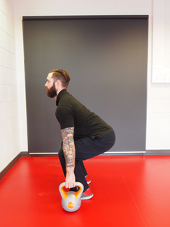
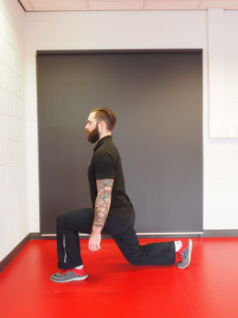
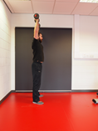
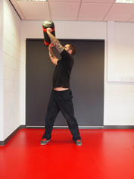
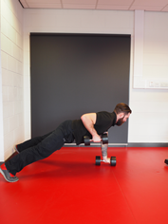
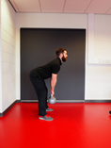
Preventative Strategies – Movement Ability
Move well then move often
Base fitness training around functional movement patterns
Utilise role specific activities and task simulations within fitness training
Notes:
What we need to look at gym based training is the transfer of training effect – and improvements will actually confer benefit on the fireground and other practical situations
The training we prescribe will be based upon: squatting, stepping, lunging, pressing, pulling, trunk stability / anti rotational stability patterns of movement
These are underpinning movement patterns the majority of all practical tasks
This approach is really about developing the individuals capability to adapt to varying movement challenges and giving them the tools to do so
really vision – still new haven't implemented yet but this is what we will do

Slide 27
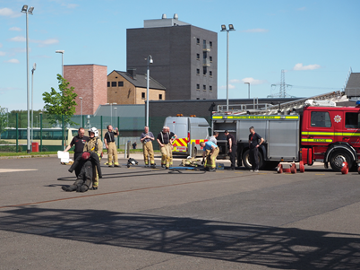
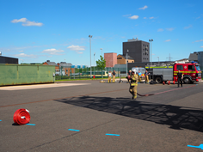
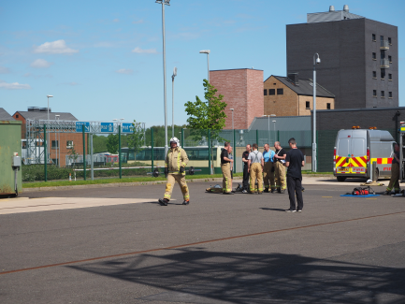
Preventative Strategies – Movement Ability
Move well then move often
Base fitness training around functional movement patterns
Utilise role specific activities and task simulations within fitness training
Notes:
Lastly we want to increase role specific fitness training and actually become more familiar with activities individuals will undertaken
Need to expose to actual movements faced within role,

Slide 28
Preventative Strategies – Sedentary Activity
Raise awareness of health risks of sedentary activity
Consideration to equipment/ design of working environments
Make physical activity / fitness training more accessible
guidance
facilities
time
Notes:
Sedentary activity is a risk factor for msk injury but for cardiac and metabolic disease – people / organisation need to be aware of this
Prevention of this does not necessarily mean participation in exercise but simply a reduction in time spent sitting – no set guidelines
We can look at the design of work environments sit stand desks / exercise work stations etc.
Active commuting – showers – changing facilities, bike storage etc. – bike to work scheme
We can look to remove other barriers to participation in physical activity
can make advice and guidance readily accessible
we can look at facilities for example – physical training equipment – remote stations we can offer guidance on training without equipment or how task simulatins / op equipemtn can be used within training
we can looka t time allocated to fitness training in work routines

Slide 29
Next Steps
What is the direction of the relationships between individual characteristics and injury?
What are the relationships between individual characteristics and injury in other staff groups?
Continue to record and report on musculoskeletal injury data and react to emerging trends
Notes:
Still new – and only retrospective – need continued focuss
Cannot wait – 2-3 years for prospective data to show causation – effect on individuals and service and also ethical issue
If we have reason to believe there is an association we cant do nothing so we needed proceed but can
Look at causation over coming years and will have the benefit of growing data from wider adoption
We can look t causative factors / apply recommendations to other staff groups
We will need to continue to review H+S events and injury/absence data to react to emerging trends

Slide 30
Recommendations
Identify and address limitations in movement
Make health and fitness advice accessible
Access to physiotherapy and rehabilitation services
Raise awareness of the health risks associated with sedentary activity
Encourage physical activity and reduction of work related sedentary activity
Notes:
Quite specific to SFRS
But from this I feel there can be a number of broad recommendations made for other organisations depending on their resources/circumstances
Need to assess movement – at the very least MH training needs a practical component- this should be varied and reflect actual activities individuals are expected to undertake
You can look at making fitness advice accessible – to improve movement / fitness
Access to physiotherapy to ensure appropriate rehabilitation and reduce lasting effects of injuries
Awareness of risks – individual responsibility
Look at working environment – how can you reduce sedentary activity – work breaks – active commuting – equipment desks etc.

Slide 31
Questions?

