Slide 1
OUTLINE:
Different grip options.
Posture/positions:
Shoulder
Elbow
Wrist
Summary of evidence:
Strength v endurance.
Position
Practical exercises
Moving a patient laterally in bed
Move a patient higher up in bed
Other grip considerations
Other Tasks
Considerations for patient

Slide 2
My background:
Moving & Handling for over 10 years
Commercially
Community
Physiotherapist for 15 years
Martial Arts for 20 years
Personal Objectives:
Bringing together principles from martial arts, anatomical & physiological knowledge and evidence based practice to improve moving and handling.
Objectives of this presentation:
Combining what we know about grip from evidence based practice, anatomy and physiology with some insight from grips in martial arts.

Slide 3
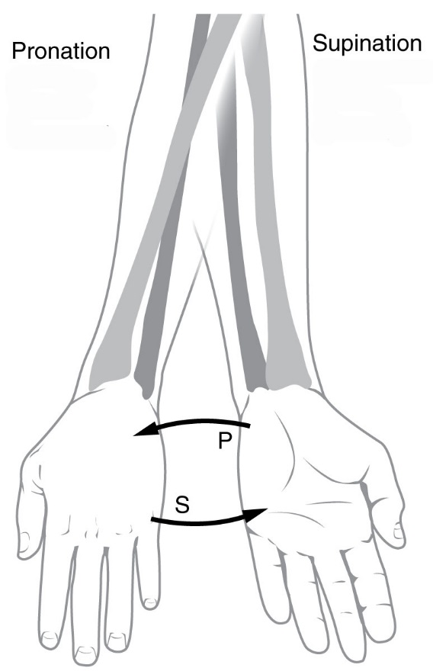
Hand/Forearm position
supination, (what’s up)
Neutral (neither up nor down)
Pronation – rest your hands ON.
Wrist position – flexion, extension, ulnar & radial deviation.
https://commons.wikimedia.org/wiki/File:Pronation_and_supination.jpg

Slide 4
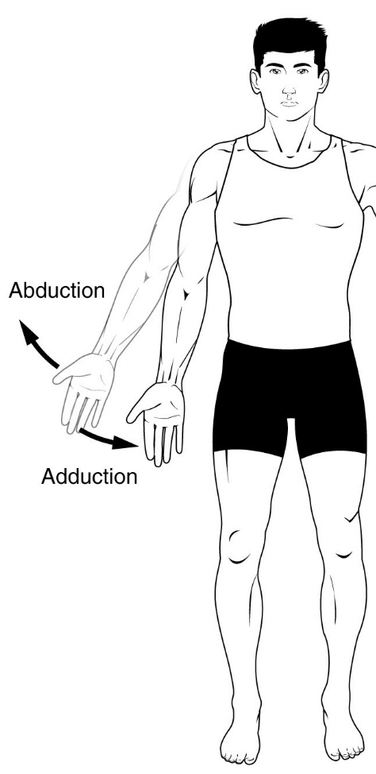
https://commons.wikimedia.org/wiki/File:Ab_add_and_circumduction.jpg

Slide 5
https://en.wikipedia.org/wiki/Anatomical_terms_of_motion#/media/File:FlexsionExtension2017.jpeg

Slide 6
Key Points | Citation
Changing Muscle Length affects muscle force capacity, & linked to upper limb posture. | Shyam Kumar, A.J., Parmar, V., Ahmed, S., Kar, S., & Harper, W.M. (2008). A study of grip endurance and strengh in different elbow positions. J Orthop Traumatol, 9: 4: pp209–11.
Peak grip strength: -Shoulder abduction 0 degrees -Elbow 135 degrees -Wrist in neutral position. | Kattel, B. P., Fredericks, T. K., Fernandez, J. E., & Lee, D. C. (1996). The effect of upper-extremity posture on maximum grip strength. International Journal of Industrial Ergonomics, 18(5-6), 423-429.
- Grip endurance decreases with upper arm abduction. - Grip endurance increases the closer the grip is to neutral. - Inward rotation & humeral forward flexion results in WMSDs. | Farooq, M., & Khan, A. (2012). Effect of elbow flexion, forearm rotation and upper arm abduction on MVC grip and grip endurance time. International Journal of Occupational Safety and Ergonomics, 18(4), 487-498.
Upper arm flexion of less than 90° results in injuries when packing pencils. Peak strength at 0° abduction, elbow at 135° & neutral wrist position. | Coury HJCG, Kumar S, Rodgher S, Narayan Y (1998). Measurement of shoulder adduction strength in different postures. Int J Ind Ergon. 22: 3: pp195–206
There is a weak but definite correlation between eye movement and EMG readings in the neck and shoulder. | Biguer, B., Jeannerod, M., & Prablanc, C. (1982). The coordination of eye, head, and arm movements during reaching at a single visual target. Experimental brain research, 46(2), 301-304.
We must allow for greater grip strength to increase the safety margin in case we have unanticipated forces or slips (when working with tool) | Johansson H, Sojka P. Pathophysiological mechanisms involved in genesis and spread of muscular tension in occupational muscle pain and in chronic musculoskeletal pain syndromes: a hypothesis. Med Hypotheses. 1991;35(3):196–203.
Supine grip activates antierior deltoid & with less trapezius activity. Prone grip, has more trapezius activity (although still less than anterior deltoid). | Bagchi, A., & Raizada, S. (2016). Electromyographical investigation of anterior deltoid and trapezius muscles during three different variations of front raise. International Journal of Physical Education, Sports and Health 3: 6: pp56-59

Slide 7
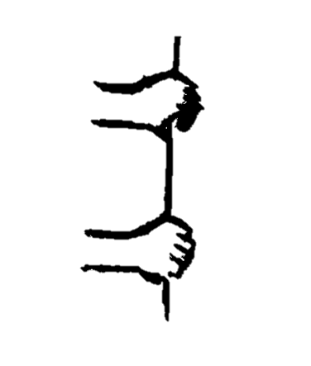
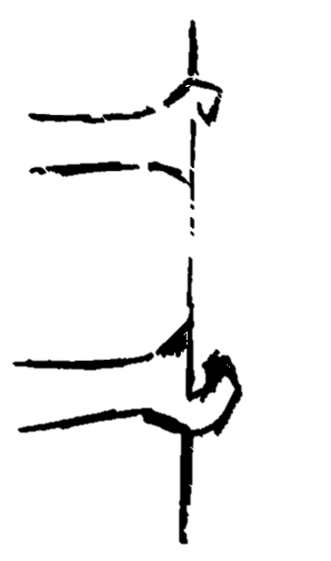
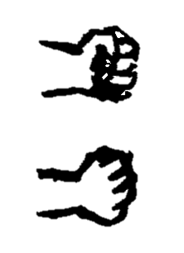
PRONE
SUPINE
NEUTRAL

Slide 8
LATERAL
PRONE
SUPINE
NEUTRAL

Slide 9
HIGHER IN BED
PRONE
PRONE
SUPINE
NEUTRAL

Slide 10
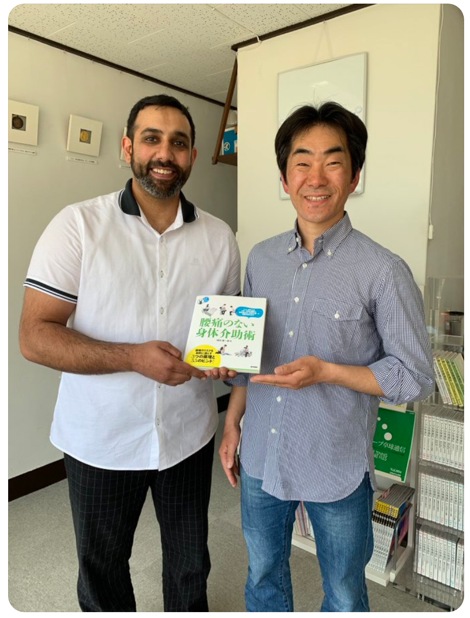
Grip
Okada-san has a philosophy for living everyday life with an approach based on ancient principles of movement. These principles can be used for working at low heights (such as when living on tatami mats), how we stand from the floor, in walking and also in helping others to move. Patient handling is an important consideration for Okada-san, and he advised using an even pressure through the hands and feet when working with patients.
No Grip – hands down lateral
No Grip – hands up lateral
No Grip – higher up in bed

Slide 11
Questions & Final thoughts?

Slide 12
Questions & Final thoughts?
Thank you for your time

Slide 13
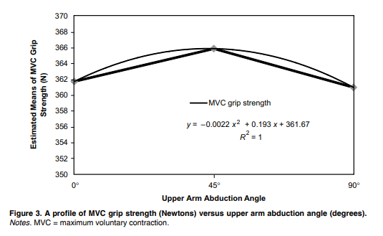
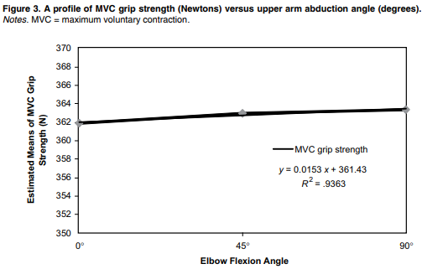
Farooq, M., & Khan, A. (2012). Effect of elbow flexion, forearm rotation and upper arm abduction on MVC grip and grip endurance time. International Journal of Occupational Safety and Ergonomics, 18(4), 487-498.

Slide 14
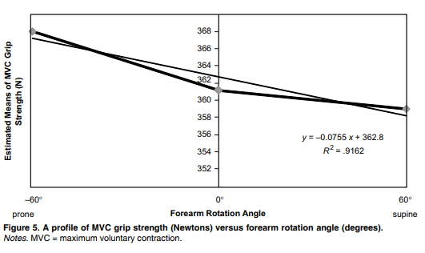
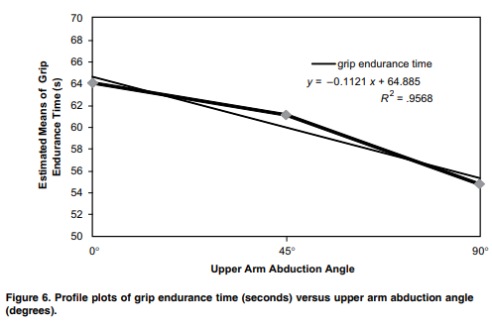
Farooq, M., & Khan, A. (2012). Effect of elbow flexion, forearm rotation and upper arm abduction on MVC grip and grip endurance time. International Journal of Occupational Safety and Ergonomics, 18(4), 487-498.

Slide 15
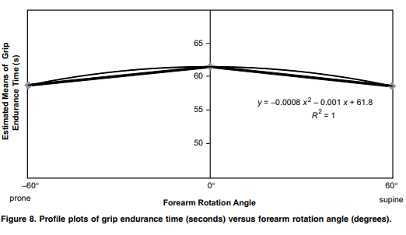
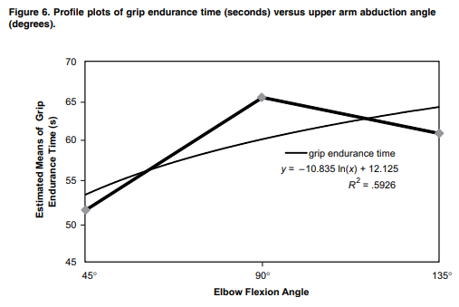
Farooq, M., & Khan, A. (2012). Effect of elbow flexion, forearm rotation and upper arm abduction on MVC grip and grip endurance time. International Journal of Occupational Safety and Ergonomics, 18(4), 487-498.

