Slide 1
Implementing the Passport System into Leonard Cheshire Disability
Caroline Redford National Back Care Advisor

Slide 2
The Different Settings We Work In
Supported Living
Support at Home
Care Homes with and without Nursing
Day Services
Short Breaks & Leisure
Notes:
2
We have 41 services across Scotland offering a range of different support settings. Each of these has unique challenges, in supported living and Support @ Home we work closely with other agencies to ensure the correct equipment is available.
In traditional care home settings we have more autonomy but this brings its own challenges of ensuring staff know what equipment is and s not suitable.
At our holiday cottage every week can bring a new challenge as people come from across Britain to relax and unwind, staff here need to flexible and adaptable to meet individual need

Slide 3
Introducing the Passport
Location(s)
Communication
Staff Engagement
Notes:
We had to find ways of introducing a new system into a number of small services across a large geographical area,
Communication was the key but we found this just wasn’t working, a lot of our staff are not regular computer users so e-mailing all services had limited effect
Spreading the word of the passport has been difficult, many staff are still unaware that it has been introduced into the organisation,

Slide 4
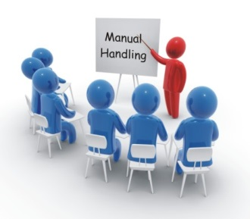
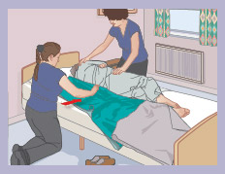
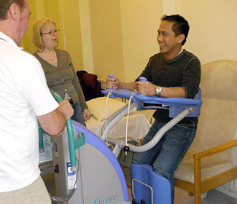
Providing Manual Handling Training
Advanced Manual Handling Skills Instructors
Manual Handling Skills Instructors
Updating existing Instructors
Monitoring Training
Notes:
4
Ensuring that key personnel are trained to carry out practical handling training to the standard required and how this is monitored.
We have worked hard in the past 9 months to increase the number of Manual Handling Skills Instructors within the organisation, whilst at the same time ensuring current instructors have been updated to the new framework.
All new instructors are observed delivering in practice preparing to introduce a system of observation for all existing instructors

Slide 5
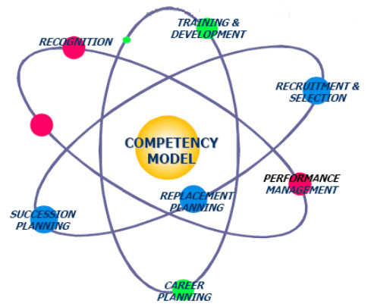
Competency Based Framework
Staff are sceptical
Instructors are apprehensive
Notes:
5
Introducing a competency based framework to a sceptical workforce. Staff have never really been assessed for competency before, it is a learning curve for everyone.

Slide 6
Spreading the Passport Practice
Implemented in all 4 Countries of the UK
Notes:
6
Taking good practice from Scotland and implementing it across the UK. We have decided to implement the passport framework across all of our services within the UK not just Scotland.

Slide 7
Thank You for Listening – Any Questions?

