Slide 2
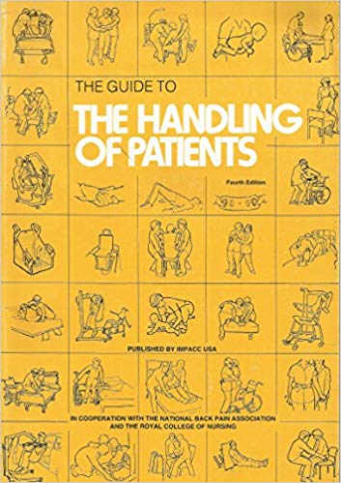
First edition 1981
(red)
Second edition 1987
(turquoise)
Third edition 1992
(yellow)
Fourth edition 1997
(green)

Slide 3
HOP 5
2005

Slide 4
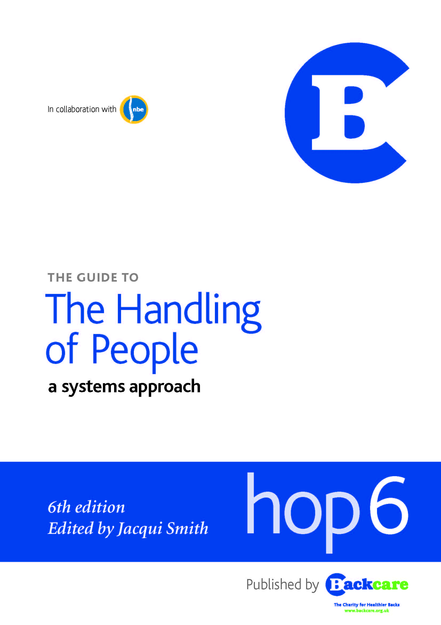
HOP6
2011

Slide 5
Editorial team and authors recognised as experts and innovators in the field of person handling and volunteers!
Evidence-based
Peer Reviewed
Sets a standard for best practice in the UK – and hence for the Courts
Internationally endorsed as the gold standard

Slide 6
Who is it for?
Moving and Handling Practitioners / Trainers
Needs Assessors
Risk assessors
Decision-makers
Budget holders
Policy makers
All staff working in health and social care and the emergency services who may be directly or indirectly involved in moving and handling &/or MH decision-making
Educators in universities and colleges of FE
Legal profession & expert witnesses
Potentially, every user of health / social care services

Slide 13
Format of practical chapter
Context and Reasoning
Person Ability
Environment and Equipment Considerations
Methods and Variations
Precautions and Considerations

Slide 25
Summary and Thanks

