Slide 1
Scottish Manual Handling Forum HSE - Update
Elizabeth Warren
Health and Social Care Services Team
Engagement and Strategic Interventions Directorate
May 2016

Slide 2
Overview of topics to be covered
HSE Strategy
Regulation changes
Statistics – health and social care
Recent prosecutions
Recent work on manual handling
Future work

Slide 3
Strategy - Helping Britain Work Well
Six themes:
Acting together
Tackling ill health
Managing risk well

Slide 4
Helping Britain Work Well
Supporting small employers
Keeping pace with change
Sharing our success
#HelpGBWorkWell

Slide 5
Regulation changes - CQC
Changes from April 2015 – enforcement of patient care by CQC
HSE - staff and others
Patient RIDDOR still reported to HSE

Slide 6
Regulation changes - Scotland
Revised Liaison Agreement signed between HSE, CI and Scottish LAs
Available on HSE website
http://www.hse.gov.uk/scotland/pdf/liaison-agreement-1215.pdf
The Agreement does not change the fundamentals of how we operate
http://www.hse.gov.uk/healthservices/arrangements.htm#a1
Partnership on Health and Safety in Scotland (PHASS)

Slide 7
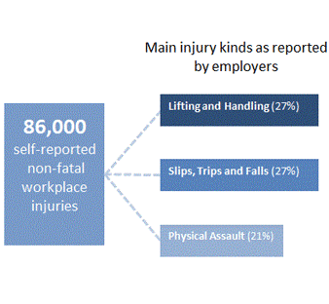
Statistics – health and social care

Slide 8
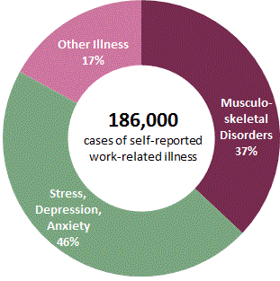
Statistics

Slide 9
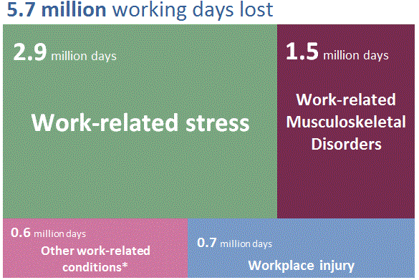
Statistics - health and social care
http://www.hse.gov.uk/Statistics/industry/healthservices/index.htm

Slide 10
Moving and Handling Reported event types slide courtesy of MHRA – copyright protected

Slide 11
Moving and Handling - alert

Slide 12
Prosecutions Fall from bath hoist
87 year old man being bathed
Slipped from bath hoist and fell approx. 3 feet.
Trust fined £107000 Costs £25000

Slide 13
Prosecutions Fall from hoist
100 year old lady fell from hoist
Being moved from chair to bed
Individual director prosecuted as well as the company
Director fined £150,000 Costs of £100,000
Company fined £50,000 Costs of £36,992.24.

Slide 14
Prosecutions Patient falls
4 patient deaths in NHS hospital
3 were caused by patient falls
Trust fine £500,000 Costs £35,517.34

Slide 15
Learning points from incidents
Communication
Care plans
Implementation
Management
Training

Slide 16
Other health care prosecutions
Mobility scooter
Choking
Scalding x 2
Legionella
Suicide
Corporate manslaughter of a care home

Slide 17
Moving and Handling
L23 Manual Handling Operations Regulations 1992 - guidance on Regulations under revision
Birthing pools
Sonographers

Slide 18
Future issues
Stress
Mental health/control and restraint/violence
Dermatitis
Electromagnetic fields – new Regulations
HSE guidance
http://www.hse.gov.uk/healthservices/index.htm

Slide 19
Future issues
What are your concerns regarding moving and handling?

