Slide 1
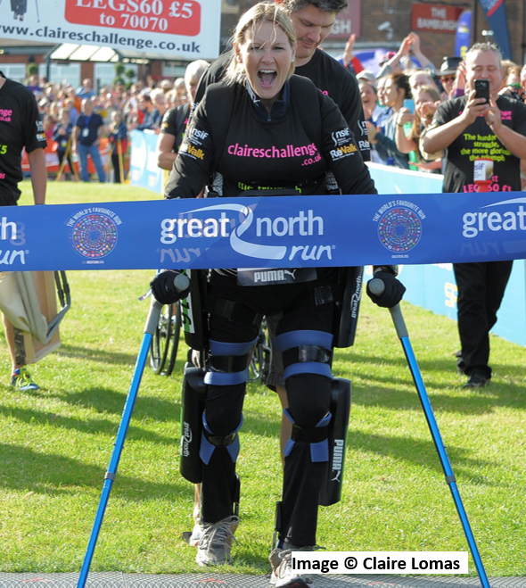
Claire Lomas MBE

Slide 2
https://www.youtube.com/watch?v=Omjr7lfJhIs

Slide 16
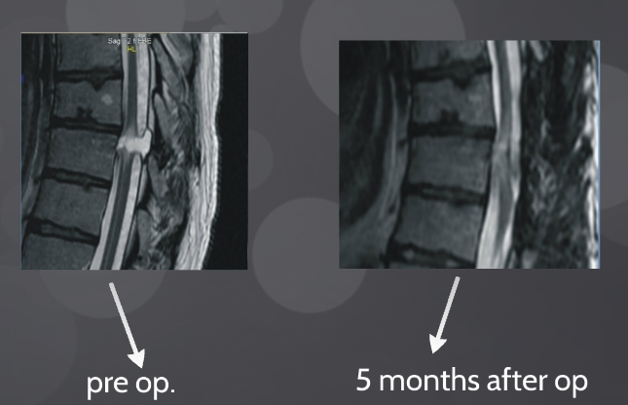

Slide 17
https://youtu.be/0JE2muePb08

Slide 18
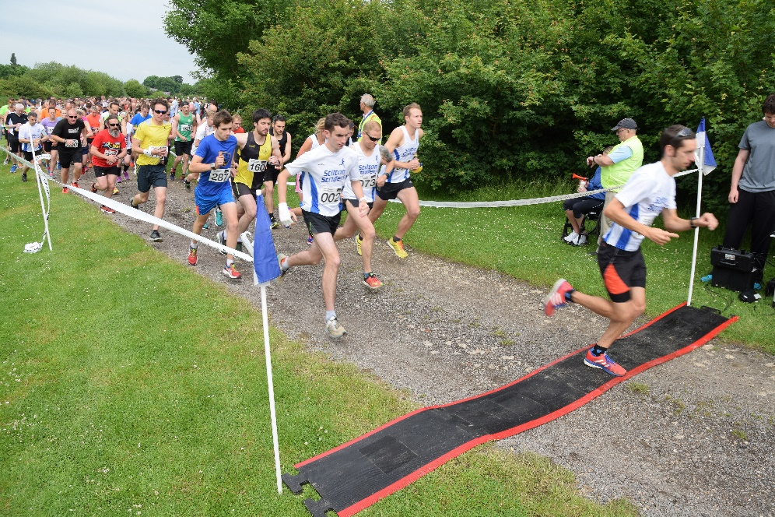
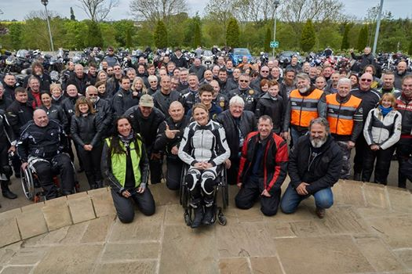
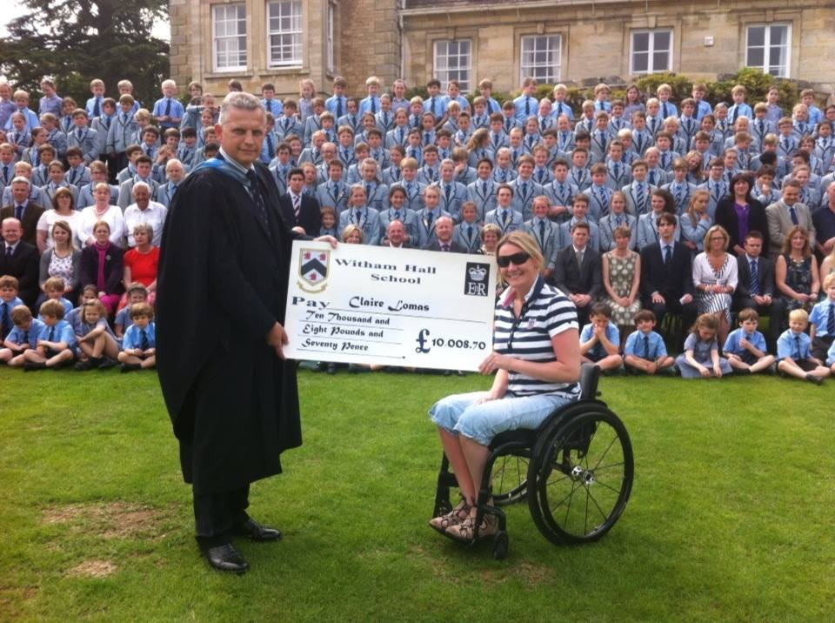
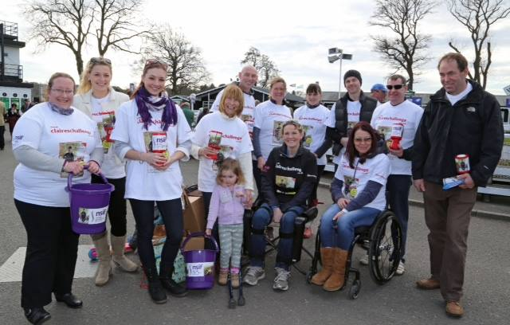

Slide 19
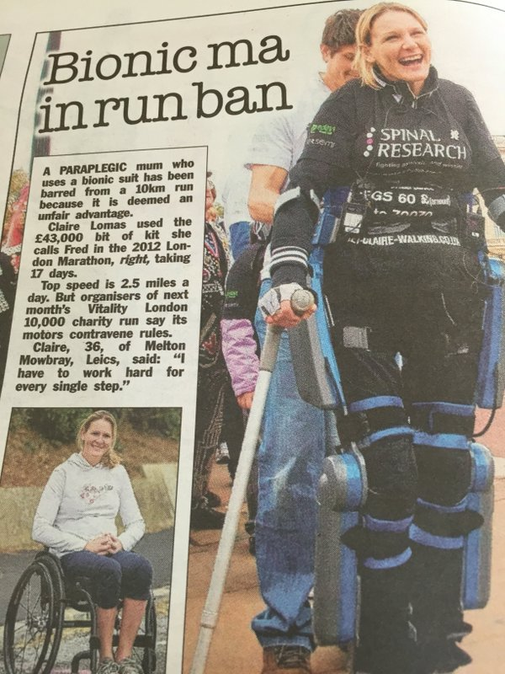
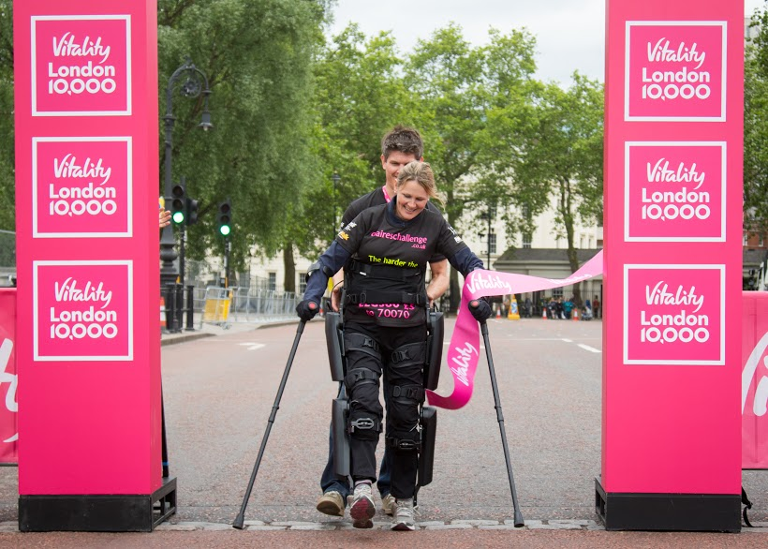
Vitality London 10k in a day
https://www.youtube.com/watch?v=1nhKkOIrNwg&t=43s

Slide 22
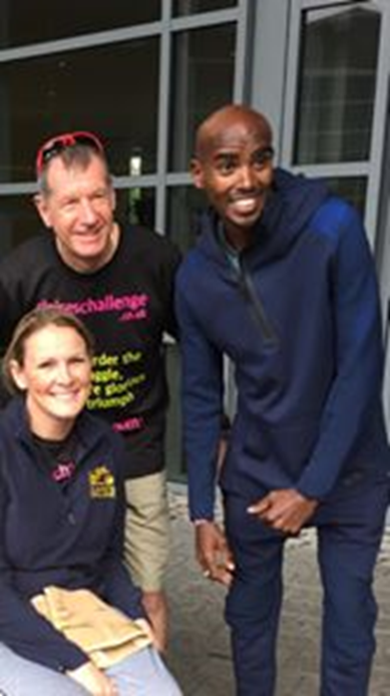
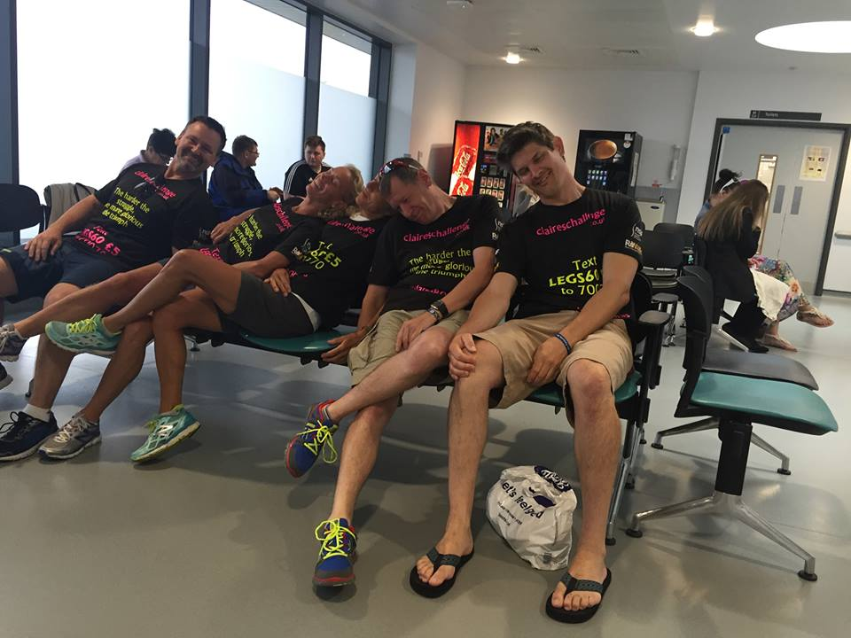

Slide 23
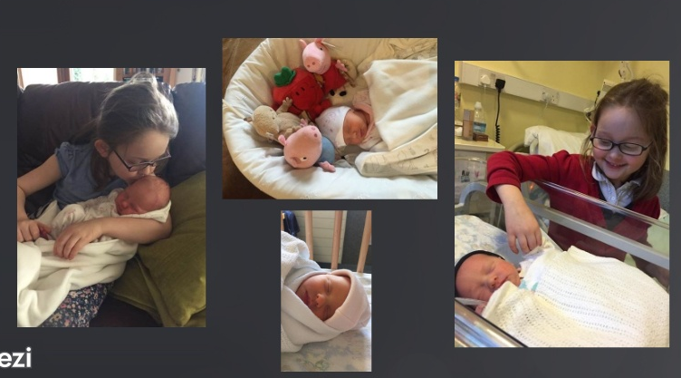

Slide 25
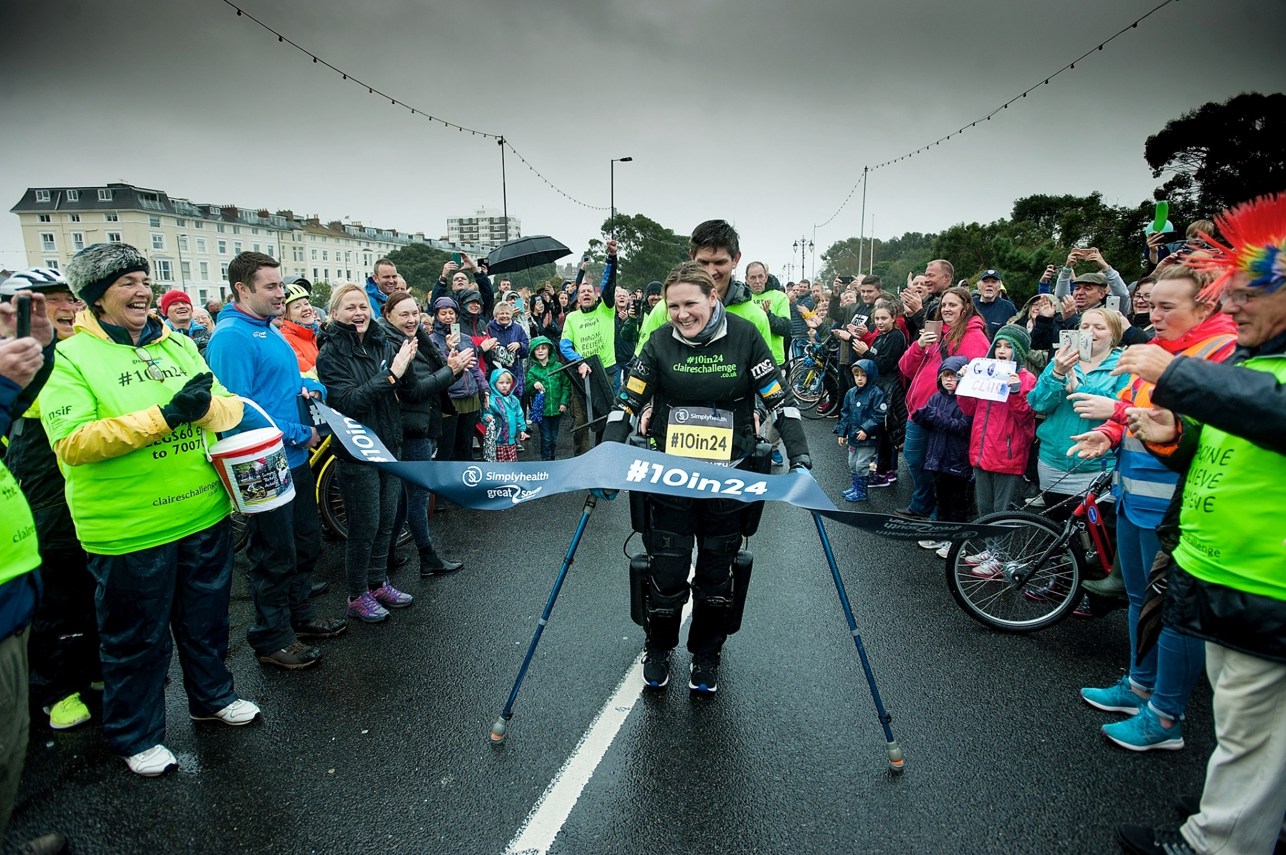
https://m.youtube.com/watch?v=0EOz9Yq1Zao

Slide 26
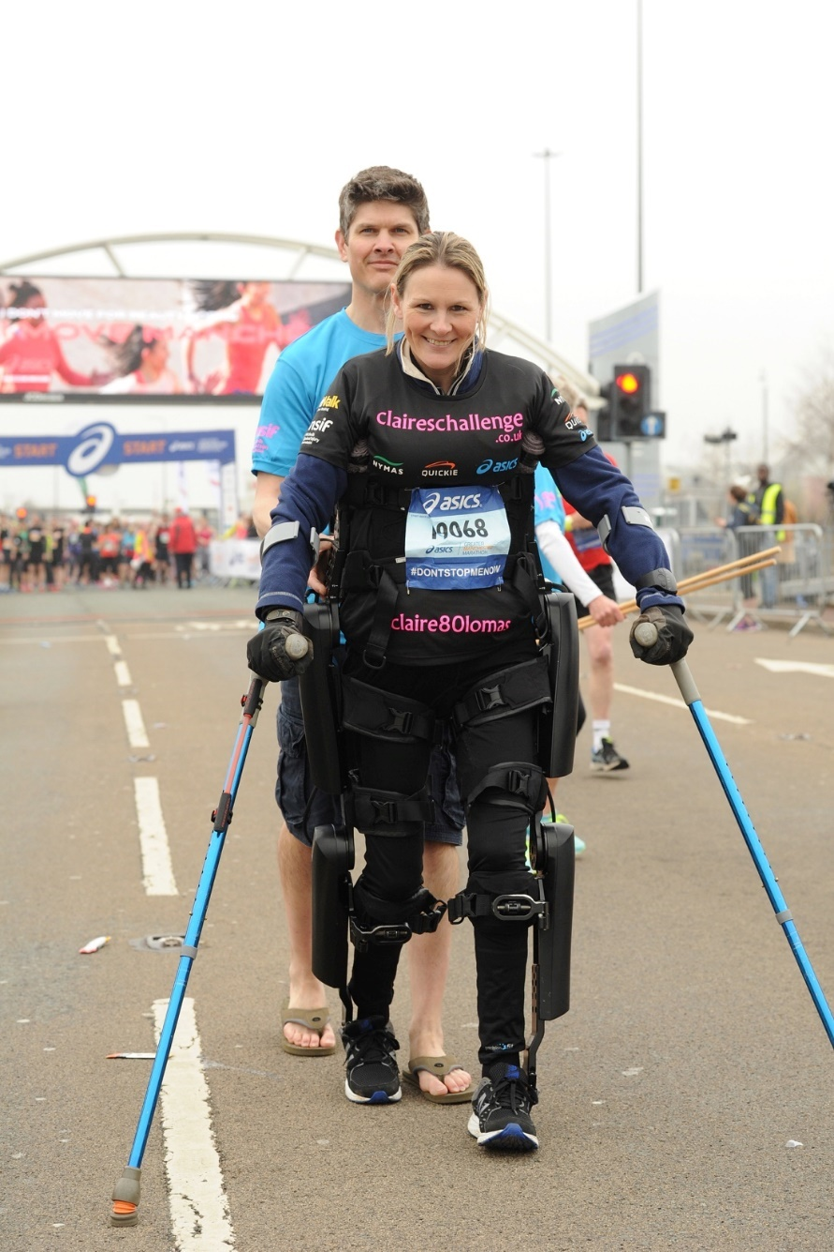
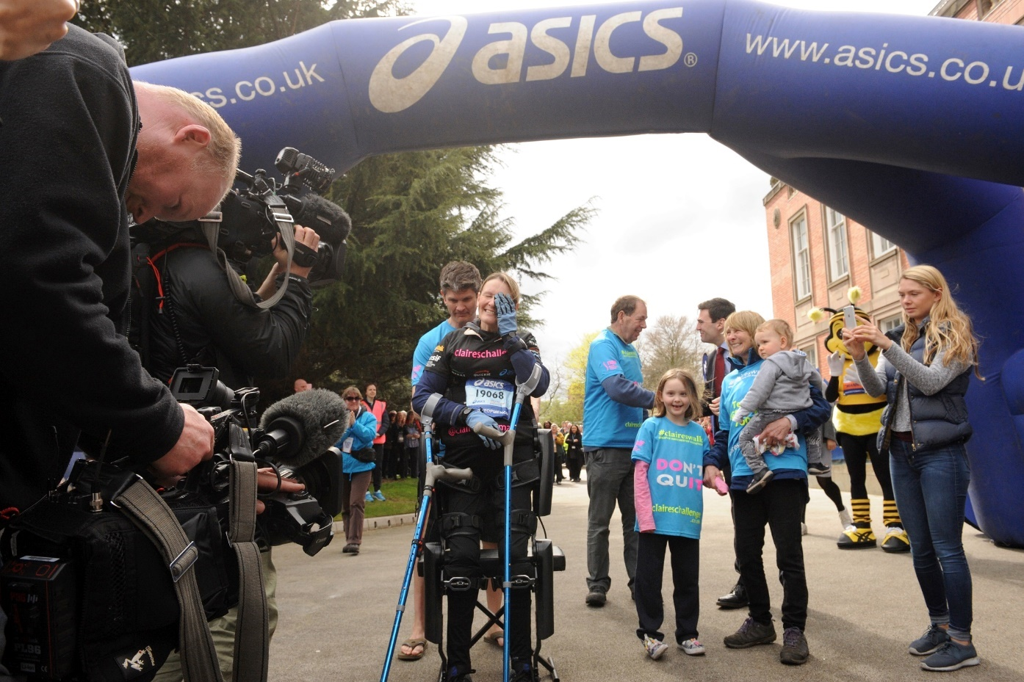

Slide 28
https://youtu.be/zb3rB97iaOI

