Slide 2
BARIATRIC: WHY SEATING MATTERS

Slide 3
Obesity is now recognised as a worldwide epidemic
In 2010, 42% of men and 32% of women in the UK were classed as overweight (EPUAP)
The government project that by 2050 60% of men and 50% of women could be clinically obese
In the past 20 years there has been an increasing number of bariatric clients which presents a significant challenge to healthcare providers who must ensure they provide care and equipment which is safe for both clients and staff

Slide 4
Assessment of the Bariatric Client
Very little literature or training available for this area of seating and positioning. It is a relatively new addition to our case loads
In 2010/11, there were 8,087 weight-loss stomach operations in England's hospitals, up from 7,214 in 2009/10, according to data from the NHS Information Centre
The report highlights around a 30-fold increase in the number of people going under the knife in the last decade, from just 261 weight loss operations in 2000/01
Education and research has not kept up with this challenge

Slide 5
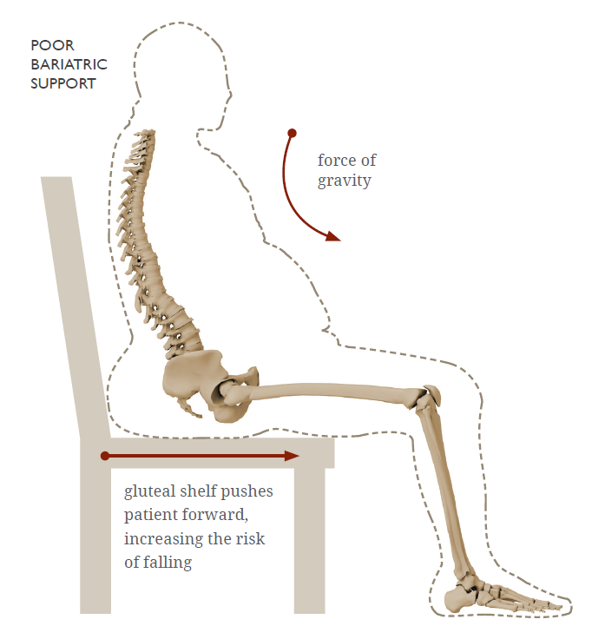
Assessment of the Bariatric Client
Accommodating the larger clients in a chair is not just about getting a wider chair
This client group have unique challenges in sitting and have unique body shapes
Assessing these needs will almost always require at least two people to have accurate measurements

Slide 6
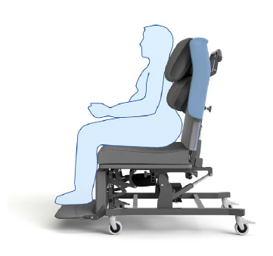
Factors to consider in bariatric seating
Reduced range of motion due to mass of body parts. Body parts e.g. legs and arms can be very heavy
Altered centre of gravity: Generally speaking the centre of gravity is more forward in the bariatric client. Tilt is space facilitates a better posture for these clients while maintaining function
Bulbous gluteal region (excess buttock tissue) which reduces the ability to make contact with the seat back. If bulbous Gluteal region is not accommodated the client is forced to sit is a PPT, causing back pain and sliding out of the chair

Slide 7
Factors to consider in bariatric seating
Increased risk of pressure ulcers
Slower and impaired wound healing
Reduced mobility and reduced ability to stand transfer
Breathing difficulties - a larger number of these clients do do like to lie down and therefore are very dependent on their chair.
Getting the chair right is imperative

Slide 8
FACTORS TO CONSIDER WHEN MOVING THE BARIATRIC CLIENT
Body shape
Large body mass
Centre of gravity shifts
Decreased balance
Poor sensation in feet
Unable to see feet
Reduced ability to move joints
Reduced strength and endurance
Tire easily
Need more space
Limited bending at knees and hips
Breathless

Slide 9
HIP FLEXION
Measuring hip flexion in the Bariatric client is challenging due to the excess tissue.
By using the back angle recline on the chair we are accommodating any possible hip flexion restriction and reducing the hip abduction.
This will necessitate some ‘trial and error ‘ in order to get it as accurate as possible.
KNEE FLEXION/EXTENSION
Accommodation of tight hamstrings is necessary to prevent the client from sliding of the chair, however with the obese client the restriction in knee flexion may be due to excess tissue.
This must be accommodated in the chair to avoid pressure ulcers. Adjustable leg rest is imperative for this client group.

Slide 10
SEAT WIDTH\FOOTREST WIDTH
Seat width and footrest width are always considered together.
Ensure the width of your hand can fit comfortably between the lateral aspects of the clients thigh and the armrest, to reduce the risk of shear or friction.
When measuring use a wood guide to assist with accurate measurements

Slide 11
Pressure ulcers and skin damage represent a preventable and serious health threat to bariatric clients…
It is estimated that by 2050 obesity related diseases and complications will cost an extra £45.5 billion a year

Slide 12
Bariatric clients are at an increased risk of skin breakdown particularly:
Between folds of skin
Across the buttocks
Other areas of high adiposity (fatty tissue) and reduced vascularity (Sturman-Floyd 2013)
Skin damage may also develop in locations where tubes, such as oxygen and catheters have been compressed (EPUAP)
Lateral aspects of knee
Lower leg
Notes:
Sturman-Floyd, M., 2013. Moving and handling: supporting bariatric residents. NRC, 15(6): 432-437
European Pressure Ulcer Advisory Panel and National Pressure Ulcer Advisory Panel. 2009. Prevention and treatment of pressure ulcers: quick reference guide. Washington DC: National Pressure Ulcer Advisory Panel.

Slide 13
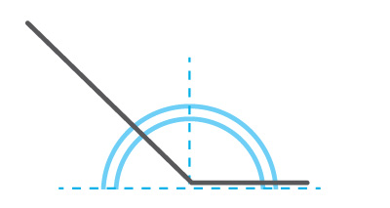
Specific seating features to consider
Arms - should be removable this always for ease of transfer or application of sling
Adjustable backrest - to accommodate various body shapes (bulbous gluteal region)
Back angle recline – to accommodate hip flexion
Forward tilt - to assist with stand transfers
Negative angle leg rest setting - to accommodate legs & assist in stand transfer
BACK ANGLE RECLINE

Slide 14
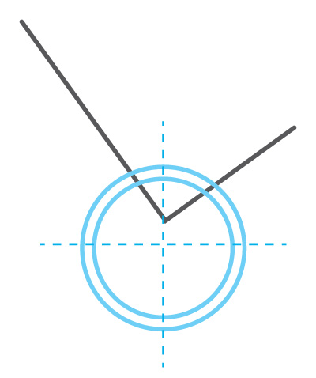
Specific seating features to consider
Powered adjustment - for ease of moving and handling
Tilt in Space – to facilitate pressure redistribution
Vapour permeable/breathable material - to reduce microclimate & moisture on the skin surface
Is the clients weight stable - history of weight needs to be obtained
TILT IN SPACE

Slide 15
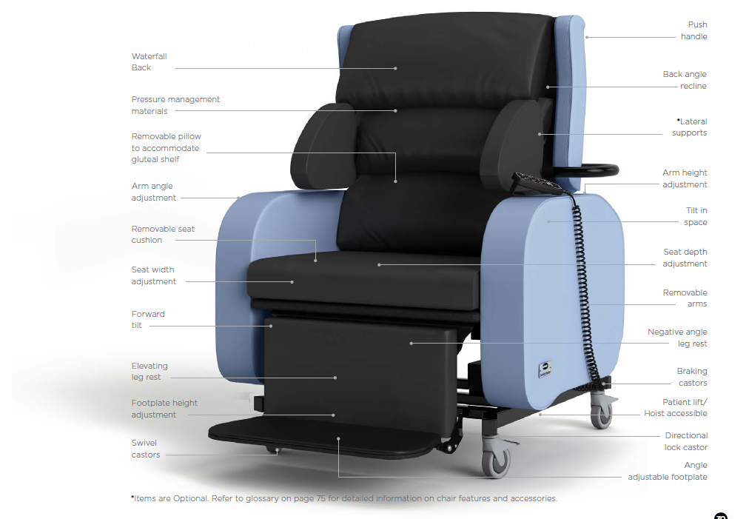
BARIATRIC sORRENTOTM
Safety.
Pressure
Management.
Independence.
The Bariatric Sorrento™ was designed to help seat bariatric patients by using improved postural support and repositioning, while reducing the risk of injury to the patient and staff alike.
Notes:
The Bariatric Sorrento has been designed with the complex needs of bariatric clients and their carers in mind and designed to improve comfort, posture, pressure management and moving and handling for bariatric clients.

Slide 16
The world’s only bariatric tilt in space chair

Slide 17
Bariatric case study - LEN
Stroke sufferer approaching 400lbs (~28 stone).
Spent most of day in bed.
Using the Bariatric Sorrento, Len can:
Get from bed to chair safety.
Tilt and recline himself, becoming more functional - improving his quality of life and reducing strain on caregivers.
Spends most of his day in his chair.
Notes:
Link to full blog: http://blog.seatingmatters.com/bariatric-wheelchair-aids-stroke-victim-recovery

Slide 18
Bespoke Mobile Options

Slide 19
Bespoke Lift and Recliners

Slide 20
Evolution Healthcare Limited Scotland
Lewis Seaton – Seating and Postural Advisor 07525814962
Kevin Seaton – Seating and Postural Advisor 07720739970
Head Office 02887727855
www.Evolutionhealthcare.co.uk

