Slide 1
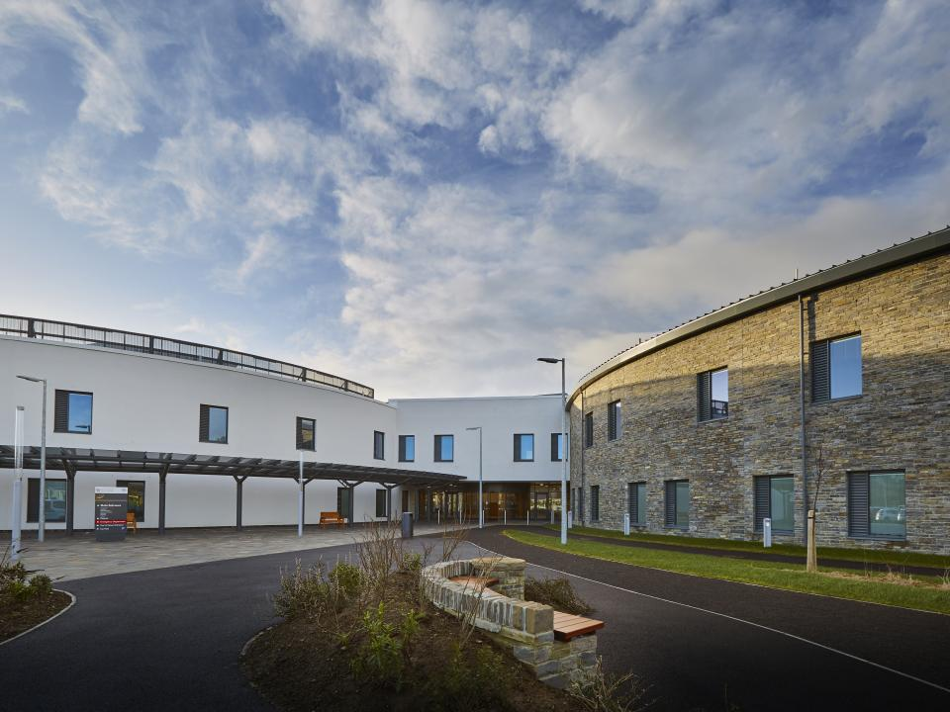
NHS Orkney
What we are learning with HSE
Tony Miller
Manual Handling Trainer

Slide 2
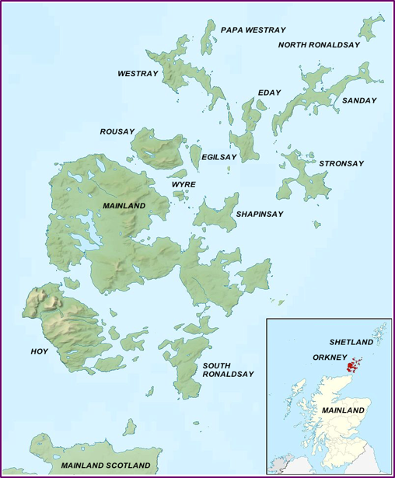
NHS Orkney is situated on the Mainland of Orkney just off the north coast of Scotland. Orkney has a Population of approx 20,000 which is spread over the Mainland and 12 of the other Islands, 9 of these islands are covered by GP practices or Advanced Nurse practitioners.

Slide 3
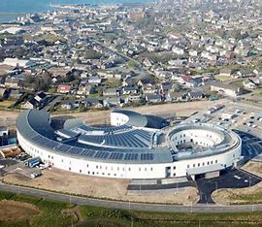
NHS Orkney is the one of the Smallest board in Scotland employing around 700 staff across all disciplines. In June 2019 we moved into the recently completed 48 bed hospital, “The Balfour”

Slide 4
October 2021 saw the first contact with the health and Safety executive

Slide 5
4 HSE Inspectors arrived to look at Manual Handling and the Management of Violence and Aggression.
During their visit, the HSE inspectors identified that NHS Orkney was not compliant with some of its duties in both areas and improvement notices were issued.

Slide 6
The Improvement Notices were short, concise, and explained the issues found by the inspectors, they gave reasons for their decisions, and also gave suggestions to address the failings raised.

Slide 7
How did we get here?
Key posts had been vacant for a time.
Decisions around the delivery of training while managing Covid 19 outbreak.

Slide 8
How did we work towards addressing the issues
We:
Initiated an action plan and had regular meetings to review and manage the work.
Sought help from specialists, and colleagues from other Health boards.
Reviewed and amended our policy and procedures where needed.
Designed new training plans to ensure compliance.

Slide 9
We also devised a plan to show how we were able to meet our legal responsibilities in the future.
The major difficulty for us was trying to achieve attendance at Manual Handling training.

Slide 10
Thank you!
All staff who went the extra mile to get NHS Orkney back on track.

Slide 11
Improvement Notices Closed 29 September 2022

Slide 12
Make sure you include all relevant staff in conversations around rectifying issues raised, you will get a better picture to enable more informed solutions.
Don’t be afraid to ask for support from outside your organisations, New Ideas and differing experience makes all the difference.

Slide 13
The Health and Safety Executive are also there for advice. Keep in communication with them.
Don’t be afraid to ask for more time to meet deadlines if you can justify it.

Slide 14
Inspection programme
The Health and Safety Executive ran a 4-year inspection programme which was carried out throughout Scotland between 2018 and 2022. It identified a number of key findings and recommendations for the management of risks from workplace violence and aggression (V&A) and musculoskeletal disorders (MSDs) in the NHS.

Slide 15
The recent report on the inspection programme identified management failings across Scotland in 4 broad areas:
Risk assessment
Training
Roles and responsibilities
Monitoring and review

Slide 16
Thank you for your Time
Tony Miller
Manual Handling Trainer
NHS Orkney
Tony.miller2@nhs.scot

