Slide 1
H
P
M
A
N
U
A
L
N
S
D
S
L
P
I
O
N
R
Scottish Manual Handling Passport Scheme
G
T
Review Group – Sarah Crawshaw and Jacqui Treays
Notes:
Hi my name is Sarah Crawshaw and I’m the Moving and Handling Manager at NHS Highland and this is Jacqui Treays who is a Senior Learning and Development Partner at Hillcrest Futures.
We are both part of the SMHPS Review Group and we’d like to share some of the work we do and explain how we’d like you to engage with us, the benefits to you, your organisation, your patients/customers/service users/tenants.
For some of you, if Moving and Handling is your sole role, the SMHPS might be very familiar, if – like Jacqui, it’s only a small part of your role it can feel like trying to fit a jigsaw puzzle together. We’re hoping to give you a clear picture of the past, present and future in the context of the SMHPS

Slide 2
What we are going to share with you
Whistle-stop tour of the SMHPS journey
The review group’s progress since the last conference
Case study – Hillcrest Futures
Registration…why would you not?
Some dates and contact details
Notes:
So, how are we going to do that? Because sharing is caring and we care very much about M&H we’re going to share a whistle stop tour of the Passport for you.
It’s background
The purpose of the scheme
What it is
The role of the Review Group
We’ll then update you on what we’ve been up to behind the scenes and the progress we’ve made since the last conference.
Then Jacqui will be talking about Hillcrest Future’s story with the Passport, it was initially designed and used in healthcare settings but it’s now been broadened to Health and Social Care and Hillcrest Futures is a Third Sector/charitable organisation so she’ll be sharing their perspective.
Jacqui will continue the journey by talking about her experience of completing Registration, something I’m going to talk about just shortly.
We’ll finish with some dates and contact details to support you on your journey.

Slide 3
It’s time for your whistle stop tour…
make yourselves comfortable
S
S
U
M
M
A
R
Y
H
P
S
Notes:
What is the SMHPS -
Original Passport was NHS boards getting together to agree minimum standards and to have consistency with initial training for staff moving between boards - 2009
Revised passport published in 2014 to include all public sector bodies with support from Scottish Government, COSLA, HSE
Management Arrangements
Training and education framework for initial training
Documents
Audit
SMHPS Monitor and Review Group – set-up a register to allow organisations to demonstrate they have completed the audit and are following passport standards
Progress since last update:
New audit document published
Training providers audit completed and published
Use of the register increasing
Questions?
I’ll now hand you over to Jacqui to share Hillcrest Futures journey

Slide 4
F
Our Story
Warts and all…
U
T
U
H
I
L
L
C
R
E
S
T
E
S
O
M
G
Notes:
Going back to 2014…before we were even Hillcrest Futures (Back then, we were known as Gowrie Care) At that point I was mentoring and supporting our M&H Instructors from an L&D point of view with the training for Instructors coming from OHSAS. We became aware of the SMHP, it sounded good. As an organisation we thought the purpose was fantastic. Then I fully read the Scheme document and my first reaction was OMG…and a few other words. It looked like a mammoth task (and document) and I just didn’t see how we, as an organisation, a charity, could achieve this. M&H was a tiny part of what I did. Our M&H instructors were practitioners that we trained as instructors. Their day jobs were operational, they were support workers, assistant managers. So I recommended that the instructors read the document, we all thought it was great. We were happy to meet the foundation training requirements for staff…and then we put the document down. Wiped the sweat from our brows and got on with our day jobs.

Slide 5
S
S
O
U
Our Why...Thank you Fife Council!
L
P
C
U
L
C
S
T
R
A
T
E
G
Y
I
N
S
O
N
S
N
I
S
N
G

Slide 6
Solving One Puzzle at a Time
Prioritising and keeping moving forward = key to success
Planning + Structure + Commitment = Momentum

Slide 7
Registering
S
The thought was worse than the reality
T
I
M
E
H
Just do it!
P
S

Slide 8
It’s all About The People
L
So why wouldn’t you want to do this?
E
L
E
A
R
N
D
I
N
G

Slide 9
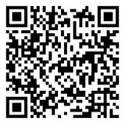
W
E
You may not know where to start
You are not alone…
A
H
N
E
T
O
L
SMHPS.Register@gmail.com
P
3 Support Dates:
1 in September
1 in October
1 in December Details to follow – just let us know if you’re interested in attending or becoming involved and we’ll be in touch

Slide 10
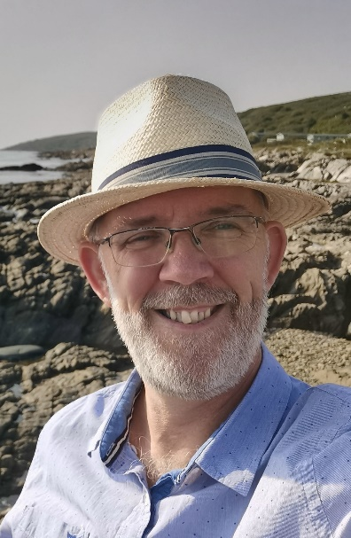
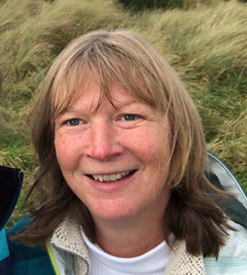
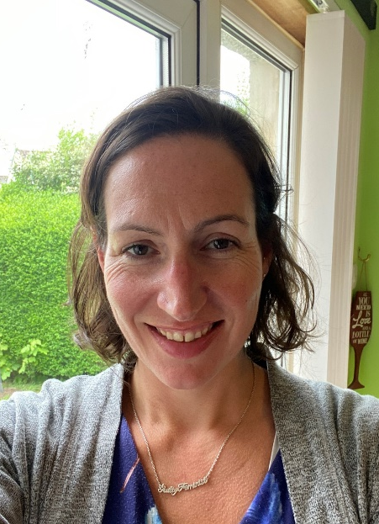
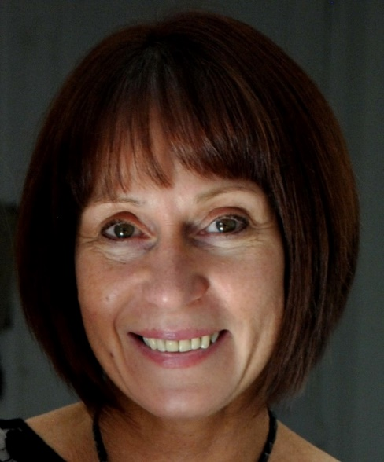
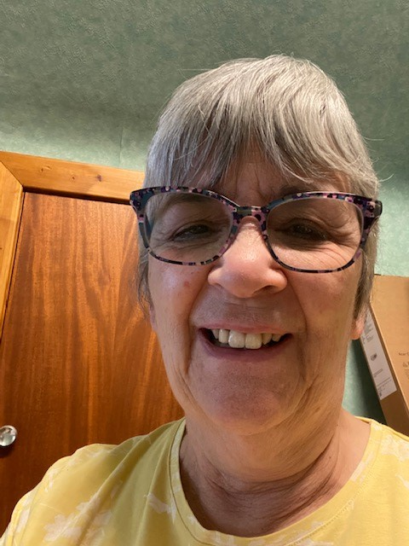
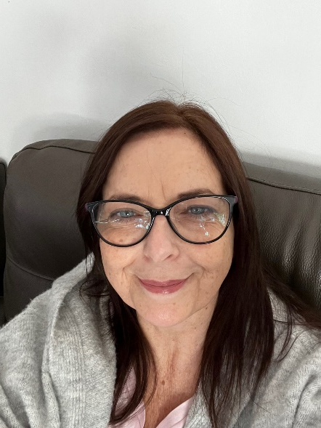
Your SMHPS Review Group
Emma Collins
M&H Lead Officer
Fife Council
Cameron Raeburn
Head of Health and Safety
NHS Forth Valley
Sarah Crawshaw
M&H Manager
NHS Highland
Sue Hain
M&H Consultant
CHAS/Enable/Hillcrest Futures
Charlotte McWhirter
L&D Advisor
Angus Council
Jacqui Treays
Senior L&D Partner
Hillcrest

Slide 11
?
Q
U
E
S
T
I
O
N
S

