Slide 1



Ergonomics/Human Factors
Colin Munro
Consultant Ergonomist
BSc(Hons) MSc MCSP
The Keil Centre
Tel: +44 (0) 131 229 6140
Email: colin@keilcentre.co.uk
www.keilcentre.co.uk
Notes:
1

Slide 2

Chartered Ergonomists
Chartered Psychologists
Applying ergonomics and psychology to promote organisational success
  Human and organisational factors in health and safety
  Management development
  Psychological health
  International client base
  High Hazard / Safety Critical Industries
  Established 1983
  Edinburgh & Australia offices
Physiotherapist & Manual Handling Advisor – NHS Lothian
MSc Ergonomics (Human Factors)
Consultant Ergonomist
  Human Error Analysis
  Safety Critical Task Analysis
  Control Room Ergonomic Analysis
  Energy Institute Briefing Notes
  W506 Ergonomics Essentials (BOHS/OHTA)
  Human Factors & Procedures
  Healthcare, oil & gas, animal & plant laboratory biohazards and transport (rail)

Slide 3
Workshop Objectives
Understand what is meant by Ergonomics / Human Factors (HF)
Recognise HF contribution to an incident through gap analysis
High level awareness of Human Error Analysis

Slide 4
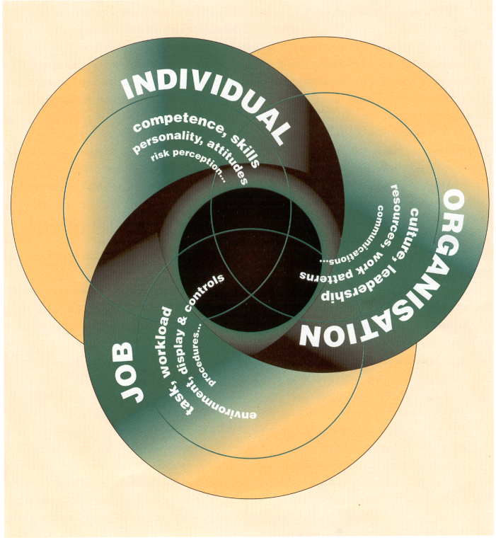
Human Factors – What is it…?
The Health and Safety Executive defines human factors as:
  “environmental, organisational and job factors, and human and individual characteristics which influence behaviour at work in a way which can affect health and safety.
Human Factors are all those things that affect performance in the workplace

Slide 5

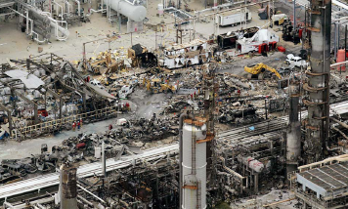
Why Apply “Human Factors”?
Regulatory - UK Health and Safety Executive
  Guidance on HF - HS(G)48
  10 key human factors topics
Major Accidents
  Many human factors causes
  “Behavioural safety” not enough to manage behavior
Occupational Health & Safety

Slide 6
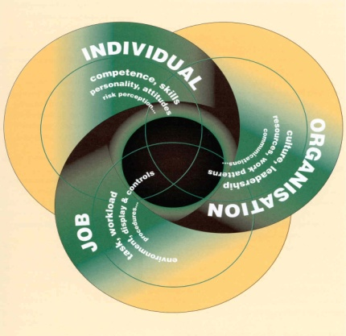
What do we mean ‘human factors’ in safety critical industries?
10 Key UK HSE human factors issues
Managing human failure
Procedures
Training and competence
Staffing
Organisational change
Safety-critical communication
Human factors in design
Fatigue & shift work
Organisational culture
Maintenance, inspection and testing
www.hse.gov.uk

Slide 7
HF Gap Analysis
7
Review of an incident from a safety critical industry
Use the gap analysis worksheet to record relevant HF issues
Feedback, discussion….and application to healthcare

Slide 8


Human Factors Roadmap
8
Major Accident Hazards
Safety Critical Tasks
Task Analysis
Human Error Analysis
Human Factors in Design
HF in safe systems (e.g. procedures, training, supervision)

Slide 9
Human Error Analysis
  Deals with the question of what can go wrong in a system from a human error perspective
  Preference for qualitative methods rather than predictive quantitative methods
  Workshop format with subjective matter experts (SMEs)

Slide 10
Human Error Analysis
  Description of a task
  Identify performance shaping factors
  Define error mode and type of error
    Action - Operation too short / long, Right operation wrong object
    Checking - Check omitted, Wrong check right object
    Information retrieval - Wrong information obtained, Incorrectly interpreted
    Communication - Information not communicated, Communication unclear
    Selection - Selection omitted, Wrong selection made
    Planning - Plan omitted, Plan incorrect
    Violation - Deliberate action
  Describe error and consequences
  Identify potential error recovery
  Identify error prevention measures
    Prevent, or improve detection / recovery
    Design
    Safe systems, e.g. procedures, training, supervision, communications …..
Performance Shaping Factors
Task | Communication
Procedures & Documentation | Training & Experience
Environment | Human Interfaces
Personal Factors | Social & Team Factors

Slide 11
Questions…..
….thank you for your time

