Slide 1
Introduction to behavioural styles and preferences. Overview of what is available to SMHF delegates from the British Healthcare Trades Association
David Beavis
Director of MediSmart Technologies, certified Everything DiSC® behavioural style trainer and section Chair and Council Member of the BHTA

Slide 2
Learning Outcomes:
To have an overview of behavioural styles, the background behind the Everything DiSC® model, and what other facilities are available for future research
To have a brief understanding of our own behavioural style and what that means
How to best interact with others with a different style

Slide 3
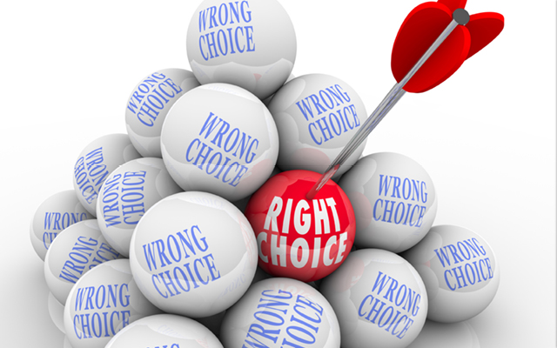

Slide 5
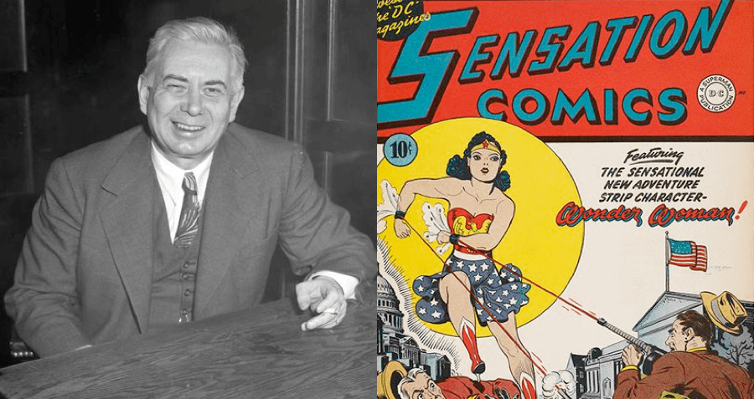

Slide 6
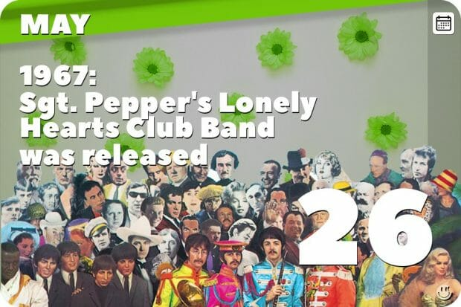

Slide 7
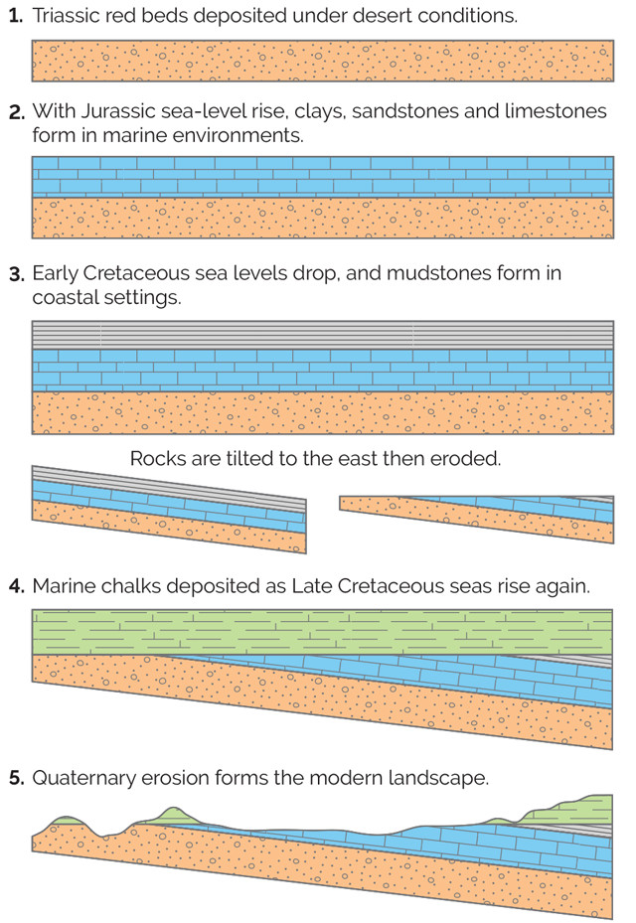
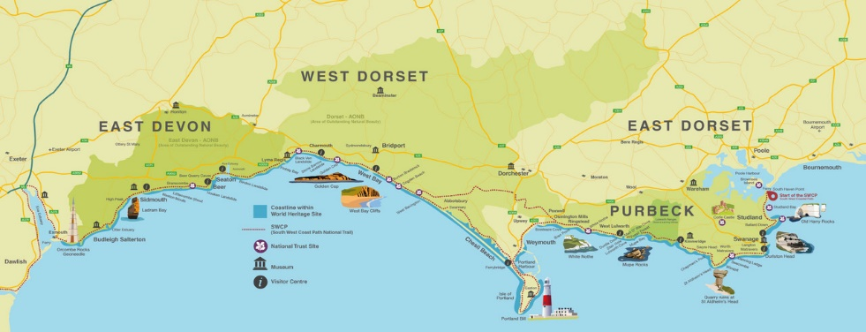

Slide 8
How You See Yourself
Fast-paced & Outspoken
Cautious & Reflective

Slide 9
How You See Yourself
Questioning &
Sceptical
Accepting &
Warm

Slide 10
How You See Yourself
Fast-paced & Outspoken
Questioning &
Sceptical
Accepting &
Warm
Cautious & Reflective

Slide 11
How You See Yourself
Fast-paced & Outspoken
Fast-paced & Outspoken
Questioning & Sceptical
Accepting & Warm
Questioning & Sceptical
Accepting & Warm
Cautious & Reflective
Cautious & Reflective

Slide 12
How You See Yourself
D
i
C
S

Slide 13
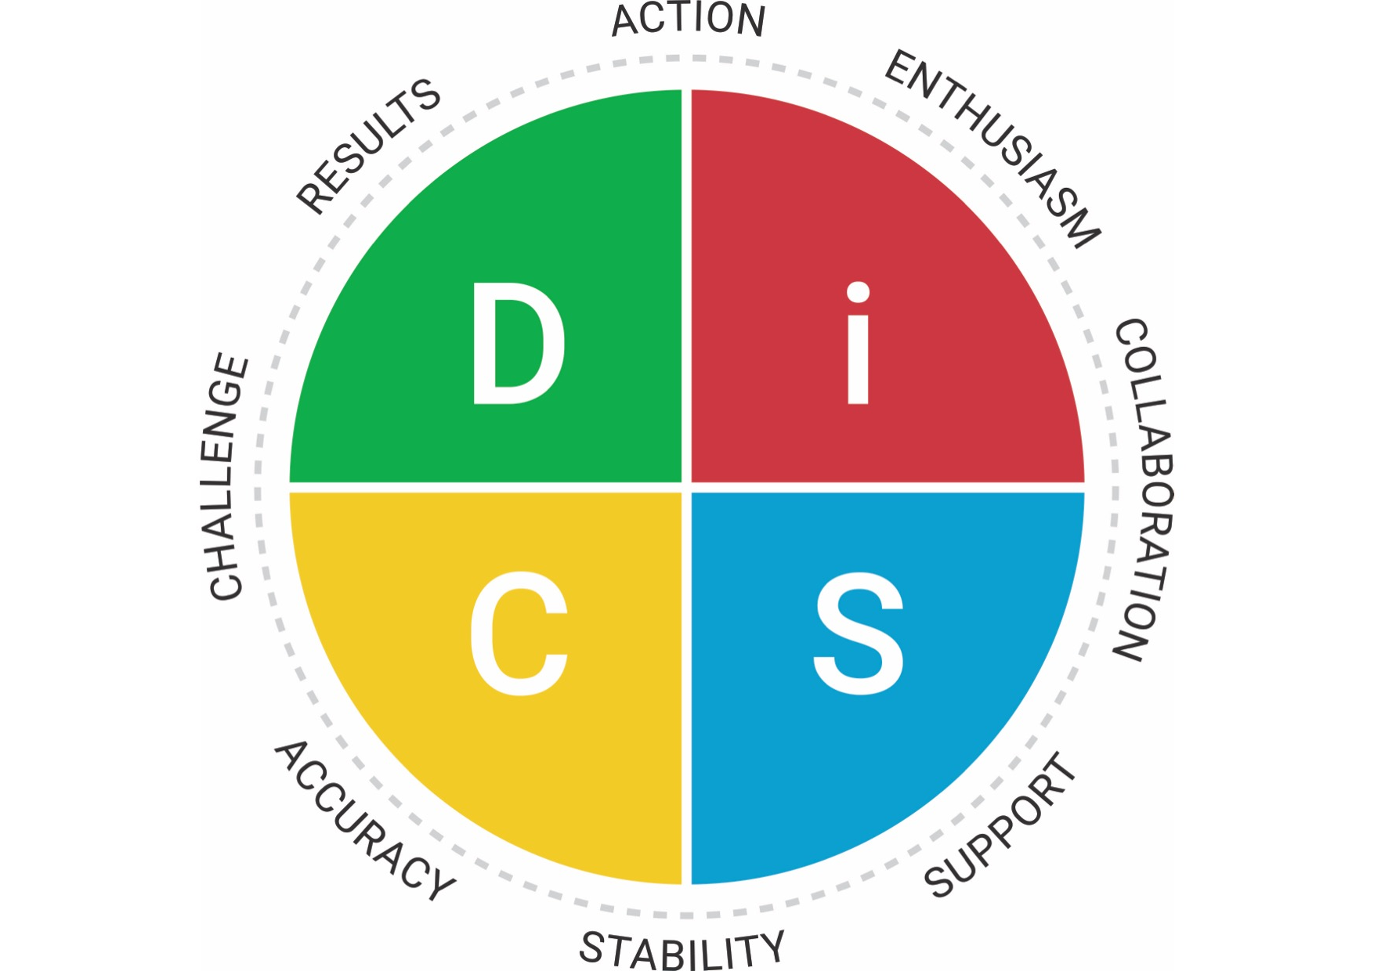
Direct
Self assured
Forceful
Adventurous
Daring
Risk taker
Decisive
Competitive
Influential
Persuasive
Confident
Trusting
Gregarious
Generous
Sociable
Enthusiastic
DOMINANCE
INFLUENCE
Fast-paced & Outspoken
Questioning &
Sceptical
Accepting &
Warm
Loyal
Sincere
Relaxed
Team-player
Amiable
Stable
Patient
Good listener
Conscientious
High Standards
Accurate
Fact-Finder
Diplomatic
Systematic
Courteous
Analytical
Cautious & Reflective
CONSCIENTIOUSNESS
STEADINESS

Slide 14
Flexing

Slide 15
What is flexing?
Your ability to adjust your style
About understanding everyone’s priorities and taking your own approach to the situation
Doing your best to understand and be understood
It isn’t about you changing your style completely to become someone you’re not

Slide 16
Address issues quickly and directly
Focus on the big picture
Get to the point quickly
Expect candour
Focus on results
Make efficient use of time
Be open to collaboration
Find ways to recognise them
Remain optimistic
Expect spontaneity
Build a relationship
Show and value enthusiasm
Use an objective, fact-based approach
Go through details
Focus on logic and facts
Expect scepticism
Emphasise high standards and show appreciation for their logic
Show warmth
Respect their cautious pace
Avoid forceful tactics
Show you care
Listen
Take an easy going approach

Slide 17
Some examples of future research opportunities:
 | Programme | What I would like to do:
1) | Adaptive Testing report | Receive an in-depth report of personal style following an on-line assessment
2) | Workplace | Develop a team and improve workplace relationships
3) | Productive conflict | Curb destructive conflict behaviours
4) | Management | Become more effective in the areas of directing and delegating
5) | Comparison report | Help two individuals to improve the way they work together by understanding their similarities and differences
6) | Team view | Obtain a snapshot of all the individual styles in a particular group

Slide 18
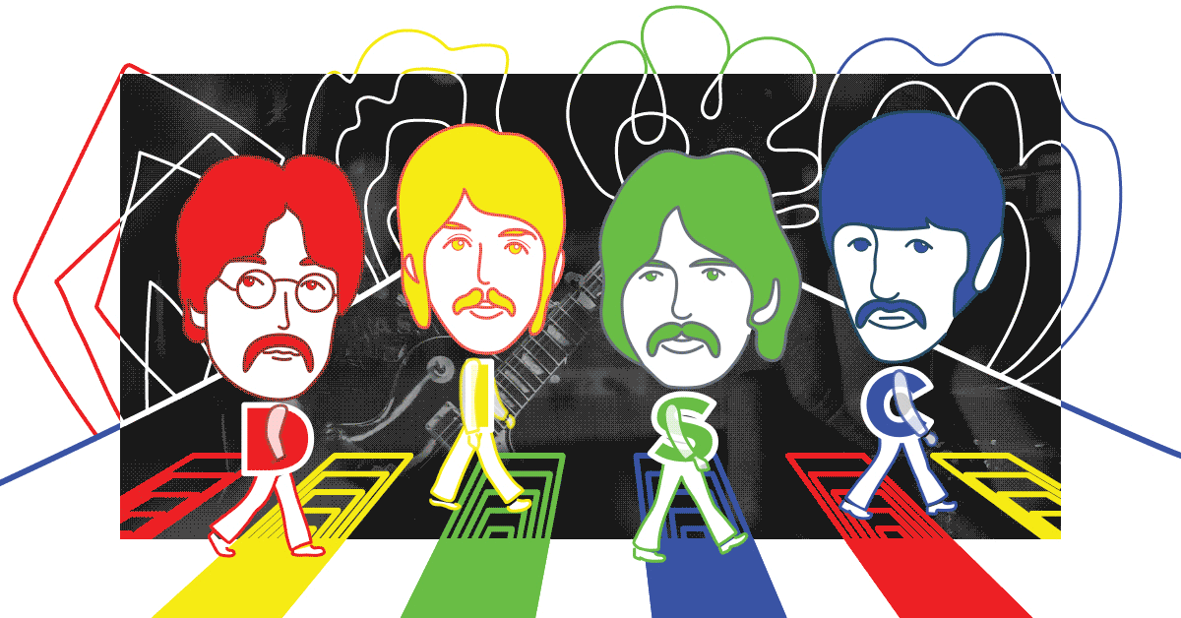
Source: TTI Success Insights

