Slide 1

Employee accident claims – how are we doing?
Norma Shippin

Slide 2
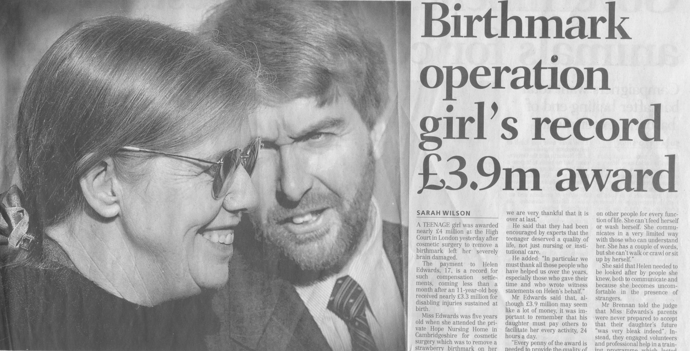

Slide 3

Clinical Negligence and Other Risks Scheme - CNORIS
The Scheme was launched on 1 April 2000
Membership - mandatory for Boards
Clinical and non-clinical claims and risks

Slide 4
CNORIS
Clinical -
Medical and Dental
Nurses
Midwives
PAMs
Ambulance and Laboratory staff

Slide 5
CNORIS
Non-clinical -
Employers’ liability
Public liability ( including directors)
Product liability
Professional indemnity
Income generation (but only in respect of NHS to NHS activity)

Slide 6
CNORIS
Exclusions -
Third party risks
Business interruption
PFI/PPP
Motor Vehicles
Engineering
Personal Accident
Property damage

Slide 7
CNORIS is not an insurance scheme

Slide 8
Payments under the scheme
CURRENT TRENDS – SCOTLAND
2010/11 £60.7m
2011/12 £27.2m
2012/13 £35.0m
2013/14 £36.7m
2014/15 £45m
2015/16 £52m
2016/17 £42m

Slide 9
Claims
Accident and Emergency
General Surgery
Obstetrics and Gynaecology

Slide 10
Prescription of claims
Normally 3 years from date of incident
Discretion of court
Position of children and incapax

Slide 11
Employee accident claims
Settled Claims | No | Award Payments | Adverse Expenses
 |  | £K | £K
2008-2009 | 234 | 1,505 | 876
2009-2010 | 205 | 1,532 | 893
2010-2011 | 190 | 1,993 | 1,015
2011-2012 | 228 | 2,176 | 1,145
2012-2013 | 207 | 2,073 | 1,035
2013-2014 | 232 | 2,134 | 1,385
2014-2015 | 231 | 2,190 | 1,607
2015-2016 | 214 | 1,694 | 1,420
2016-2017 | 235 | 2,420 | 1,195

Slide 12
Visitor accident claims
Settled Claims | No | Award Payments | Adverse Expenses
 |  | £K | £K
2008/2009 | 6 | 46 | 19
2009/2010 | 3 | 12 | 8
2010/2011 | 4 | 8 | 11
2011/2012 | 4 | 14 | 11
2012/2013 | 3 | 3 | 3
2013/2014 | 4 | 41 | 36
2014/2015 | 6 | 248 | 49
2015/2016 | 4 | 13 | 6
2016/2017 | 1 | 11 | 4

Slide 13
Outstanding “Manual Handling” claims are split between:
Injured whilst handling / lifting / carrying – other than as specified below 17
Injured whilst handling / lifting / carrying – equipment 68
Injured whilst handling / lifting / carrying – person 31

Slide 16
Most common causes of Non clinical claims
Slips, trips and falls
Needlestick injuries
Exposure to harmful substances
Violence from patient
Manual handling

Slide 17
Anatomy of a claim
Duty of care
Breach of duty of care
Breach must cause loss or damage

Slide 18
EMPLOYER LIABILITY
Provide and maintain safe plant and equipment
Have a safe system of work
Provide sufficient competent staff supervision and training
Provide a safe place of work with safe access and egress

Slide 19
THE “SIX PACK” REGULATIONS
The Management of Health and Safety at Work Regulations 1992
The Workplace (Health Safety and Welfare) Regulations 1992
The Provision and Use of Work Equipment Regulations 1992

Slide 20
THE “SIX PACK” REGULATIONS
The Personal Protective Equipment at Work Regulations 1992
The Manual Handling Operations Regulations 1992
Health & Safety (Display Screen Equipment) Regulations 1992

Slide 21
Enterprise and Regulatory Reform Act 2013
S 69 amends section 47 of Health & Safety at Work Act
Into force 1 October 2013

Slide 22
Enterprise and Regulatory Reform Act 2013
Limits right to claim for compensation to where negligence by employer can be proved
Reasonable steps relevant
Not retrospective

Slide 23
Not to be confused –
An Expert Report And A Report Of Treatment Given

Slide 24
Giving evidence
What did you do?
Can you remember?
Do your notes help?
Does your usual practice help?

Slide 25
Normal practice evidence
Did you buy your petrol on your way here today?
Where?
How much?

Slide 26
Normal practice 5 years on
Where do you usually buy petrol
Have you any paperwork about it
Are you a creature of habit or not?

Slide 27
Giving evidence
Preparations – but no coaching!
Not allowed to run away
Attending court
Oath or affirmation
Examination in chief
Cross Examination
Re-examination
Re-calling witnesses

Slide 28
Giving evidence
Do
Arrive in plenty of time and bring your citation
Practice stating your age, professional qualifications and details of your experience
Dress for the occasion

Slide 29
Giving evidence
Do
Address your remarks to the Sheriff/Judge and call him “My Lord”
When entering or leaving the court be conscious of the family and press

Slide 30

Giving evidence
Do
Be aware of the content of your report/statement
Provide only relevant information and ensure it is first hand

Slide 31
Appearing in Court
Do
Keep your answers short and to the point
Refer to the Medical records
Be able to substantiate evidence from records

Slide 32
Giving evidence
Do not
Give an opinion on a matter on which you are not qualified to give an opinion
Guess if you do not know the answer
Pretend to remember the patient if you do not

Slide 33
Appearing in Court
Do not
Consume any alcohol or fizzy drink before giving evidence
Discuss your evidence with other witnesses
Attribute fault to others unless you are an expert witness

Slide 34
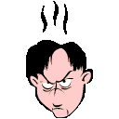
Appearing in Court
Do not
Try to be funny
Use abbreviations or slang
Lose your temper!

Slide 35
Giving evidence
Do not refer to documents which have not been officially produced and lodged in court

Slide 36
Giving evidence
Be as well prepared as possible

Slide 37
Factors giving rise to risk
Intrinsic
Intervention
Inadequate training
Inappropriate delegation
Inadequate communications/ records

Slide 38
Personal risk factors
Ignorance
Lack of insight
Inattention
Irritation
Interruption
Idleness/inertia

Slide 39
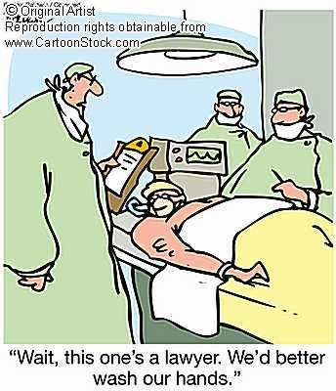

Slide 40
Questions?
Norma Shippin

