Slide 1
Competency and assessment tools in proportionate care using a single-handed care approach
A 4-year longitudinal study
Jo Webb, MSc, Dip COT ROT, PCCAP,FHEA. Senior Lecturer
University of Salford
Deborah Harrison, RGN, Dip PMH, Dip SM. PGCert VR,
Managing Director of A1 Risk Solutions
Notes:
Thank you for inviting us to speak today

Slide 2


Notes:
Introduce ourselves – professional backgrounds…met on a train!
Clarify that we DO NOT work together – That A1 Risk Solutions is NOT owned by the University – This is a piece of independent research to meet both parties individual needs:
Evaluation of the tool to improve student experience and skill level prior to placement
Providing a robust evidence base to support application of the tool and its potential impact and advantages across a range of health and social care environments.

Slide 3



Aims of this session
Explore competency evaluation versa traditional training methods
Share the results of a 4-year longitudinal study transforming the pedagogical delivery of practical safe patient handling
Explore alternative strategies to M&H training
Introduce the A1 Risk Solutions & University of Salford Competency Passport
Notes:
An introduction to the online system and how this can support a competency training approach for refresher training to minimise risk
Explore the possibilities of alternative strategies to training
Present the latest longitudinal results that give us an evidence base that is currently lacking in the field of manual handling
Discuss future opportunities for RCOTed the dissemination of this approach and best practice nationally
What is single handed care and how it was simply embedded in to the programme.

Slide 4
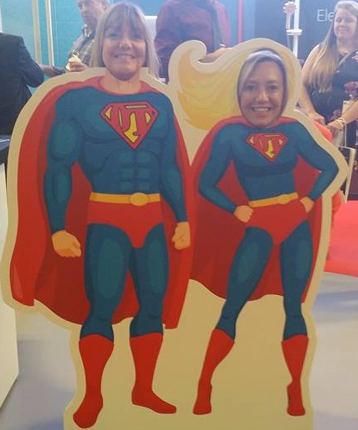
Super Visions!
Embedded safe single handed care philosophy as the norm
Standardised approach reducing risks
Improved core competencies
Improve patient safety
Reduction in errors
Less mentoring required
Notes:
National Standardised training for under graduate OT’s
Baseline core skills of moving and handling competencies
Encourage use of the online system to reduce the standard deviation across cohorts
To embed single handed care philosophy with all under graduates nationally
The outcomes are going to be widespread and positively effect
Skill level/ competency
Confidence
Reduce errors
Increase safety
Putting OT at the forefront of moving and handling assessment and facilitation of safe patient handling in a range of health social and educational setting
A yearly competition to inspire a future leaders in the field of moving and handling. First year pilot was successfully received. A vision to be extended across all Universities

Slide 5
What is Competency?
Definitions – Competence:
“The combination of training, skills, experience and knowledge that a person has and their ability to apply them to perform a task safely. Other factors, such as attitude and physical ability, can also affect someone’s competence.”
(http://www.hse.gov.uk/competence/what-is-competence.htm)

Slide 6



Where could a passport take you?
This Photo by Unknown Author is licensed under CC BY-SA
This Photo by Unknown Author is licensed under CC BY-SA
This Photo by Unknown Author is licensed under CC BY-SA
Notes:
Staff receive the training they actually need
Less release time for staff
Cost saving
Diversion of saved resources into other priorities
Carried out as part of the workplace/ classroom activity
An employer’s commitment to educate their employees to a minimum level
Demonstrates compliance with the law, reducing litigation cases & complaints.

Slide 7





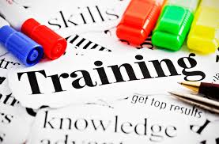
Current State of Play
National Back Exchange
Professional bodies - curriculum guidance
Practice placement hours
NHS NW Core skills
Educators feedback
Student confidence levels
Notes:
Guidance from College of Occupational Therapists outlines curriculum content essential to develop competencies but does not specify minimum teaching hours or regular updates, varies from HEI to HEI across the U.K.
WFOT states minimum practice placement hours of 1030 across undergraduate programme but again, no specifics re type of practice placement: could be physical, mental health, children, community, acute etc.
No guarantee of students gaining M + H experience on placement.
U o S has taken guidance of core skills from HENW Core Skills framework – M+H, BLS, Handwashing etc. All elements completed to BASIC standards prior to first practice placement.
However, feedback from educators on placement and student confidence levels has resulted in current undergraduate delivery of;
Theoretical session online (HENW core skills)
3 hours practical – sit to stand, slide sheets and transfer boards
3 hours practical using a hoist
Considering that once qualified, it is often the OT who is considered to be the “expert” for moving and handling / hoist assessments.
Interested to evaluate the tool from a skills and retention perspective but also from a student perspective prior to investing in the product.
Debs – Audit from NW Trusts and level of training varies enormously !!
Lack of opportunity
Lack of time to practice
Learning taking place outside of the working environment
The time before the situation arises may be months or even years
Lack of opportunity to implement learning within a short time frame after gaining the new knowledge and skills affects transfer of training (Ling et al 2011, Brown and McCraken 2009).
Lack of time to practice Clarke (2002) and the learning taking place outside of the working environment Ford et al. (1992).
The time before the situation arises may be months or even years

Slide 8
The pilot project begins - 2015
Initial experimental study in 2015 with 130 students to measure:
Level of skill
Number of errors
Levels of safety
Establish the most common manual handling errors
Notes:
Initial story of meeting Deb on a train…my role as M + H co-Ordinator for OT and what University needed vs evidence base needed to support A1 system.
The start of a positive working relationship , improving experience for students and testing out if the system did what it said on the tin!!
Reinforce original training was good – met all guidance from RCOT, HCPC and NW Core skills. We were doing it well with 6 hours practical training every year yet still getting negative feedback from placement educators saying our students were not confident or competent and students always asking for more practice and getting anxious prior to placement!

Slide 9
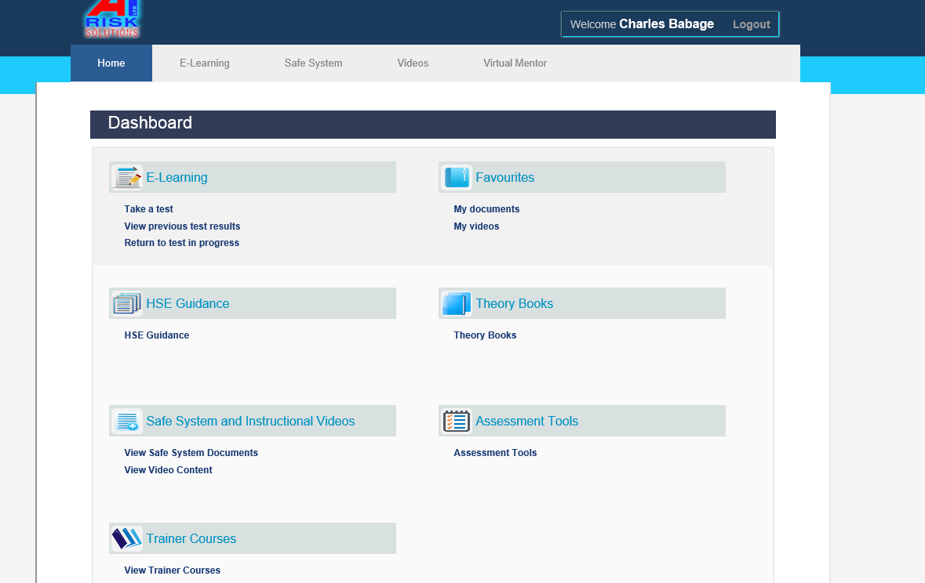
Notes:
This is a screen grab of the on training and risk management system
It is an on line resource everything to do with manual handling training

Slide 10
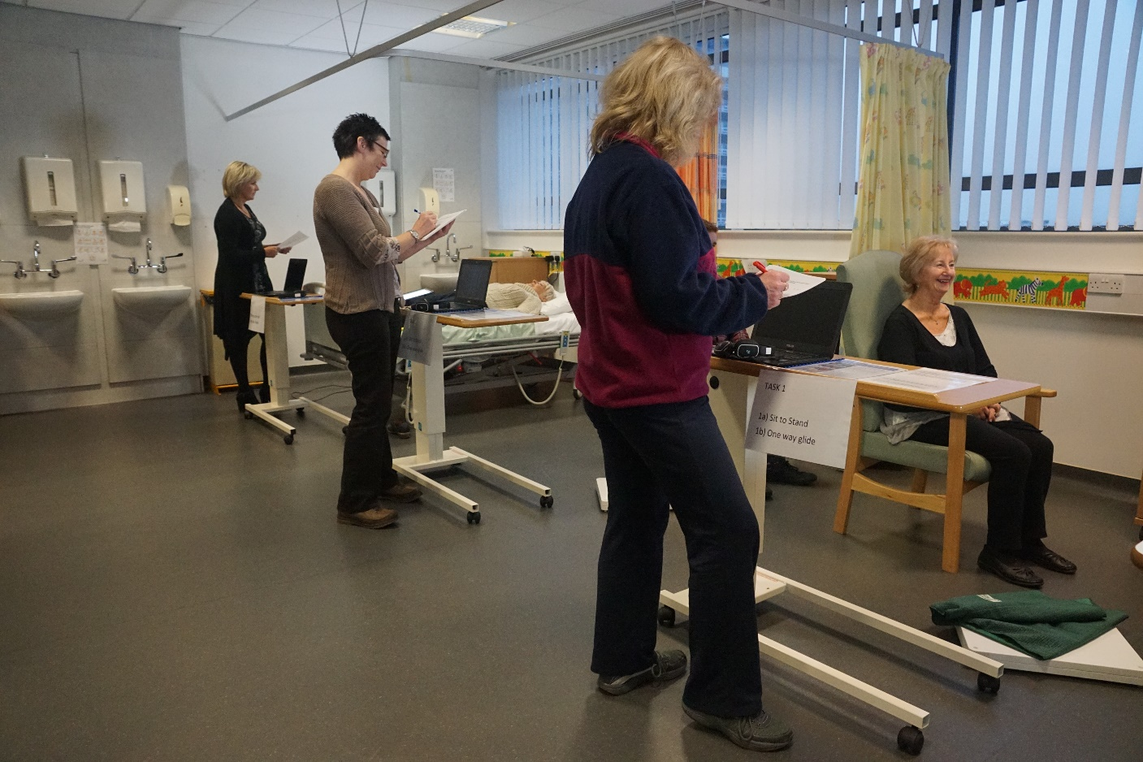
Notes:
The patients had to be trained to NOT be HELPFUL
Each patient was assigned a role to play and there was a range of 9 patients varying in ages
Task allocation to provide consistency with scoring (internal validity)
Patients briefed prior to data collection
7 women: 2 men (ages 18 – 70)
New assessors were trained in the assessment criteria and tool – assessors were taken from NBE and had to be trained NOT to slip back into trainer mode but to just assess. (Unless student deemed unsafe and then task was stopped and it became a training exercise. This was not re-assessed as this would skew the results).
The assessors and patients kept to the same tasks in the main
The set up was the same apart from the access to the video clip prompt

Slide 11
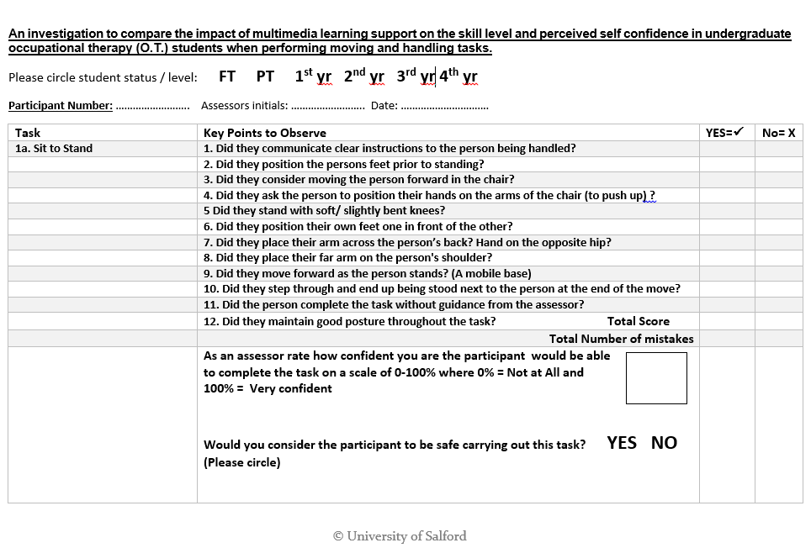
Example of score sheet
Notes:
In typical OT style, we used activity analysis to break down each task to key elements needed for the task to be completed safely.
The score sheets had been piloted with students and assessors – same activity analysis principle sued for each task score sheet
Each data sheet had points within it identifying risk of harm to
Staff
Patients
Delay in rehabilitation
Any student identified as unsafe – task stopped and then used an a training session…future learning needs identified
Explain at end of each station were had lots of numbers!! Score of what was right, how many errors and if safe….lots of data to play with!!

Slide 12
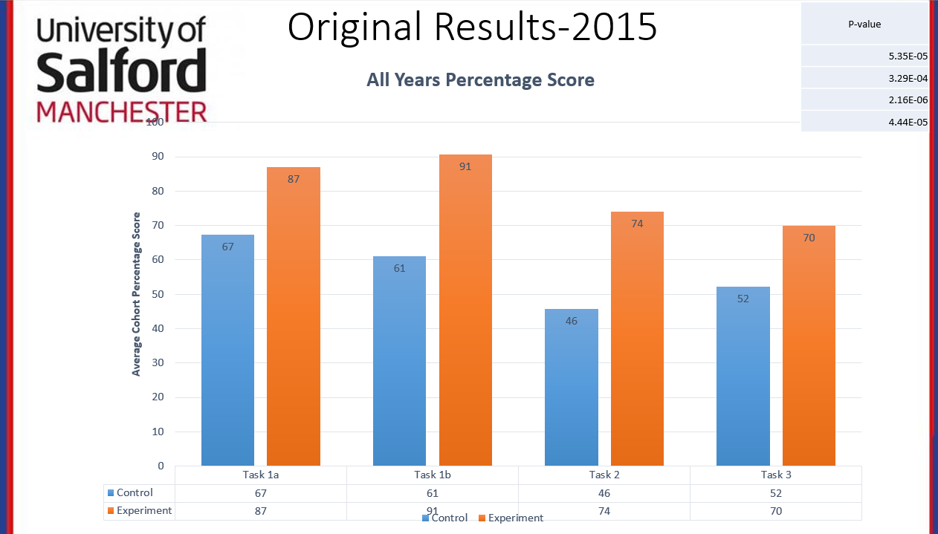
Notes:
Comparing recency in the original results

Slide 13
Original study conclusions
Results demonstrate statistically significant improvements across all tasks in all year groups, reducing the number of unsafe participants significantly.
Each error point indicates key areas for training to improve clinical skills and minimise risk – links to tissue viability, H.R / sickness absence, enablement and supervision levels
As a result of this study, The University of Salford invested in this tool for all undergraduate O.T. students a change in pedagogy.
Notes:
And so the longitudinal story begins……..
Explain access 24 hours a day following initial Practical training in Level 4 (Required by professional body and NW Core Skills Framework)

Slide 14
Research informed teaching changed pedagogy
All students given full access to A1 online moving and handling system from September 2015
Practical training in second and third year stopped
Competency based classroom evaluations annually
Longitudinal follow up of one complete co-hort of students as they progress from 1st year to graduation
Notes:
From September 2015 all students had access to the online system. This was introduced at the point of entry and reinforced within the practical moving and handling training in the first year. Students encouraged to engage by being sent emails once a semester with a problem to solve…
Linked to case studies across modules
Prior to this students had 6 hours practical “updates” every year where they attended as a group, tasks were demonstrated and they were given time to practice with each other. Despite this every year, I was often asked for additional “panic” sessions as placement drew closer!! = Additional staff time and constant catch ups to ensure all students have had some moving and handling element before they go on placement.
Problems with non-attenders, students not engaging, working as a group instead of individually, “Free loaders”.

Slide 15
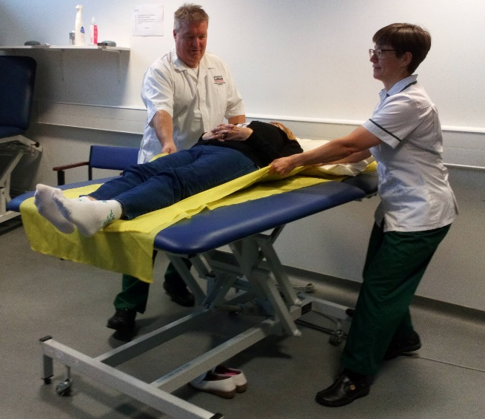
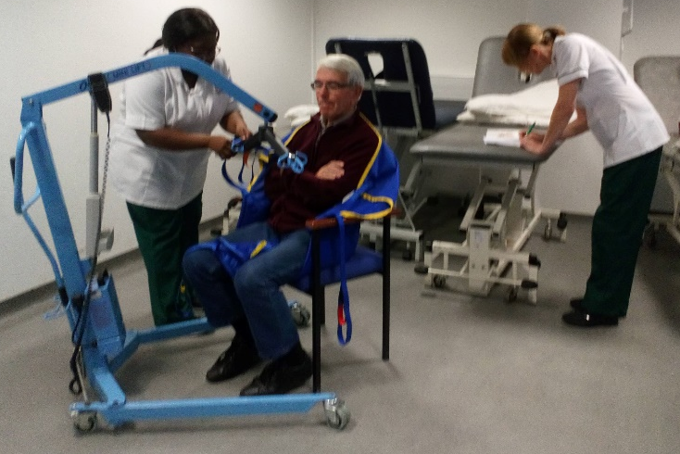
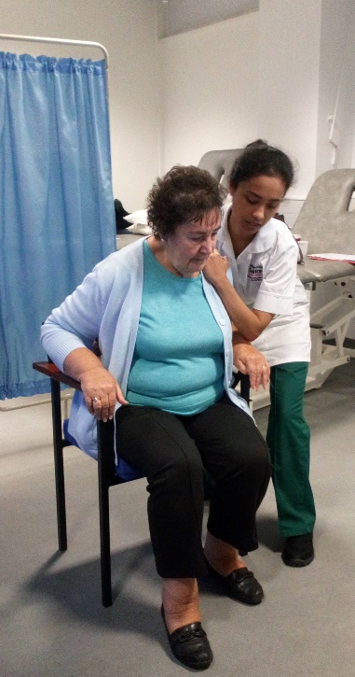
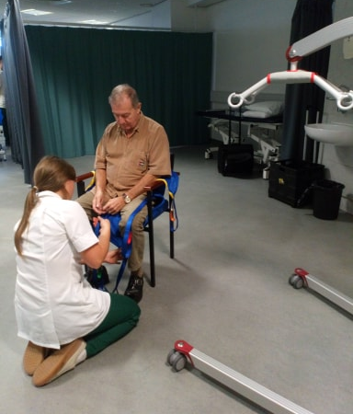
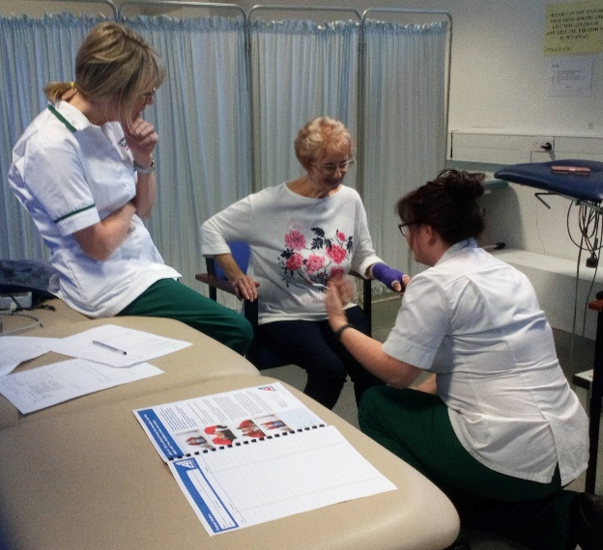
Research Methodology
Ethical approval by the University of Salford
Access to A1 online system replaced ALL refresher practical M + H training
Notes:
Research Informed Teaching – competency training model
Continuation of the study involved huge change in pedagogy of m + H training plus investment from the University to provide A1 system for all students on the programme.
This system REPLACED regular “hands on practical “ training and updates prior to placement.
Students encouraged to use the online system and assessed in 4 tasks on an individual basis. Students attend a 40 minute session each year and are assessed carrying out the above tasks. Standardised assessors used to carry out assessments and tasks carried out with “service users” and NOT on other students.
Students attend assessment in their uniform and each task is carried out in a screened area so they cannot see other students working. Following assessment, students given feedback, any unsafe students are identified for further training and students asked to complete a personal evaluation of their levels of competence for their PDP portfolio to identify future learning needs.

Slide 16
Data collection process
Year 1 – Students have practical training in M + H for 6 hours in semester 1
Year 2 – No practical training
Students assessed at start of semester individually in 4 tasks with service users – data collected
Year 3 – No practical training
Students assessed at start of semester individually in 4 tasks with service users – data collected
End of Programme (Leavers)
Students assessed at end of final semester prior to final placement individually in 4 tasks with service users – data collected
Notes:
Year One – Large groups of students – practice M + H tasks on each other in small groups following demonstration.
Staff Use scoring system with students as a learning tool to guide them through key points of each task – formative feedback to identify areas for future development in Uni or on placement.
Essentially, three data collection points:
Year 2 – induction
Year 3 – induction
Year 3 end (prior to final placement as this may bias results significantly)

Slide 17
What did we Expect?
Hypothesis :
Access to the online moving and handling system will have an impact on skill level, number of errors and safety in the four moving and handling tasks
Notes:
At this point of the study, we ere not sure what to expect…a bit scary!!
Huge change in delivery of training…what if students didn’t engage with the system? How would they respond to no practical sessions? What could this mean to patient safety? How would educators perceive the changes? Would our students fail on placement?
Nerve racking but the pilot study had indicated positive results from just a “taster” session. The University was offering thw financial support for the system and could potentially have a big impact of staff time delivering numerous practical sessions and updates prior to placement across the three year undergraduate programme.

Slide 18
Notes:
Final year students….now have end point (purple box) this is where students were just about to go on final placement and be released into the world with their green trousers!!
Highlight significant p values for task 2 + 3 and discuss progression of significance from pilot to final data set (leavers)
Also look at comparison between induction 2017 (September) to end point (June 2018)…significant improvement again (apart from Task 2)
Again spread of scores is much smaller in final data set so the system helps to “standardise” the skill set rather than having some students who do really well and others that let the side down.

Slide 19
Conclusion
Results demonstrate statistically significant improvements in skill level across all tasks, reducing the number of errors and unsafe students significantly.
Highly significant results with more complex tasks 2 + 3
Students are better equipped and more confident in their moving and handling skills despite LESS actual “hands on” practical teaching of these skills
Active engagement with the online system and learning tools within it combined with regular “competency assessment” encourages a student centred, problem solving and reflective approach to practical skill development
Notes:
Students take more responsibility for their own learning and professional development rather than a “tick box” approach of attending an update, signing the register and being deemed “competent” to practice for another year.
Reduction in group practical teaching is supported by a range of literature stating that practical annual “refresher training” (often delivered by many Trusts and LA’s is ineffective when practical skills demonstrated or practiced are not applied regularly….we forget!

Slide 20
Moving and Handling
University passport
The passport is used to reinforce the competency framework approach
The online system supports the students throughout their undergraduate journey
Encourages reflection and development of action plan for life-long learning
Single Handed is embedded within the moving handling programme since September 2015
Notes:
Competency model – as mirrored by Scottish Manual handling Passport
This academic year, competency training model continues but students receive their scores and feedback as part of their “Core Skills” and Manual handling Passport.
Areas for development are identified and they must record within their action plan how they aim to achieve these goals.
Effective method of reflection and LLL as directed by HCPC, RCOT.
This is where I showed them the tool so far and just flicked through the different tasks developed so far but discussed the potential for a booklet to accompany the system for future training so maybe a full range of task could be chosen at random for competency updates within a care home or Trust setting.

Slide 21
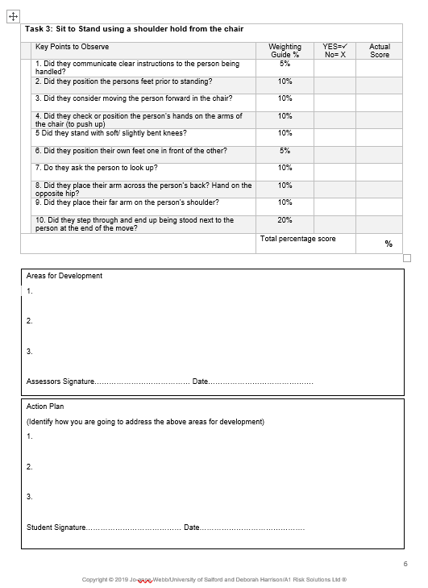
Are you competent?
Notes:
Feedback t

Slide 22
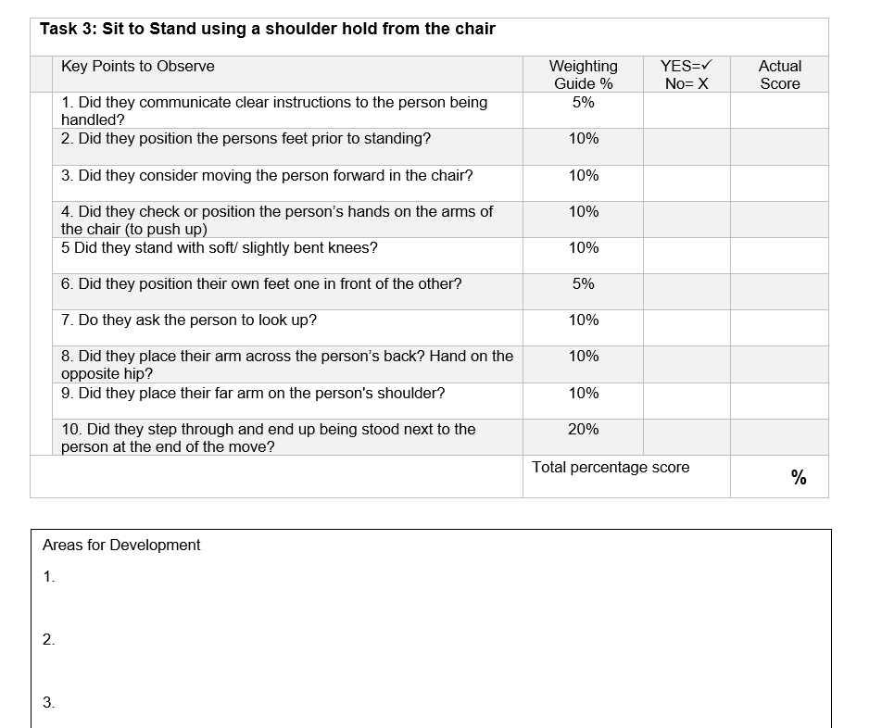
Notes:
Talk about how they use the tool.

Slide 23
The Journey so Far
Created 355 competency assessment tools
Weighted according to common risks associated with each individual task
Key points were created linking risk factors that would impact on the safety of the staff, patient as well as linking into common themes such as:
Falls
Tissue viability
Posture
Reablement

Slide 24
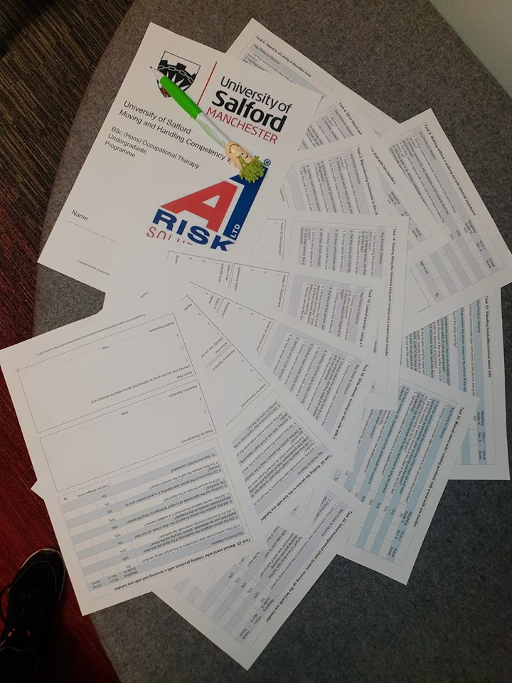

Slide 25
Moving and Handling
University passport
The passport is used to reinforce the competency framework approach
The online system supports the students throughout their undergraduate journey
Encourages reflection and development of action plan for life-long learning
Single Handed is embedded within the moving handling programme since September 2015
Notes:
Competency model – as by Scottish and all wales Manual handling Passport
This academic year, competency training model continues but students receive their scores and feedback as part of their “Core Skills” and Manual handling Passport.
Areas for development are identified and they must record within their action plan how they aim to achieve these goals.
Effective method of reflection and LLL as directed by HCPC, RCOT.
This is where I showed them the tool so far and just flicked through the different tasks developed so far but discussed the potential for a booklet to accompany the system for future training so maybe a full range of task could be chosen at random for competency updates within a care home or Trust setting.

Slide 26
Notes:
Talk about how they use the tool.

Slide 27
Notes:
Journey so far
Created one passport tool containing 90 individual competency assessment tools- still more to be developed
Weighted according to common error points and risks associated within each individual task
Key points were created linking risk factors that would impact on the safety of the staff, patient as well as linking into common themes such as:
Falls
Tissue viability
Posture
Re-ablement

Slide 28
Future Plans
Are we being over ambitious?
A passport to compliment the A1 system
completely
Customised
Individualised
Standardised “pick and mix”
To meet the needs of any service

Slide 29
References and Further Reading
Ang, L., Ooi ,Hui, W., Phuah, Huei, V.K. (2011). The relationship between work environment factors and transfer of training among plantation workers. Jurnal Kemanusiaan, (18), pp. 94-104. ISSN 1675-1930
Clarke, N. (2002). Job/Work Environment Factors Influencing Training Transfer within a Human Service Agency: Some Indicative Support for Baldwin and Ford’s Transfer Climate Construct. International Journal of Training and Development, 6(3), 146-215.
Brown, T. C., McCracken, M. (2009). Building a bridge of understanding: How barriers to training participation become barriers to training transfer. Journal of European Industrial Training 33(6), 492-512.
Ford, J.K., Quinones, M.A., Sego, D.J., Sorra, J.S. (1992). Factors Affecting The Opportunity to Perform Trained Tasks on The Job. Personnel Psychology, 45(3), 511-527.
Elangovan, A.R., Karakowsky, L. (1999). The Role of Trainee and Environmental Factors in Transfer of Training: An Exploratory Framework. Leadership & Organization Development Journal. 20(5), 268-275.
Baldwin, T.T., Ford, J.K. (1988). Transfer of Training: A Review and Directions for Future Research. Personal Psychology, 41(1), 63-105.
Haslam, C., Clemes, S. A., McDermott, H., Williams, C., Shaw, K., Haslam, R. (2007). Manual handling training: investigation of current practices and development of guidelines. Research Report RR583. Norwich: HMSO
Swain, J., Pufahl, E., Williamson, G.E. (2003). Do they practise what we teach? A survey of manual handling practice amongst student nurses. Journal of Clinical Nursing 12.2: 297-306.

Slide 30
References and Further Reading
H.S.E. (2013), Health and Safety Executive, Musculoskeletal Disorders in Great Britain [Online], Health and Safety Executive. Available: http://www.hse.gov.uk/statistics/causdis/musculoskeletal/msd.pdf [Accessed 23 September 2014]
Anderson, M.P., Carlise, S., Thomson, C., Ross, C., Reid, H.J., Hart, N.D., Clarke, A. (2014 ). Safe moving and handling of patients: an interprofessional approach. Nursing Standard, 28 (46): 37-41.
Personal interview by phone Structure: Harrison, D. (2014, February 11). Telephone interview
Miller, B.M., Moore, D.E., Stead, W. W., Balser, J. R. (2010). Beyond Flexner: a new model for continuous learning in the health professions. Academic Medicine, 85 (2) : 266-272.
Ellaway, R., and Masters, K. (2008). "AMEE Guide 32: e-Learning in medical education Part 1: Learning, teaching and assessment." Medical teacher 30 (5): 455-473.
Masters, K., and Ellaway, R. (2008). "e-Learning in medical education Guide 32 Part 2: Technology, management and design." Medical teacher 30 (5) (2008): 474-489.
Biggs, J., and Tang, C. (2011). Teaching for quality learning at university. McGraw-Hill International.
Blomberg, G., Sherin, S., Renkl, A., Glogger, I., Seidel, T. (2014). Understanding video as a tool for teacher education: investigating instructional strategies to promote reflection. Instructional Science 42 (3): 443-463.
Clemes, S. A., Haslam, C., and Haslam, R.A. (2010). What constitutes effective manual handling training? A systematic review. Occupational medicine 60 (2) : 101-107.
Hignett, S., and Crumpton, E. (2007). Competency-based training for patient handling. Applied ergonomics 38 (1) : 7-17.

Slide 31
References and Further Reading
YUSMINAR, Y, and SALIM, J. (2013). E-LEARNING EVALUATION IN MALAYSIAN PUBLIC SECTOR FROM THE PEDAGOGICAL PERSPECTIVE: TOWARDS E-LEARNING EFFECTIVENESS. Journal of Theoretical & Applied Information Technology 51 (2).
Clark, Ruth C., and Richard E. Mayer. (2011). E-learning and the science of instruction: Proven guidelines for consumers and designers of multimedia learning. John Wiley & Sons.
Sun, P-C., Tsali, R.J., Finger, G., Chen, Y.Y., and Yen, D. (2008). What drives a successful e-Learning? An empirical investigation of the critical factors influencing learner satisfaction. Computers & Education 50 (4) : 1183-1202.
Cornish, J., and Jones, A. (2010). Factors affecting compliance with moving and handling policy: Student nurses’ views and experiences. Nurse education in practice 10 (2) : 96-100.
Zhang, D., Zhou, L. Briggs, R.O. and Nuamaker, J.F. (2006). Instructional video in e-learning: Assessing the impact of interactive video on learning effectiveness. Information & Management 43 (1) : 15-27.
Wieling, M. B., and Hofman, W. H. A. (2010). The impact of online video lecture recordings and automated feedback on student performance. Computers & Education 54 (4) : 992-998.

Slide 32
Referencing and Further Reading
Seidel, T., Blomberg, G., and Renkl, A. (2013) Instructional strategies for using video in teacher education. Teaching and Teacher Education 34 (2013): 56-65.
Hignett, S. (2003). Intervention strategies to reduce musculoskeletal injuries associated with handling patients: a systematic review. Occupational and Environmental Medicine 60 (9): e6-e6.
Biggs, J.B. (2003). Teaching for quality learning at university. Buckingham: Open University Press/Society for Research into Higher Education. (Second edition)
Collins, J. A., Greer, J. E., Kumar, V. S., McCalla, G. I., Meagher, P., & Tkatch, R. (1997). Inspectable user models for just-in-time workplace training. User Modeling (pp. 327-337). Springer Vienna.

Slide 33
Questions
deborah@a1risksolutions.co.uk

